Slide 1
https://www.sacurriculum.sa.edu.au/learning-design

Slide 2
Acknowledgement of Country
We acknowledge that the work undertaken to develop this leaders’ guide took place on the traditional lands of South Australia’s First Peoples and we respect their spiritual relationship with their country.
In delivering public education in South Australia, we acknowledge the importance of understanding Aboriginal knowledge, languages, cultures and voices which provide critical contributions and value across our workplaces, classrooms, partnerships and communities.
Note: The Department for Education uses the term ‘Aboriginal’ to refer to people who identify as Aboriginal, Torres Strait Islander, or both Aboriginal and Torres Strait Islander. This term is preferred by Aboriginal South Australians and the department.

Slide 3


Content overview

Slide 4
Contents
SECTION 1 | Weekly pedagogic prompts
SECTION 2 | Our learners
2.1 The voices of our SA learners
2.2 The aspirations of my learners
2.3 The choices we have made as a system
SECTION 3 | Unpacking our strategy for public education
3.1 Deepening our understanding of the areas of impact
3.2 Areas of impact – our school’s choices
3.3 Identifying actions to activate the areas of impact
3.4 Our ways of working
3.5 Building coherence for our learners
SECTION 4 | Culture of collaboration
4.1 Collaboration with colleagues
SECTION 5 | Collaboration across levels of schooling
5.1 Lenses for dialogue
5.2 Generate-sort-connect-elaborate
5.3 Microlabs
5.4 Same but different
SECTION 6 | Building a strong learning culture
6.1 Strong learning cultures in action
6.2 The Learning Pit
6.3 Creating safety for challenge
SECTION 7 | Metacognition and self-regulated learning
7.1 Productive struggle
7.2 EEF Metacognition and self-regulated learning
7.3 Creating think alouds
7.4 Scaffolding for planning, monitoring and evaluating
7.5 Check-in and act: Learning logs
SECTION 8 | Success criteria
8.1 Planning for students to understand what success looks like
SECTION 9 | Feedback for learning
9.1 Austin’s butterfly: Peer critique
9.2 The many connections to feedback
9.3 EEF Teacher feedback to improve student learning
9.4 Student to teacher feedback
SECTION 10 | Checking for understanding
10.1 Introducing all student response systems
10.2 Check-in and act: Mini whiteboards
10.3 Check-in and act: Question shells
10.4 Engineering effective discussions to elicit evidence of learning
10.5 What have we learned?
SECTION 11 | Hooking students into the learning
11.1 Designing for engagement in challenging learning
SECTION 12 | Teachers as learners
12.1 Reflecting on our practice

Slide 5
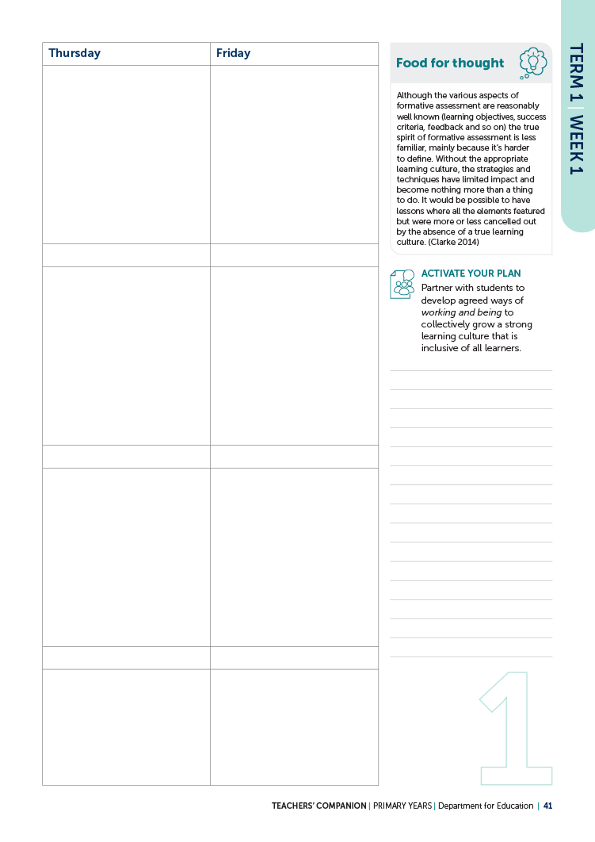

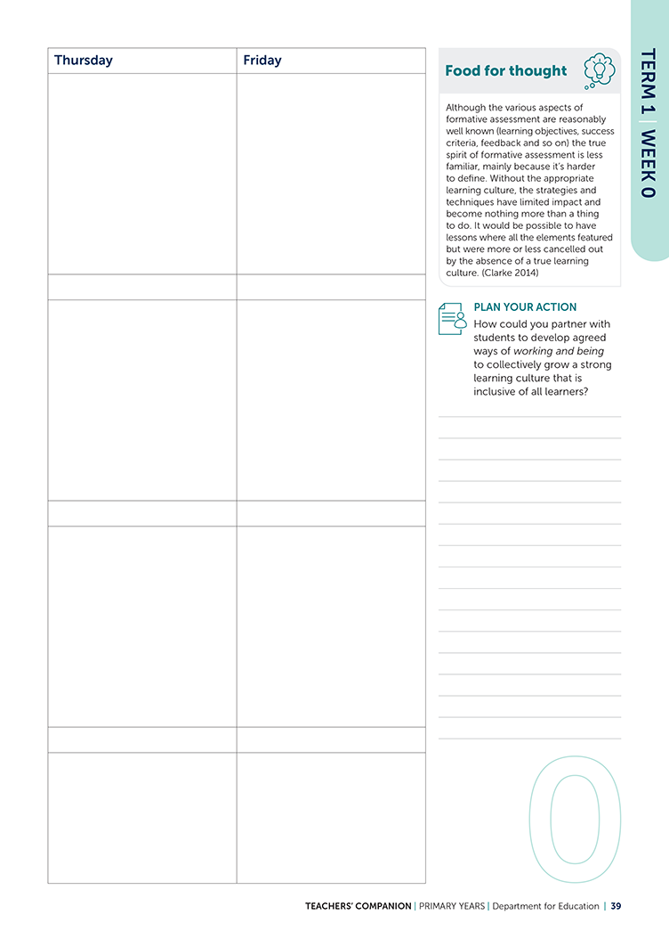
SECTION 1 | Weekly pedagogic prompts
REFER TO PY COMPANION PAGES 39 to 133

Slide 6

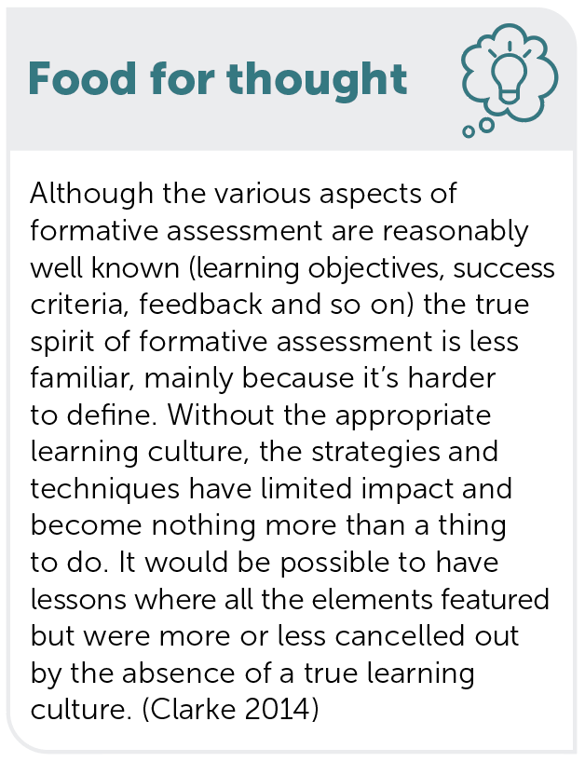
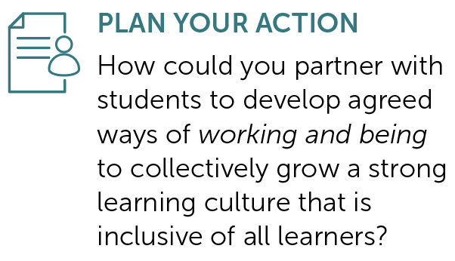
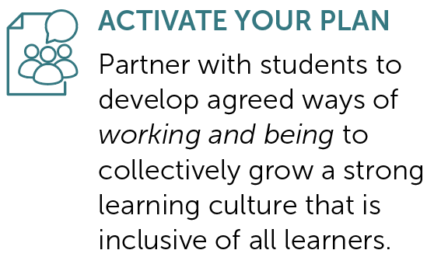
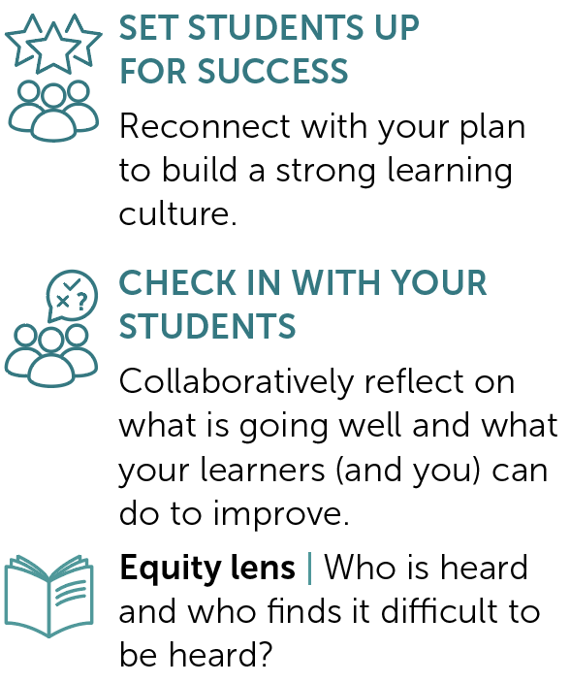
TERM 1 | Weeks 0 to 2
PY
PAGES
39 to
43
Building a strong learning culture
Provocation Week 0 Week 1 Week 2

Slide 7
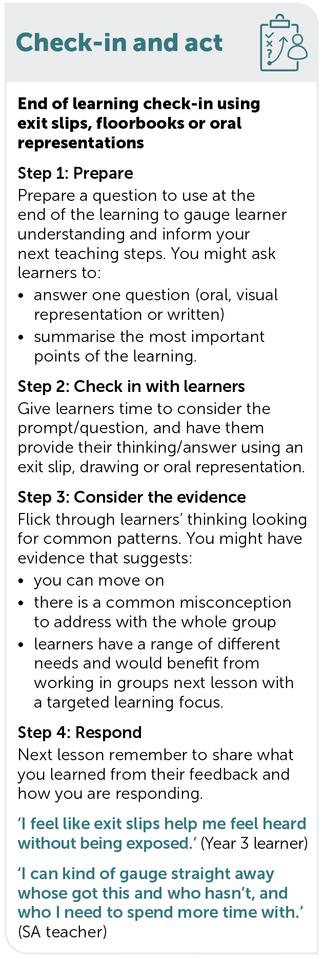
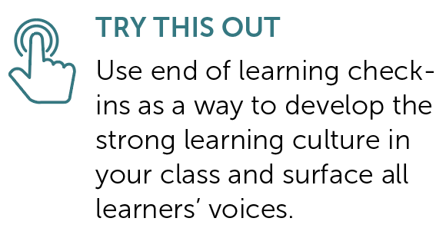
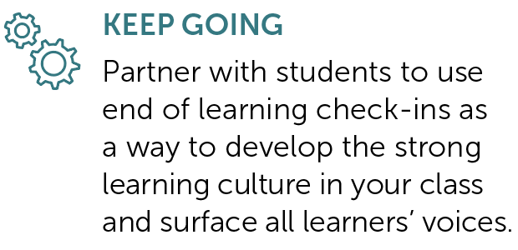
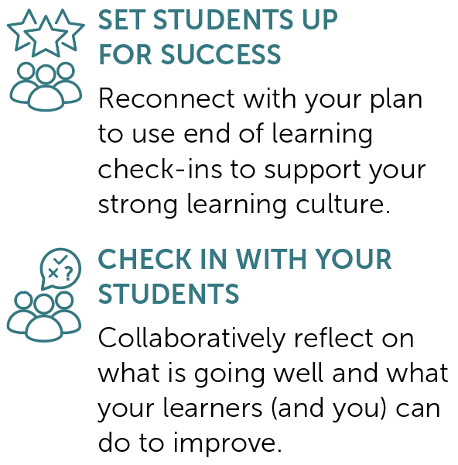
TERM 1 | Weeks 3 to 5
PY
PAGES
45 to
49
Check-in and act: Exit slips, floorbooks or oral presentations
Provocation Week 3 Week 4 Week 5

Slide 8
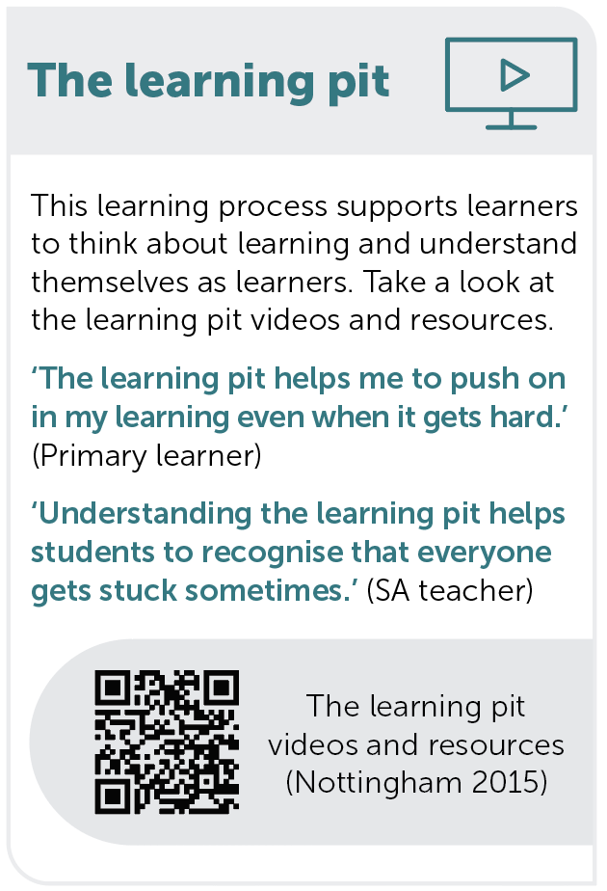
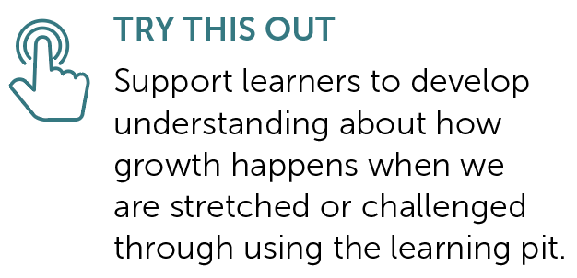
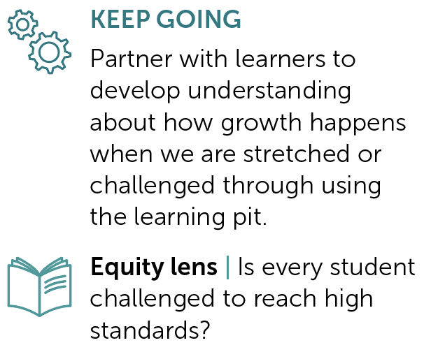
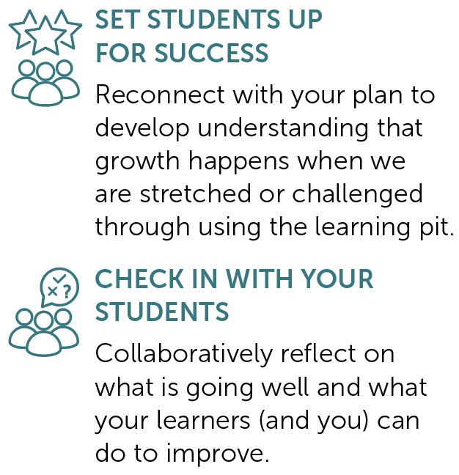
TERM 1 | Weeks 6 to 8
PAGES
51 to 55
The Learning Pit
Provocation Week 6 Week 7 Week 8

Slide 9
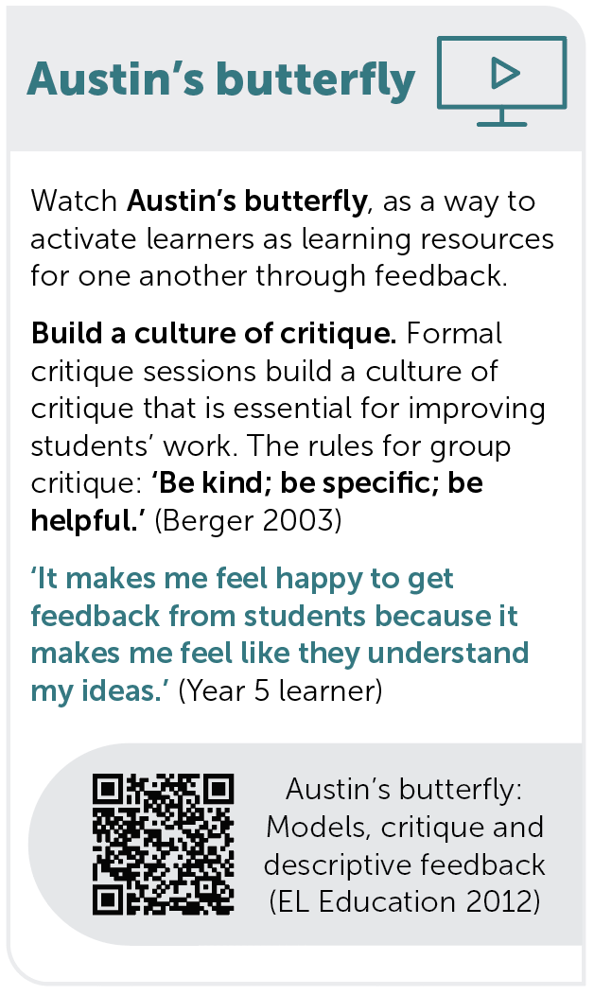
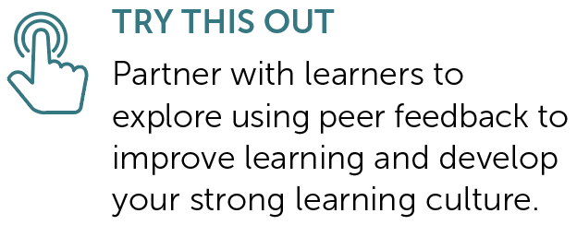
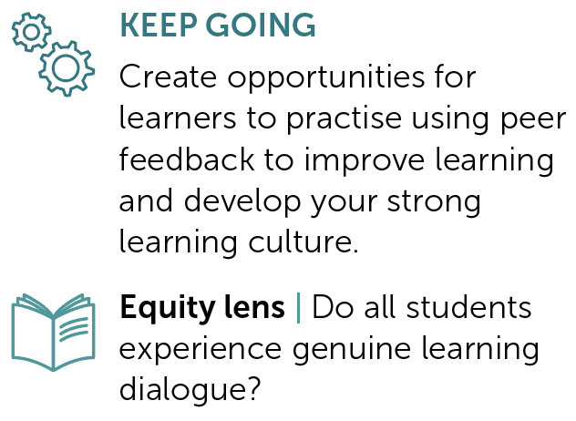
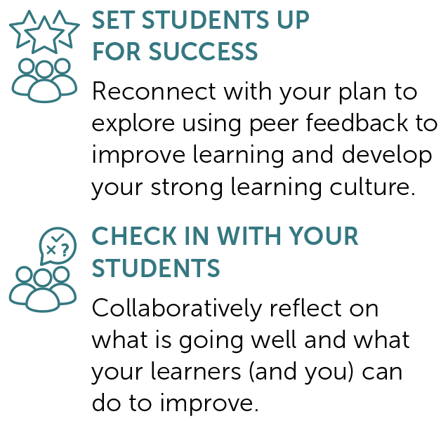
TERM 1 | Weeks 9 to 11
PY
PAGES
57 to
61
Austin’s butterfly
Provocation Week 9 Week 10 Week 11

Slide 10
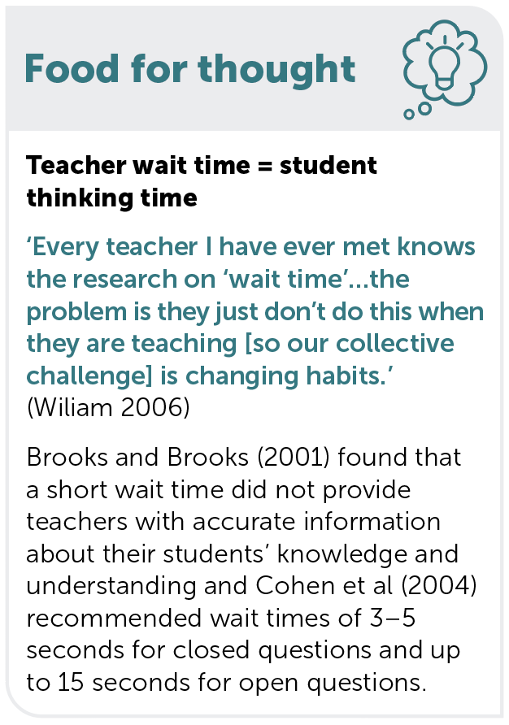
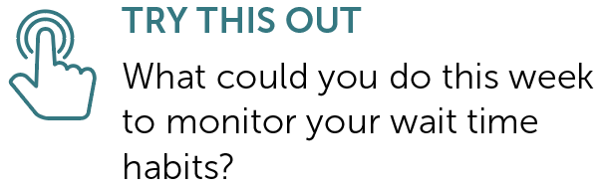
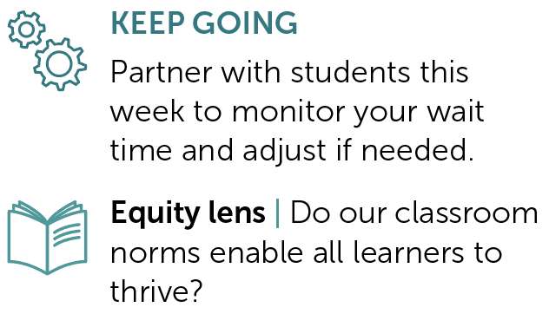
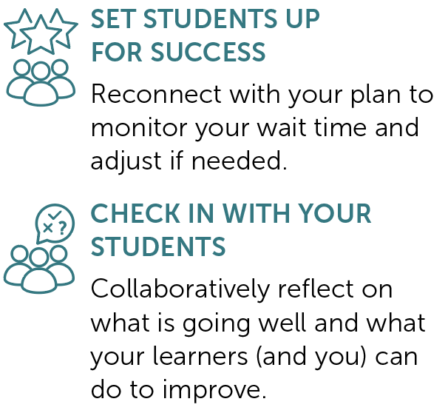
TERM 2 | Weeks 1 to 3
PY
PAGES
67 to
71
Wait time
Provocation Week 1 Week 2 Week 3

Slide 11
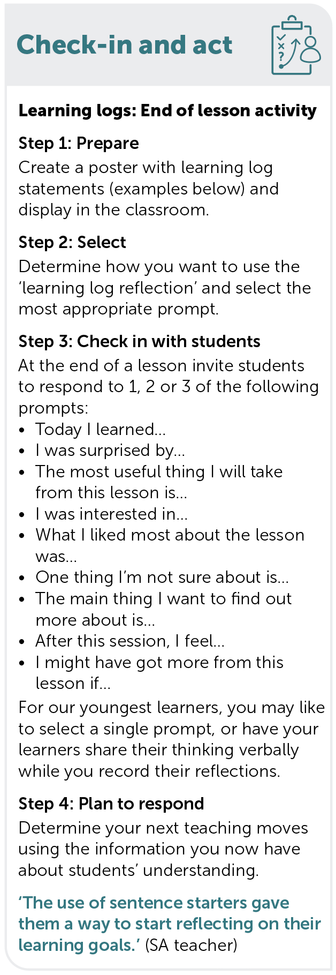
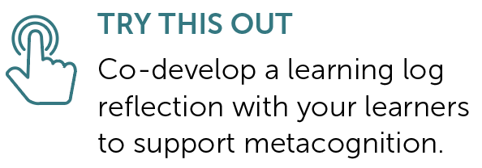
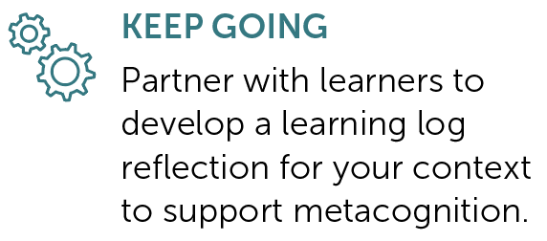
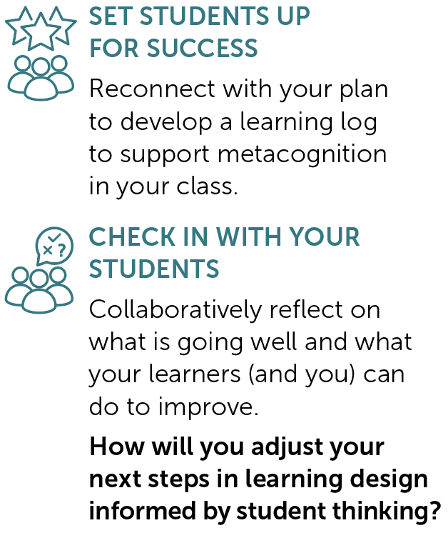
TERM 2 | Weeks 4 to 6
PY
PAGES
73 to
77
Check-in and act: Learning logs
Provocation Week 4 Week 5 Week 6

Slide 12
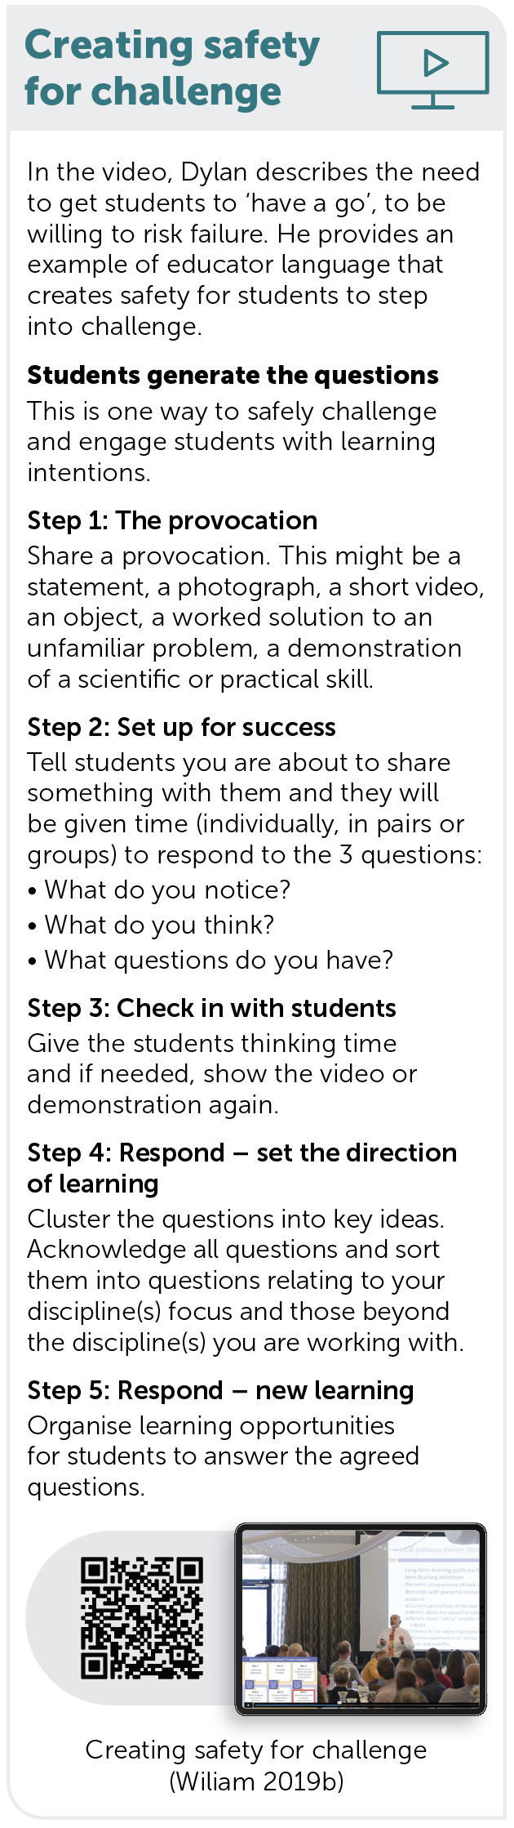
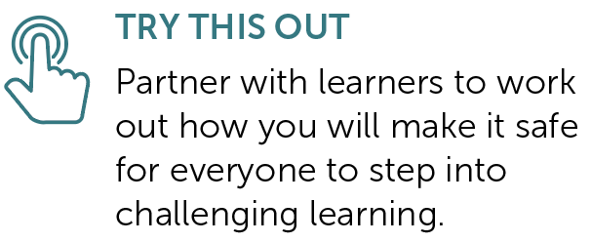
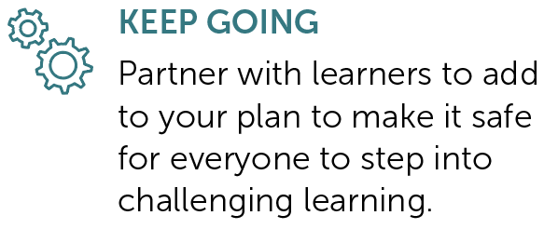
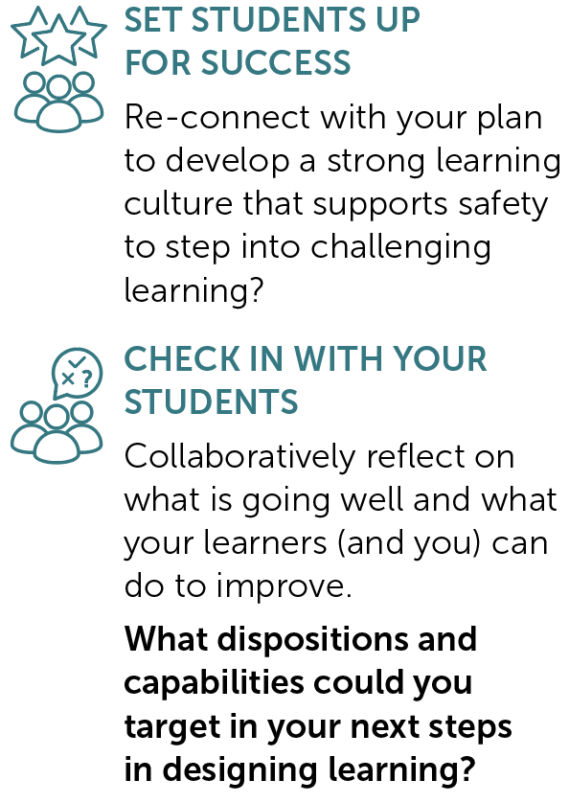
TERM 2 | Weeks 7 to 9
PY
PAGES
79 to
83
Creating safety for challenge
Provocation Week 7 Week 8 Week 9

Slide 13

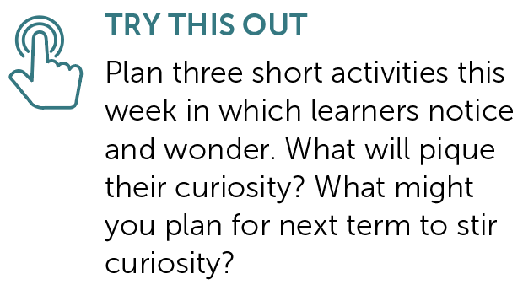
TERM 2 | Week 10
PY
PAGE 85
Curiosity: Notice and wonder
Provocation Week 10

Slide 14

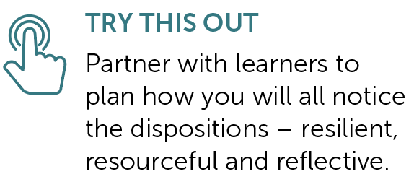
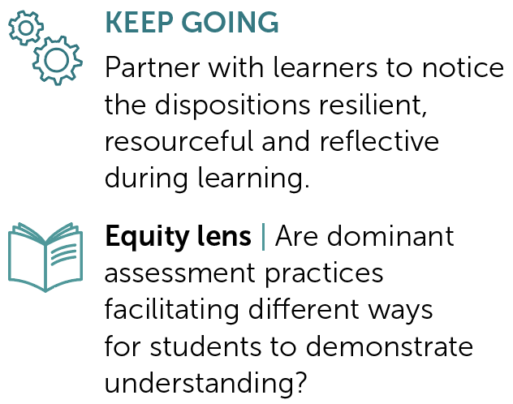
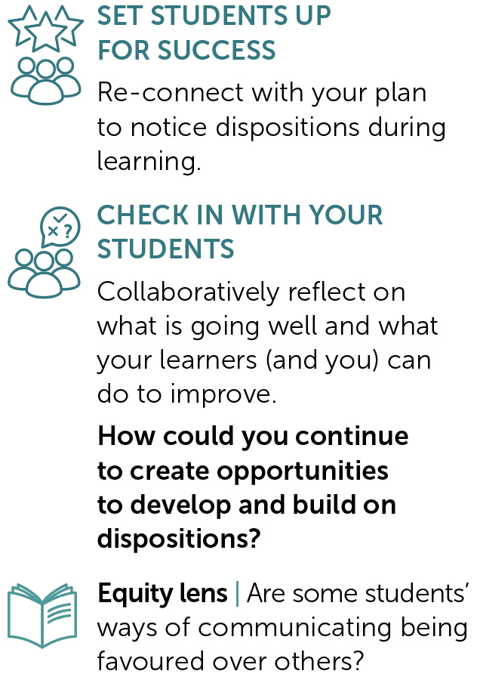
TERM 3 | Weeks 1 to 3
PY
PAGES
93 to
97
Noticing dispositions
Provocation Week 1 Week 2 Week 3

Slide 15
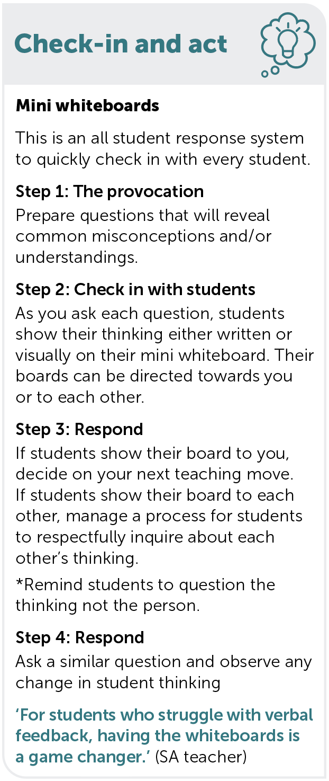
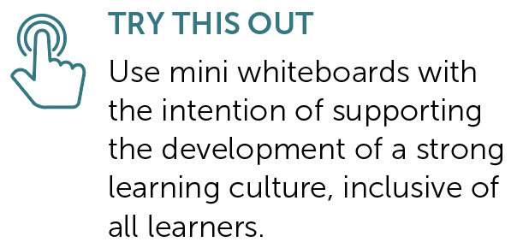
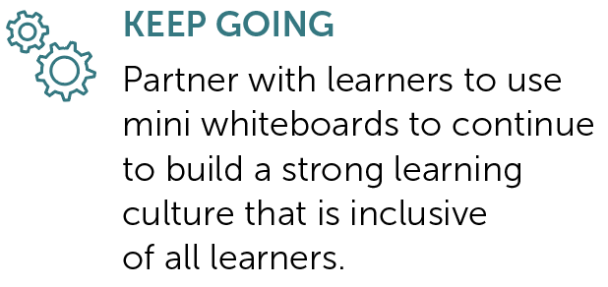
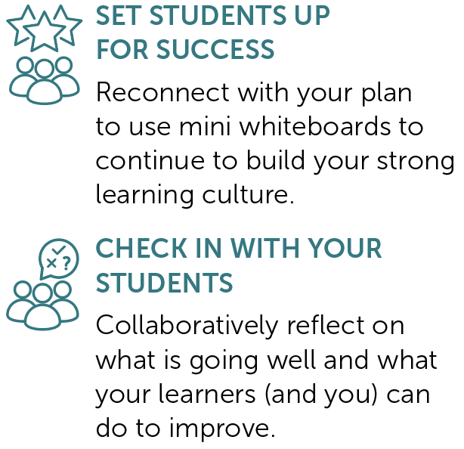
TERM 3 | Weeks 4 to 6
PY
PAGES
99 to
103
Check-in and act: Mini whiteboards
Provocation Week 4 Week 5 Week 6

Slide 16
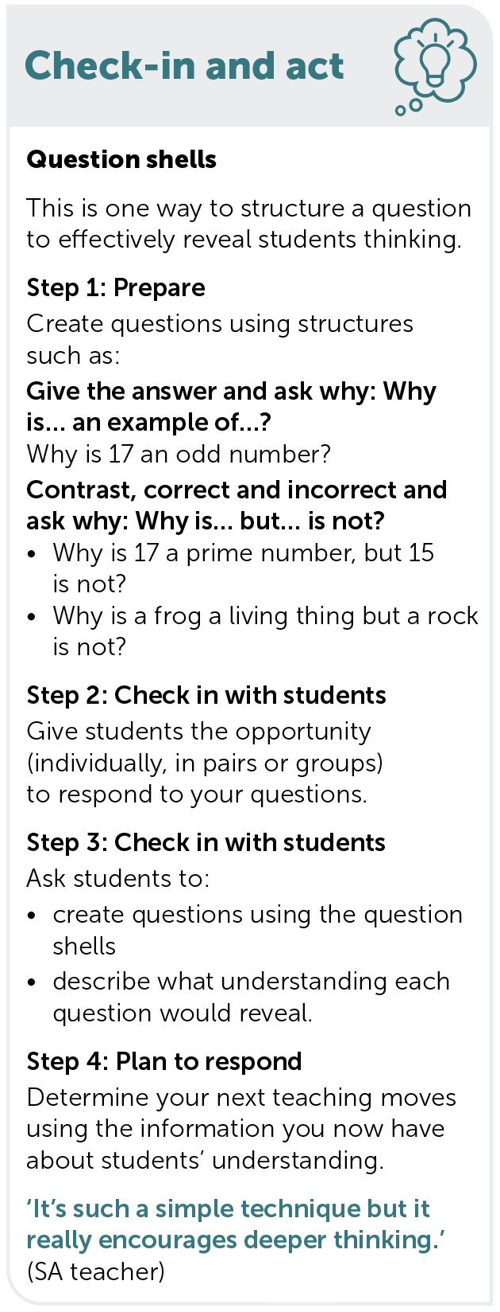
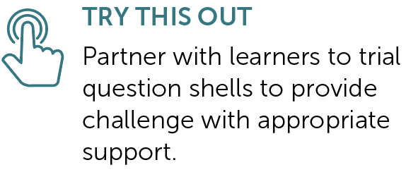
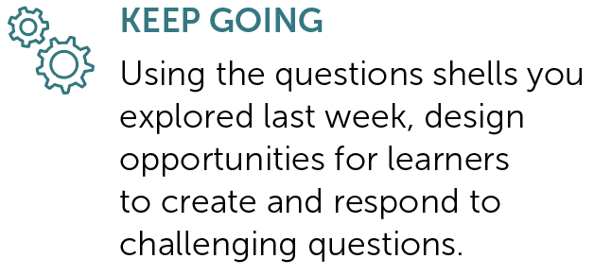
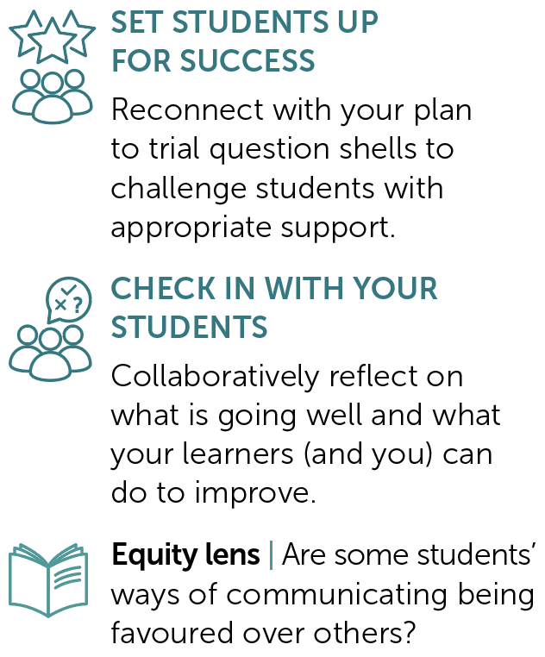
TERM 3 | Weeks 7 to 9
PY
PAGES
105 to
109
Check-in and act: Question shells
Provocation Week 7 Week 8 Week 9

Slide 17
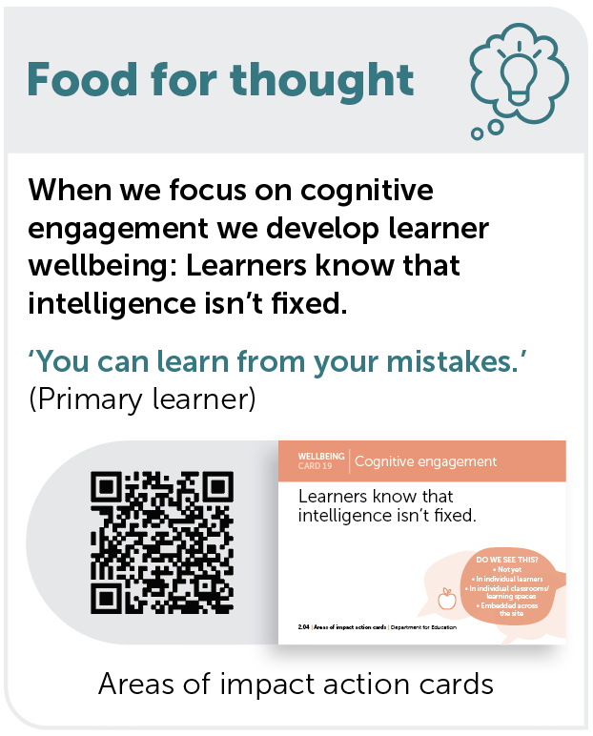
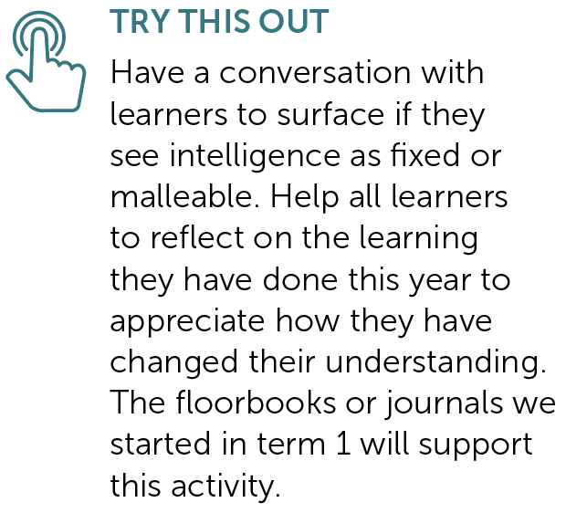
TERM 3 | Week 10
PY
PAGE
111
Cognitive engagement: Growth mindsets
Provocation Week 10

Slide 18
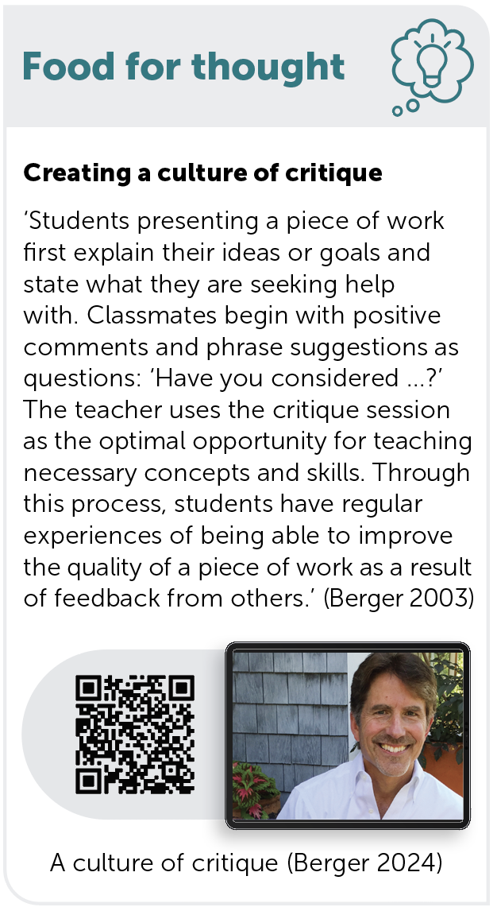
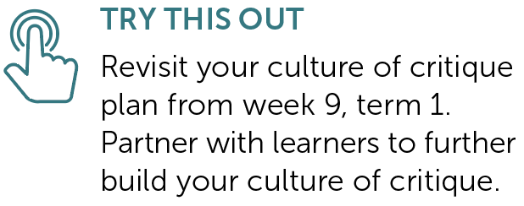
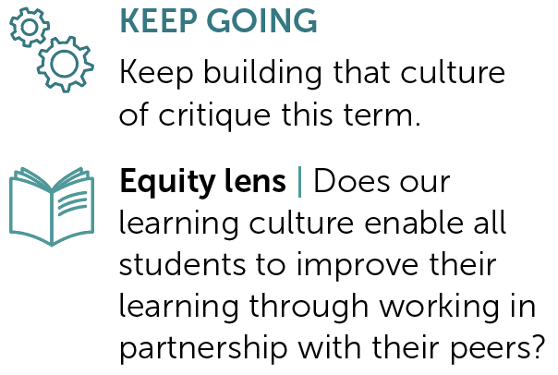
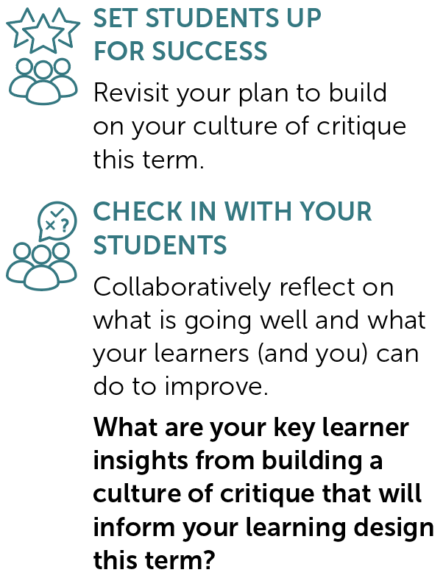
TERM 4 | Weeks 1 to 3
PY
PAGES
117 to
121
Creating a culture of critique
Provocation Week 1 Week 2 Week 3

Slide 19
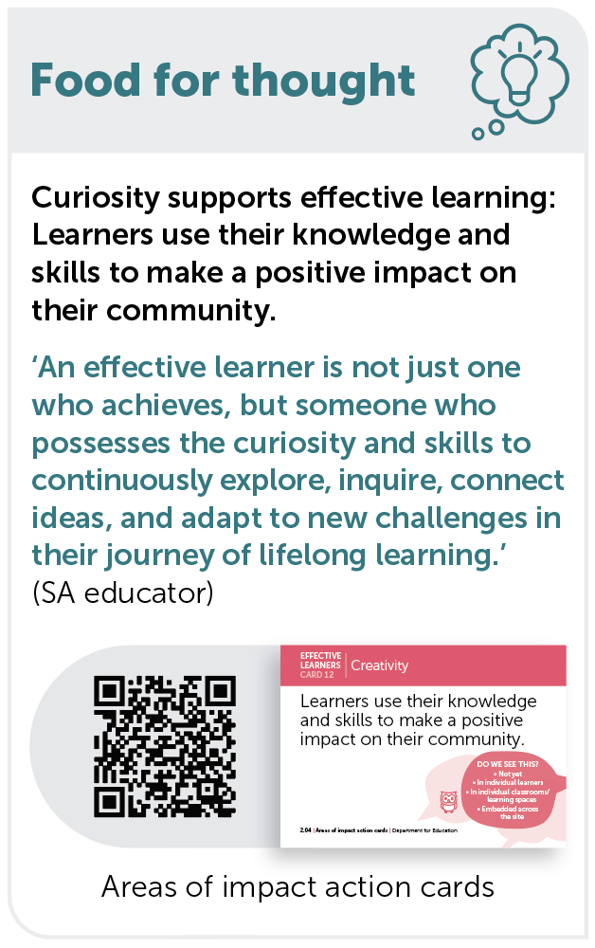
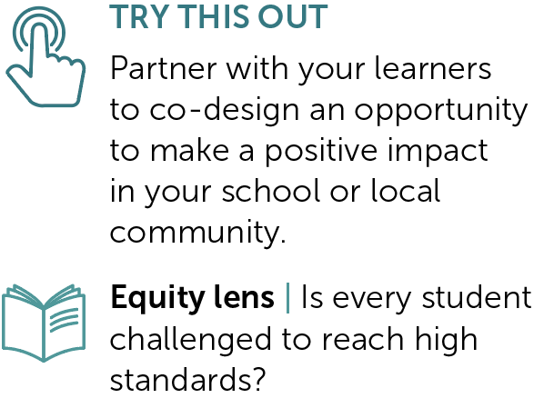


TERM 4 | Weeks 4 to 6
PY
PAGES
123 to
127
Curiosity: Community partnerships
Provocation Week 4 Week 5 Week 6

Slide 20




TERM 4 | Weeks 7 to 9
PY
PAGES
129 to
133
Partners in learning
Provocation Week 7 Week 8 Week 9

Slide 21



SECTION 2 | Our learners
REFER TO PY AND SY COMPANION PAGES 6, 7 and 8

Slide 22





2.1 | The voices of our SA learners
PAGE
6
Students desire more active learning and opportunities beyond the classroom.
Students value collaboration and discussions with their peers.
Students seek flexibility in learning connected to their world and passions.
1
Discussed is the somewhat perceived outdated education delivery and assessment methods.
2
But often feel they don’t get
the opportunity to work through problems and tasks in this manner.
3
As suggestions to increase student engagement and motivation to learn.
Students all want to have agency in learning and the confidence to participate.
Students crave the belonging and curiosity present in earlier years.
4
Safety to take risks, to voice their thinking and opportunities to develop and demonstrate agency.
A strong undertone in student feedback includes added pressures, changes in ‘delivery’ and support mechanisms. This is particularly prevalent in relation to transition to high school.
5
Source: Square Holes (2022)

Slide 23

2.1 | The voices of our learners
What might our learners say about how they want to experience learning for it to be most effective for them?
How do we know that?
PY AND SY COMPANION PAGE 6

Slide 24

2.2 | The aspirations of my learners
PAGE
7
How might we gain insight into the aspirations of our learners this year?
How might we capture their perceptions of themselves as learners?
How might we incorporate these insights into the choices we make in our learning design?
NOTE: Page 7 differs for primary and secondary years.

Slide 25



2.3 | The choices we have made as a system
PAGE
8
Purpose-driven, data-informed
The first big choice is to be a purpose-driven, data-informed education system. Being purpose-driven,
we keep children and young people at the centre when we make decisions and deeply consider what improvement looks like as we work towards our purpose. Data informs us, learner outcomes define us.
………………………………………………………………………………………………………………………………………………………………………………………………………………………………........................................
Areas of impact
The second big choice is to define our areas of impact. We can do anything, but we can’t do everything, so we have made choices as a system based on evidence about what makes the biggest difference to students’ learning and lives. Because context matters, schools will identify their focus within these choices. As schools work on their focus area of impact/domain(s) they will open up opportunities to intentionally pursue other areas over time.
………………………………………………………………………………………………………………………………………………………………………………………………………………………………........................................
The SA Curriculum for public education
The third big choice is to ensure the curriculum aligns with our purpose and areas of impact. The SA Curriculum* will help guide teachers on what to focus on and emphasise as they intentionally design learning that develops dispositions, capabilities and knowledge to support our children and young people to learn and thrive.
* The SA Curriculum is an adaptation of the Australian Curriculum version 9.0.

Slide 26


2.3 | Choice 1: Purpose-driven, data-informed
REFER TO PY AND SY PAGE 8 | Source: Department for Education 2024

Slide 27
2.3 | Choice 2: Areas of impact
REFER TO PY AND SY PAGE 8 | Source: Department for Education 2024a

Slide 28
2.3 | Choice 3: SA Curriculum for public education
REFER TO PY AND SY PAGE 8 | Source: Department for Education 2024b

Slide 29
2.3 | The choices we have made as a system
Why is it important to be purpose-driven and data-informed?
What do we see as the difference between being ‘purpose-driven
and data-informed’ rather than ‘data-driven’?
Being purpose-driven and data-informed guides us to think beyond standardised measures. Why does this matter for us and our learners?
REFER TO PY AND SY PAGE 8

Slide 30
2.3 | The choices we have made as a system
We can choose our focus area of impact/domain(s). Our focus will
guide and inform our work in curriculum and in the broader aspects
of students’ experiences of school. How might this benefit us and
our learners?
Our purpose statement says that ‘...we are relentless in our ambition for all children and young people to enter the world beyond the classroom ready to learn and to create opportunities to live a satisfying and fulfilling life of their choosing.’ How do we see the presence of dispositions and capabilities in the curriculum supporting this ambition?
REFER TO PY AND SY PAGE 8

Slide 31



SECTION 3 | Unpacking our strategy for public education
REFER TO COMPANION PY or SY PAGES 12 to 19, 22, 27 to 29

Slide 32



3.1 | Deepening our understanding of the areas of impact
PAGE
12
Reflecting on practice
Using the areas of impact action cards:
What are our existing strengths?
What could benefit from further development?
What could be our ‘step in’ to this space?
PARTNERS IN LEARNING
How could we use these cards
to partner with learners?

Slide 33
3.2 | Areas of impact – our school’s choices
PAGE
13
Getting familiar with our focus area of impact/domain(s)
Photo challenge
Take out your phone and open the photos app.
Randomly select a month and year.
Select a photo that connects to one or more area of impact/domain.
Explain the connection to a colleague, describing:
  the specific area of impact/domain(s) your photo relates to and
  if it relates to more than one – describe the connection(s)
  how your learners demonstrate this in your classroom.
REFER TO PY OR SY PAGE 13

Slide 34



3.2 | Photo challenge example
Jade selected a photo of her dog, Max, digging under the neighbour’s fence. She explains how Max, fuelled by curiosity, endured with his digging for days, changing strategies on several occasions until he
was able to squeeze his head through the hole, laying eyes on the neighbour’s yard.
Max showed curiosity because he wanted to know what was on the other side of the fence.
Max showed resilience and persistence because he kept going for days
on end until he achieved his goal.
REFER TO PY OR SY PAGE 13

Slide 35
3.2| Connections to other areas of impact
What connections do you see between our school’s chosen area of impact/
domain(s) and others?
See examples on page 13 of the companions.
REFER TO PY OR SY PAGE 13

Slide 36


3.3| Identifying actions to activate the areas of impact
PAGE
15
Wellbeing
Imagine an observer spent a day in your learning environment. Highlight each action according to
the following criteria.
Green – This would be hard to miss in my learning environment.
Yellow – This might be observed on occasion.
Pink – This is not likely to be seen.

Slide 37
3.3| Identifying actions to activate the areas of impact
Individually, consider:
Which 1, 2 or 3 actions do you believe will have the greatest impact on your learners? Why?
What other actions (not listed on the page) might
be impactful for your learners? Why?
Share your perspective with the wider group,
then discuss and record:
the consistencies that are evident within the
group’s discussion
how this might inform the next steps for your team.
REFER TO PY OR SY PAGE 15

Slide 38


3.3| Identifying actions to activate the areas of impact
PAGES
16–17
Effective learners
Imagine an observer spent a day in your learning environment. Highlight each action according to
the following criteria.
Green – This would be hard to miss in my learning environment.
Yellow – This might be observed on occasion.
Pink – This is not likely to be seen.

Slide 39
3.3| Identifying actions to activate the areas of impact
Individually, consider:
Which 1, 2 or 3 actions do you believe will have the greatest impact on your learners? Why?
What other actions (not listed on the page) might
be impactful for your learners? Why?
Share your perspective with the wider group,
then discuss and record:
the consistencies that are evident within the
group’s discussion
how this might inform the next steps for your team.
REFER TO PY OR SY PAGES 16 and 17

Slide 40

3.3| Identifying actions to activate the areas of impact
PAGE
18
Learner agency
Imagine an observer spent a day in your learning environment. Highlight each action according to
the following criteria.
Green – This would be hard to miss in my learning environment.
Yellow – This might be observed on occasion.
Pink – This is not likely to be seen.

Slide 41
3.3| Identifying actions to activate the areas of impact
Individually, consider:
Which 1, 2 or 3 actions do you believe will have the greatest impact on your learners? Why?
What other actions (not listed on the page) might
be impactful for your learners? Why?
Share your perspective with the wider group,
then discuss and record:
the consistencies that are evident within the
group’s discussion
how this might inform the next steps for your team.
REFER TO PY OR SY PAGE 18

Slide 42

3.3| Identifying actions to activate the areas of impact
PAGE
19
Equity and excellence
Imagine an observer spent a day in your learning environment. Highlight each action according to
the following criteria.
Green – This would be hard to miss in my learning environment.
Yellow – This might be observed on occasion.
Pink – This is not likely to be seen.

Slide 43
3.3| Identifying actions to activate the areas of impact
Individually, consider:
Which 1, 2 or 3 actions do you believe will have the greatest impact on your learners? Why?
What other actions (not listed on the page) might
be impactful for your learners? Why?
Share your perspective with the wider group,
then discuss and record:
the consistencies that are evident within the
group’s discussion
how this might inform the next steps for your team.
REFER TO PY OR SY PAGE 19

Slide 44








3.3| Identifying actions to activate the areas of impact
What student actions (cards) might manifest from the listed teacher actions in the companion?
REFER TO PY OR SY PAGES 15 to 19

Slide 45

3.4| Our ways of working
PAGE
22
Our guiding principles
What does collaboration look like for us now?
How do our current ways of working and being align with
or differ from the guiding principles?
What challenges might exist to implementing these principles and how might we address them?
What behaviours and practices would demonstrate each principle?
How will we know if we’re successfully embedding these principles?
In small groups, reflect on our day-to-day work and record an example of what each principle is and isn’t on page 22 of the companions.

Slide 46
3.5| Building coherence for our learners
PAGES
27–29
Initial brainstorm
In relation to the 4 areas of impact and the presence of dispositions and capabilities in the SA Curriculum prototype, what connections do you anticipate (or know) exist between these features of our strategy and the:
Early Years Learning Framework (EYLF 2.0)?
innovation occurring in the SACE?

Slide 47



3.5| Building coherence for our learners
Read pages 27 to 29 of the companions
Individual reading time (10 minutes).
Use the relevant area of impact action cards
to narrow your focus as you read.
You may find it useful to extend your reading later using the QR links provided on the companion pages.
REFER TO PY OR SY PAGES 27 to 29

Slide 48
3.5| Building coherence for our learners
After reading
Individually, generate a list of important connections between our focus area of impact/domains(s), the EYLF 2.0 and the SACE.
(2 to 3 minutes)
REFER TO PY OR SY PAGES 27 to 29

Slide 49
3.5| Building coherence for our learners
Add one routine
Form small groups (4 to 5 people).
  Pass your paper to the person on your right.
  Take 1 to 2 minutes to read the paper in front you, then add one new connection to the list (the addition could be an elaboration, a new point, or a relationship between multiple ideas).
  Rotate papers until you have received yours back and read your group members’ contributions.
REFER TO PY OR SY PAGES 27 to 29
Adapted from Project Zero’s +1 Routine (President and Fellows of Harvard College and Project Zero 2019)

Slide 50
3.5| Building coherence for our learners
Add one routine
After completing a rotation of add one, remain in small groups to identify and share 1 to 2 connections that you would like to follow-up to enrich your understanding of the focus area of impact/domain(s) further.
Share your thinking with the wider group.
REFER TO PY OR SY PAGES 27 to 29
Adapted from Project Zero’s +1 Routine (President and Fellows of Harvard College and Project Zero 2019)

Slide 51


SECTION 4 | Culture of collaboration
REFER TO SY COMPANION PAGES 62 to 63

Slide 52

4.1| Collaboration with colleagues
SY
PAGES
62 to
63
Historically, have we worked in a way that is more ‘cooperative’
or ‘collaborative?

Slide 53

4.1| Collaboration with colleagues
Educators as collaborators
REFER TO SY PAGES 62 to 63 | Source: Department for Education 2024d

Slide 54
4.1 | Collaboration with colleagues
Why and how we’ll collaborate
What might collaboration look like for us this year?
Use the questions on page 63 of the secondary years companion to guide your discussion and record your individual takeaways.
REFER TO SY PAGES 62 to 63

Slide 55

SECTION 5 | Collaboration across levels of schooling
REFER TO THE RELEVANT PEDAGOGICAL APPROACH OR STRATEGY PAGES IN THE PY AND SY COMPANIONS

Slide 56
5.1| Lenses for dialogue
A deeper look at <insert your focus here>
SEE | Look closely at <insert your focus here>.
What do you notice and wonder?
Adapted from Project Zero’s Lenses for dialogue (President and Fellows of Harvard College and Project Zero 2019b)

Slide 57
5.1| Lenses for dialogue
A deeper look at <insert your focus here>
CHOOSE AND SHARE A LENS | Think about how you naturally contextualise the strategy to a level of schooling you are familiar with – your lens. In pairs (or small groups), choose an alternative lens and take turns talking about how you might see the strategy through that lens.
Adapted from Project Zero’s Lenses for dialogue (President and Fellows of Harvard College and Project Zero 2019b)

Slide 58
5.1| Lenses for dialogue
A deeper look at <insert your focus here>
PROBE | Ask questions of your colleague(s) to deepen your understanding
of their lens or perspective.
Adapted from Project Zero’s Lenses for dialogue (President and Fellows of Harvard College and Project Zero 2019b)

Slide 59
5.1| Lenses for dialogue
A deeper look at <insert your focus here>
REFLECT | Look at <insert your focus here> again
and consider:
Do you have any new observations or wonderings?
How did your conversation invite you to think about things differently?
What might you take into your practice to test or trial?
Adapted from Project Zero’s Lenses for dialogue (President and Fellows of Harvard College and Project Zero 2019b)

Slide 60
5.2| Generate-sort-connect-elaborate
A deeper look at <insert your focus here>
GENERATE | a list of ideas and initial thoughts that come to mind when you think about this <insert your focus here> in your context.
Adapted from Project Zero’s Generate-Sort-Connect-Elaborate (President and Fellows of Harvard College and Project Zero 2019a)

Slide 61
5.2| Generate-sort-connect-elaborate
A deeper look at <insert your focus here>
SORT | your ideas according to how central or tangential they are. Place central ideas near the centre and more tangential ideas toward the outside of the page.
Adapted from Project Zero’s Generate-Sort-Connect-Elaborate (President and Fellows of Harvard College and Project Zero 2019a)

Slide 62
5.2| Generate-sort-connect-elaborate
A deeper look at <insert your focus here>
CONNECT | your ideas by drawing connecting lines between ideas that have something in common. Explain and write in a short sentence how
the ideas are connected.
Adapted from Project Zero’s Generate-Sort-Connect-Elaborate (President and Fellows of Harvard College and Project Zero 2019a)

Slide 63
5.2| Generate-sort-connect-elaborate
A deeper look at <insert your focus here>
ELABORATE | on any of the ideas or thoughts you have written so far by adding new ideas that expand, extend, or add to your initial ideas.
Continue generating, connecting and elaborating new ideas until you feel you have a good representation of your understanding.
Adapted from Project Zero’s Generate-Sort-Connect-Elaborate (President and Fellows of Harvard College and Project Zero 2019a)

Slide 64
5.3| Microlabs
A deeper look at <insert your focus here>
QUESTION 1 | How do you use <insert your focus here> with your learners?
Process:
Partner A speaks for 2 minutes.
Partner B speaks for 2 minutes.
Each person must only listen when their partner is speaking.
If your group finishes speaking early, quietly reflect on your conversation.
Adapted from National School Reform Faculty’s Microlab (National School Reform Faculty 2024)

Slide 65
5.3| Microlabs
A deeper look at <insert your focus here>
QUESTION 2 | How is your practice similar and different to your colleague(s)?
Process:
Partner A speaks for 2 minutes.
Partner B speaks for 2 minutes.
Each person must only listen when their partner is speaking.
If your group finishes speaking early, quietly reflect on your conversation.
Adapted from National School Reform Faculty’s Microlab (National School Reform Faculty 2024)

Slide 66
5.3| Microlabs
A deeper look at <insert your focus here>
QUESTION 3 | From listening to your colleague(s), what might you try differently when you next use this <insert your focus here> with your students?
Process:
Partner A speaks for 2 minutes.
Partner B speaks for 2 minutes.
Each person must only listen when their partner is speaking.
If your group finishes speaking early, quietly reflect on your conversation.
Adapted from National School Reform Faculty’s Microlab (National School Reform Faculty 2024)

Slide 67
5.4| Same but different
A deeper look at <insert your focus here>
Think about how you use <insert your focus here> with your learners.
With your colleague(s), consider how this <insert your focus here> might be similar
and different between primary and secondary years.

Slide 68
5.4| Same but different
A deeper look at <insert your focus here>
GALLERY WALK | As you walk around and view all the ‘Same but different’ responses, consider:
What 2 to 3 things might I take away from a different level of schooling
to trial in my practice?

Slide 69


SECTION 6 | Building a strong learning culture
REFER TO PY COMPANION PAGES 39 to 43, 51 to 55 and 79 to 83

Slide 70



6.1| Strong learning cultures in action
PY
PAGES
39 to
43
Jigsaw reading routine
Jigsaw groups – Form small groups of 3 to 6. Read the
assigned section of the passage. (5 to 10 minutes)
Form ‘expert groups’ – team up with other participants
that have read the same section of the passage. Discuss
your thoughts and key ideas to develop expertise in
this area. (15 minutes)
Return to your original jigsaw group – Each ‘expert’ summarises their discussion, communicating the key ideas presented in their section of
the text. (2 to 3 minutes each)

Slide 71
6.1| Strong learning cultures in action
Reflection
What do we see as features of a strong, inclusive learning culture?
What examples do we have of strong, inclusive learning cultures being developed in our context?
What examples do we have of students being involved in monitoring
and strengthening the learning culture? How embedded is this?
  How does building a strong learning culture connect to our focus area
  of impact/domain(s)?
REFER TO PAGES 39 to 43

Slide 72

6.2 | The Learning Pit
PY
PAGES
51 to
55
Source: James Nottingham’s The Learning Pit 2015

Slide 73
6.2 | The Learning Pit
Think | Reflect on a time you found yourself in The Learning Pit:
  How did you climb your way out?
  How did you feel:
    before you entered the pit?
    in the depths of The Learning Pit?
    after you achieved success?
Pair | Share your reflection with a partner.
Share | Two pairs join to share and discuss:
  What are the common themes emerging?
REFER TO PAGES 51 to 55
Adapted from Project Zero’s Think, pair, share (President and Fellows of Harvard College and Project Zero 2019a)

Slide 74
6.2 | The Learning Pit
Going deeper
What self-talk do you remember using before, during or after this learning experience? How did it help?
How might sharing these experiences with our students benefit them?
How does The Learning Pit connect to our focus area of impact/ domain(s)?
REFER TO PAGES 51 to 55

Slide 75
6.3 | Creating safety for challenge
PY
PAGES
79 to
83
Individually, reflect on a time where you felt challenged in your
learning:
What were the learning conditions in this scenario?
What made you feel safe to take risks or engage in challenge?
What might have prevented you from doing this?

Slide 76
6.3 | Creating safety for challenge
As a group, discuss:
What might ‘safety for challenge’ look like in our learning environments?
What signals or behaviours indicate that students feel safe to take risks?
What educator actions and beliefs promote safety for challenge?
What learner actions and beliefs promote safety for challenge?
What role might families and caregivers play in our development of safety for challenge?
REFER TO PY PAGES 79 to 83

Slide 77

6.3 | Creating safety for challenge
REFER TO PY PAGES 79 to 83 | Source: Wiliam 2019b

Slide 78
6.3 | Creating safety for challenge
Think about an upcoming experience that will involve challenging learning for your students:
How might your students’ understandings about learning and beliefs about themselves as learners influence their tolerance for challenge
in this experience?
What teacher actions might intentionally:
  ‘lower the cost of failure’ for your learners?
  increase learners’ tolerance for challenge?
REFER TO PY PAGES 79 to 83

Slide 79
6.3 | Creating safety for challenge
Considering the same upcoming experience and view page 79 of the primary years companion:
How might you use the strategy outlined on page 79
to allow all learners to step into the challenge you
have designed?
What else could you do?
REFER TO PY PAGES 79 to 83

Slide 80



SECTION 7 | Metacognition and self-regulated learning
REFER TO PY AND SY COMPANION PAGES 154, 156, 157 and 73 to 77 (PY); 118, 120 to 121 and 64 to 66 (SY)

Slide 81

7.1| Productive struggle
PY
PAGE
154
SY
PAGE
118
Introduction to metacognition and self-regulation
Have a go at the Stroop test as we watch!
After watching the video, discuss…
How did it feel?
Source: Department for Education 2024e

Slide 82

7.1| Productive struggle
REFER TO PY PAGE 154 or SY PAGE 118 | Source: Wiliam 2019d

Slide 83
7.1| Productive struggle
How do we currently design for productive struggle?
Use the questions on page 154 (primary years) or page 118 (secondary years)
of your companion to guide your discussion.
REFER TO PY PAGE 154 or SY PAGE 118

Slide 84
7.1| Productive struggle
With your colleagues, consider the following:
How might we design for productive struggle in our upcoming learning?
How might we ensure that every learner can experience this?
How might we partner with learners to design learning at an appropriate level of challenge?
REFER TO PY PAGE 154 or SY PAGE 118

Slide 85
7.2| EEF Metacognition and self-regulated learning
PY
PAGES
156 to 157
SY
PAGES
120 to 121
How are we going?
For each recommended action on the EEF poster, identify our current practice as:
embedded
progressing
emerging
not yet introduced.
Source: EEF 2021

Slide 86
7.2| EEF Metacognition and self-regulated learning
What are your team’s agreed next steps?
Record your agreed next steps on page 157 (primary years) or page 121 (secondary years) of your companion.
REFER TO PY PAGES 156 to 157 or SY PAGES 120 to 121

Slide 87
7.3| Creating think alouds
SY
PAGES
64 to
66
Source: Smekens Education Solutions Inc 2019

Slide 88
7.3| Creating think alouds
Your experience of think alouds
When have you learned from another person modelling their thinking out loud? Consider all settings, not just formal learning!
REFER TO SY PAGES 64 to 66

Slide 89
7.3| Creating think alouds
Share your experience of think alouds
With a partner, discuss:
How did being exposed to another person’s thinking support your learning in your chosen example?
REFER TO SY PAGES 64 to 66

Slide 90

7.3| Creating think alouds
Current practice with think alouds
With a partner, discuss and respond to the questions on page 65 of the secondary years companion.
REFER TO SY PAGES 64 to 66

Slide 91

7.3| Creating think alouds
Planning for think alouds
What will be your ‘step in’ or ‘next step’ for think alouds?
Record your thinking on page 66 of the secondary years companion.
REFER TO SY PAGES 64 to 66

Slide 92

7.4| Scaffolding for planning, monitoring and evaluating
EEF Metacognition and self-regulated learning
Take some time to read the recommendations from the Education Endowment Foundation’s research.
SY
PAGES
72–74
+ 120
Source: EEF 2021

Slide 93

7.4| Scaffolding for planning, monitoring and evaluating
Considering a task
Explore the Dan Meyer (2012) ‘Popcorn picker’ online task page.
Which of the EEF recommendations are evident?
http://curriculumlearningsa.shor.tn/PopcornPicker
REFER TO SY PAGES 72 to 74 and 120 | Source: EEF 2021

Slide 94

7.4| Scaffolding for planning, monitoring and evaluating
Implicit practices for planning, monitoring
and evaluating
What more subtle practices support students to embed planning, monitoring and evaluating?
Consider and respond to the questions on page 73
of the secondary years companion.
REFER TO SY PAGES 72 to 74 and 120

Slide 95

7.4| Scaffolding for planning, monitoring and evaluating
Planning to scaffold
Consider a learning experience your students will engage with soon.
How might you use questions to support your learners to plan, monitor and evaluate?
Record your thinking on page 74 of the secondary years companion.
REFER TO SY PAGES 72 to 74 and 120

Slide 96

7.5| Check-in and act: Learning logs
PY
PAGES
73 to
77
When used routinely, learning logs can be a simple way to normalise
and habituate metacognition.
Additionally, learning logs can be a powerful formative assessment strategy, giving teachers valuable insight into their students as learners.
See page 73 of the companion.

Slide 97
7.5| Check-in and act: Learning logs
Co-design a post-lesson learning log prompt with colleagues.
The purpose of the prompt will be to:
gain insights into the learning experience of your students
check for understanding
promote metacognition by scaffolding opportunities for students to evaluate their learning.
Some prompt examples are provided on the next slide.
REFER TO PY PAGES 73 to 77

Slide 98
7.5| Check-in and act: Learning logs
Post-session prompts
Today I learned…
I was surprised by…
The most useful thing I will take from this lesson is…
I was interested in…
What I liked most about the
lesson was…
One thing I’m not sure about is…
The main thing I want to find out more about is…
After this session, I feel…
I might have got more from this lesson if…
PARTNERS IN LEARNING
You might choose to display
student responses on a learning
log poster or ask students to
make individual journal entries.
REFER TO PY PAGES 73 to 77

Slide 99
7.5| Check-in and act: Learning logs
Partners in learning
How might we co-develop a learning log reflection with our students
to support metacognition?
What prompts and/or sentence starters might we provide our students
to promote this reflection?
How might our students’ insights support our future learning design?
REFER TO PY PAGES 73 to 77

Slide 100




SECTION 8 | Success criteria
REFER TO SY COMPANION PAGES 80 to 82 and 116

Slide 101

8.1| Planning for students to understand what success looks like
SY
PAGES
80–82
+ 116
EEF Teacher feedback to improve student learning
Take some time to read the recommendations from the Education Endowment Foundation’s research.
Source: EEF 2021a

Slide 102



8.1| Planning for students to understand what success looks like
Jigsaw routine – video viewing
Form 3 expert groups and view your video, keeping the EEF research about feedback in mind.
Group 1
Group 2
Group 3
Source: Wiliam 2019
Source: Wiliam 2019a
Source: Wiliam 2019d
REFER TO SY PAGES PAGES 80 to 82 and 116

Slide 103
8.1| Planning for students to understand what success looks like
Jigsaw routine – video ‘expert’ groups
In your expert groups, discuss:
How did the practice in your video connect to the EEF recommendations
on feedback?
REFER TO SY PAGES PAGES 80 to 82 and 116

Slide 104
8.1| Planning for students to understand what success looks like
Jigsaw routine – video ‘jigsaw’ groups
Form a jigsaw group of 3, with each member having
viewed a different video.
Share the connections you noticed between your video and the EEF recommendations.
REFER TO SY PAGES PAGES 80 to 82 and 116

Slide 105

8.1| Planning for students to understand what success looks like
Planning for success criteria
Remaining in your jigsaw groups, discuss:
What else do we know or want to find out about clarifying success criteria with students?
Record your thinking on page 81 of the secondary years companion.
REFER TO SY PAGES PAGES 80 to 82 and 116

Slide 106




SECTION 9 | Feedback
REFER TO PY AND SY COMPANION PAGES:
57, 59, 152, 153, 150 to 151 and 129 to 133 (PY); 89, 116 to 117, and the guided notetaking handout (SY)

Slide 107
9.1 | Austin’s butterfly: Peer critique
PY
PAGES
57 to
59
Source: EL Education 2012

Slide 108
9.1 | Austin’s butterfly: Peer critique
Goal
Practise giving and receiving peer critique using a short piece of writing, focusing on fostering a positive and growth-oriented critique culture.
REFER TO PY PAGES 57 to 59

Slide 109
9.1 | Austin’s butterfly: Peer critique
Step 1 – First draft
Write 2 sentences describing a place where you have felt a sense of belonging. Focus on creating a vivid image.
OR
Write to a prompt connected to our focus area of impact/domain(s).
Remember, this is a first draft and not about perfection.
REFER TO PY PAGES 57 to 59

Slide 110
9.1 | Austin’s butterfly: Peer critique
Step 2 – Critique groups
Work in small groups of 3 to 4. Read drafts aloud, one person at a time.
Group members provide feedback following these principles:
  Be kind – Start with what works well in the writing.
  Be specific – Point out areas that could be enhanced, eg ‘Could you add a sensory detail, like a sound or smell?’
  Be helpful – Offer actionable suggestions for improvement.
REFER TO PY PAGES 57 to 59

Slide 111
9.1 | Austin’s butterfly: Peer critique
Step 3 – Action response
Revise your passage based on the feedback you received. Focus on incorporating 1 or 2 key pieces of feedback.
REFER TO PY PAGES 57 to 59

Slide 112
9.1 | Austin’s butterfly: Peer critique
Step 4 – Reflection
As a whole group, discuss:
How did it feel to receive feedback?
How did it feel to give feedback?
What made the feedback most effective?
How might we create a similar culture of peer critique in our classrooms?
REFER TO PY PAGES 57 to 59

Slide 113












9.1 | Austin’s butterfly: Peer critique
How do the strategies demonstrated in the Austin’s butterfly video connect to the areas of impact/domains?
REFER TO PY PAGES 57 to 59 | Source: Areas of impact domain cards

Slide 114
9.2 | The many connections to feedback
SY
PAGE
89 +
handout
Peer feedback and self-assessment –
guided notetaking
Use the guided notetaking handout as we view the following video.
Note: The handout is arranged to work from right to left, so that when you return to it,
you will notice your ‘So what?’ actions first.

Slide 115
9.2 | The many connections to feedback
Culture of critique
REFER TO SY PAGE 89 and guided notetaking handout | Source: Department for Education 2024c

Slide 116
9.2 | The many connections to feedback
Culture of critique
Let’s view the video again and add more to our notes.
This time as you watch, use a different lens!
For example, if you viewed the video through a classroom practice lens the first time, then view it now through the lens of how you work with colleagues.
REFER TO SY PAGE 89 and guided notetaking handout

Slide 117
9.2 | The many connections to feedback
Culture of critique
REFER TO SY PAGE 89 and guided notetaking handout | Source: Department for Education 2024c

Slide 118

9.2 | The many connections to feedback
So what?
Which of your ‘So what?’ notes might you action to take a ‘step in’ or ‘next step’ in developing a culture of critique?
REFER TO SY PAGE 89 and guided notetaking handout

Slide 119

9.2 | The many connections to feedback
In small groups, discuss:
How might peer feedback, self-assessment and a culture of critique help us with our chosen area of impact/domain(s)?
How does peer feedback, self-assessment and
a culture of critique connect with other areas
of impact or domains?
If we choose to be intentional with these strategies, what impact could they have for
our students?
REFER TO SY PAGE 89 and guided notetaking handout

Slide 120
9.2 | The many connections to feedback
Planning for your learning
Keeping in mind the connections we have made
with our focus area of impact/domain(s), discuss:
What else do we know or want to find out about peer feedback and self-assessment?
Record your thinking on page 89 of the secondary years companion.
REFER TO SY PAGE 89 and guided notetaking handout

Slide 121

9.3 | EEF Teacher feedback to improve student learning
Take some time to read the recommendations from the Education Endowment Foundation’s research.
PY
PAGES
152 to
153
SY
PAGES
116 to
117

Slide 122
9.3 | EEF Teacher feedback to improve student learning
How are we going?
For each recommended action on the EEF poster, identify our current practice as:
embedded
progressing
emerging
not yet introduced.
REFER TO PY PAGES 152 to 153 or SY PAGES 116 to 117

Slide 123

9.3 | EEF Teacher feedback to improve student learning
What are your team’s agreed next steps?
Record your agreed next steps on page 153 (primary years) or page 117 (secondary years) of your companion.
REFER TO PY PAGES 152 to 153 or SY PAGES 116 to 117

Slide 124
9.4| Student to teacher feedback
PY
PAGES
129 to
133
With colleagues, discuss:
How have we collected feedback from students about their learning experiences?
Examples might include:
exit slips
digital surveys (eg Microsoft Forms, Google Forms, Pear Deck, Slido, Mentimeter)
personal conferencing.

Slide 125
9.4| Student to teacher feedback
Partners in learning
Set a short-term goal to collect insights from students about their learning experiences.
Record the questions we might ask to elicit these insights.
How could we respond to the feedback we receive from students?
REFER TO PY PAGES 150 to 151

Slide 126



SECTION 10 | Checking for understanding
REFER TO PY AND SY COMPANION PAGES 99 to 103, 105 to 109 and 67 to 71 (PY); 96 to 98 (SY)

Slide 127

10.1 | Introducing all student response systems
Source: Wiliam 2019

Slide 128
10.1 | Introducing all student response systems
How might we check for understanding, in the moment, with a whole class? Hands up questioning is not the answer.
We need to know each student’s starting point, and importantly, they
need to know their starting point too.

Slide 129
10.1 | Introducing all student response systems
In small groups, discuss and document:
What all student response processes are used at our school?
Are these processes in frequent use at all year levels and learning areas?
What processes do we want our students to be familiar with?
If we were to improve the quality or frequency of this practice, what might be the impact for our learners?

Slide 130

10.2 | Check-in and act: Mini whiteboards
PY
PAGES
99 to
103
Which area of impact does it belong to?
The following slides display individual domains from
the 4 areas of impact.
On your whiteboard:
Write the area of impact you think it belongs to
(ie wellbeing, equity and excellence, learner agency
or effective learners). Display your whiteboard.
Observe the whiteboards around you. Does anyone
think differently to you? Explain your thinking.
Remember – there are no wrong answers. Flex your reasoning skills and explain your thinking to your partner or team.

Slide 131
10.2 | Check-in and act: Mini whiteboards
Which area of impact does it belong to?
Strategic awareness
REFER TO PY PAGES 99 to 103

Slide 132
10.2 | Check-in and act: Mini whiteboards
Which area of impact does it belong to?
Effective learners
Strategic awareness
REFER TO PY PAGES 99 to 103

Slide 133
10.2 | Check-in and act: Mini whiteboards
Which area of impact does it belong to?
Discernment and judgement
REFER TO PY PAGES 99 to 103

Slide 134

10.2 | Check-in and act: Mini whiteboards
Which area of impact does it belong to?
Learner agency
Discernment and judgement
REFER TO PY PAGES 99 to 103

Slide 135
10.2 | Check-in and act: Mini whiteboards
Which area of impact does it belong to?
<Insert domain name here>
REFER TO PY PAGES 99 to 103

Slide 136
10.2 | Check-in and act: Mini whiteboards
Which area of impact does it belong to?
Wellbeing
<Insert domain name here>
REFER TO PY PAGES 99 to 103

Slide 137
10.2 | Check-in and act: Mini whiteboards
Which area of impact does it belong to?
Learner agency
<Insert domain name here>
REFER TO PY PAGES 99 to 103

Slide 138
10.2 | Check-in and act: Mini whiteboards
Which area of impact does it belong to?
Effective learners
<Insert domain name here>
REFER TO PY PAGES 99 to 103

Slide 139

10.2 | Check-in and act: Mini whiteboards
Which area of impact does it belong to?
Equity and excellence
<Insert domain name here>
REFER TO PY PAGES 99 to 103

Slide 140
10.2 | Check-in and act: Mini whiteboards
Which one doesn’t belong?
The following slides display 4 actions from the areas
of impact action cards.
On your whiteboard:
Write A, B, C or D to indicate which one doesn't belong.
Display your whiteboard to the team.
Observe the whiteboards around you. Does anyone think differently to you? Explain your thinking – Why do you
think this domain doesn’t belong?
Remember – there are no wrong answers. Flex your reasoning skills and explain your thinking to your partner or team.
REFER TO PY PAGES 99 to 103

Slide 141
10.2 | Check-in and act: Mini whiteboards
Which one doesn’t belong?
A | Learners seek information and clarification through questioning
B | Learners raise questions confidently, without feeling judged
C | Learners question information and facts before accepting them
D | Learners pose and test theories
There could be multiple ‘answers’ – be prepared to justify your choice!
REFER TO PY PAGES 99 to 103

Slide 142
10.2 | Check-in and act: Mini whiteboards
Which one doesn’t belong?
A | Learners engage in lots
of purposeful learning talk with peers and adults
B | Learners have opportunities to choose what they receive feedback on and how
C | Learners know the next step towards their learning goals
D | Learners seek feedback from others to move their learning forward
There could be multiple ‘answers’ – be prepared to justify your choice!
REFER TO PY PAGES 99 to 103

Slide 143
10.2 | Check-in and act: Mini whiteboards
Which one doesn’t belong?
A | <Add action text here>
B | <Add action text here>
C | <Add action text here>
D | <Add action text here>
REFER TO PY PAGES 99 to 103

Slide 144
10.2 | Check-in and act: Mini whiteboards
Reflection
How do mini whiteboards differ from the traditional ‘hands up’ call
and response system?
What other all student response systems might we trial/improve
to check for understanding in real time?
How might we support each other to move away from the traditional ‘hands up’ call and response system?
What might be the impact for our students?
REFER TO PY PAGES 99 to 103

Slide 145
10.3 | Check-in and act: Question shells
PY
PAGES
105 to
109
Question shells can be an effective way to surface student thinking.
Examples:
How is … an example of … ?
How is … connected to … ?
Why is … but … is ...?

Slide 146
10.3 | Check-in and act: Question shells
How is feedback connected to learner agency?
Why is curiosity a disposition but critical thinking is a capability?
REFER TO PY PAGES 105 to 109

Slide 147
10.3 | Check-in and act: Question shells
Write your own
How is … an example of … ?
How is … connected to … ?
Why is … but … is ...?
REFER TO PY PAGES 105 to 109

Slide 148
10.3 | Check-in and act: Question shells
Reflection
How might question shells be used to surface student thinking in your leaning environment?
How might this deepen our insights into student thinking?
How could we be responsive to these insights?
REFER TO PY PAGES 105 to 109

Slide 149

10.4 | Engineering effective discussions to elicit evidence of understanding
SY
PAGES
96 to
98
Take some time to read and engage with the content (including the videos) on page 96 of the secondary years companion.

Slide 150
10.4 | Engineering effective discussions to elicit evidence of understanding
Our existing practices
Discuss:
How do we already check for understanding with our students?
Do our learning and teaching plans clearly identify key prerequisite knowledge and common misconceptions that students could bring
to their learning?
What all student response processes are used at our school?
Are these processes in frequent use at all year levels and learning areas?
What are our opportunities for improvement here? Which of these might have the most impact for our learners?
REFER TO SY PAGES 96 to 98

Slide 151
10.4 | Engineering effective discussions to elicit evidence of understanding
Possible ‘small step’
Discuss:
What will be our ‘small step’ in relation to improving our checking
for understanding?
How might we incorporate this into an upcoming lesson or learning experience?
What learning might we need to do before we ‘step in’?
REFER TO SY PAGES 96 to 98

Slide 152

10.4 | Engineering effective discussions to elicit evidence of understanding
Planning for your ‘small step’
Use page 98 of the secondary years companion to plan your ’small step’.
When you action your ‘small step’, keep in mind that
we will come back together to reflect and learn with
and from each other.
REFER TO SY PAGES 96 to 98

Slide 153
10.5 | What have we learned?
Educators as learners
REFER TO SY PAGES 96 to 98 | Source: Department for Education 2024e

Slide 154
10.5 | What have we learned?
Reflecting on our ‘small steps’
How did your ‘small step’ go?
In small groups, or as an individual, consider:
What did we learn in taking this ‘small step’ into our practice with our students? What worked and what didn’t?
What did we notice in our students?
Do we think it had an impact? How do we know?
What will we take with us into our practice and what might be our next ‘small step’?
REFER TO SY PAGES 96 to 98

Slide 155

SECTION 11 | Hooking students into the learning
REFER TO SY COMPANION PAGES 104 to 106

Slide 156

11.1 | Designing for engagement in challenging learning
SY
PAGES
104 to
106
Innovation playlist video
Choose a video to view from the ‘Innovation playlist’.
View the video as a learner – a learner of teaching
and learning practices.
While viewing, record what you noticed about hooking students into the learning.
http://curriculumlearningsa.shor.tn/InnovPlaylistWSCB
Source: What School Could Be 2024

Slide 157

11.1 | Designing for engagement in challenging learning
Hook students into the learning
REFER TO SY PAGES 104 to 106 | Source: Wiliam 2019b

Slide 158
11.1 | Designing for engagement in challenging learning
Share what you noticed
In small groups, share and discuss your thinking using the questions:
What did I notice about hooking students into the learning from
the videos? Consider your selected video from the Innovation Playlist, and Dylan Wiliam.
How can this serve as inspiration for educators at our school when designing ‘learning hooks’?
REFER TO SY PAGES 104 to 106

Slide 159
11.1 | Designing for engagement in challenging learning
Planning to hook students into the learning
In your small groups, discuss:
What are some strategies you might try for hooking students into learning?
Record your thinking on page 106 of the secondary years companion.
REFER TO SY PAGES 104 to 106

Slide 160


SECTION 12 | Teachers as learners
REFER TO PY or SY COMPANION PAGES 62 to 63 (PY); 40 to 41 (SY)

Slide 161
12.1 | Reflecting on our practice
PY
PAGES
62 to
63
SY
PAGES
40 to
41
Before we reflect, consider these ideas from Ron Berger and Gwyn ap Harri.
Source: Department for Education 2024c

Slide 162
12.1 | Reflecting on our practice
Individual reflection
Individually, record your thinking on page 62 (primary years) or page 40 (secondary years) of your companion.
What are you feeling proud of this term:
in relation to strengthening your pedagogy?
in relation to creating a strong learning culture?
What else do you want to reflect on and work towards?
REFER TO PY PAGES 62 to 63 or SY PAGES 40 to 41

Slide 163
12.1 | Reflecting on our practice
Collaborative reflection
In small groups, record your thinking on page 63 (primary years) or page 41 (secondary years)
of your companion.
Discuss your collective progress using the prompts on the page.
Before you plan your next steps, ensure you take the time to celebrate what you have achieved as
a team!
REFER TO PY PAGES 62 to 63 or SY PAGES 40 to 41

Slide 164
References
Australian Government Department of Education (AGDE) (2022) Belonging, Being and Becoming: The Early Years Learning Framework for Australia (V2.0), Australian Government Department of Education for the Ministerial Council, <http://curriculumlearningsa.shor.tn/EYLF2>
Berger R (2003) An ethic of excellence, Heinemann, Portsmouth, NH
Claxton G (2006) ‘What kind of learning does self-assessment drive? Developing a ‘nose’ for quality: Comments
on Klenowski (1995)’, Assessment in Education: Principles, Policy & Practice, 2 (3), 339–343, <https://doi.org/10.1080/0969595950020307>
Department for Education (2023) Our strategy for public education in South Australia, Government of South Australia, <http://curriculumlearningsa.shor.tn/StrategySAPubEdW>
Department for Education (2024) Choice 1, Government of South Australia, <https://vimeo.com/1026350025/3a1ba33479?ts=0&share=copy>
Department for Education (2024a) Choice 2, Government of South Australia, <https://vimeo.com/1026350203/9995939824?ts=0&share=copy>
Department for Education (2024b) Choice 3, Government of South Australia,
<https://vimeo.com/1026352524/657f1627f2?ts=0&share=copy>
Department for Education (2024c) Culture of critique, Government of South Australia, <https://vimeo.com/
1035846309/11925c0d69?ts=0&share=copy>
Department for Education (2024d) Educators as collaborators, Government of South Australia,
<https://vimeo.com/1036583885/c2eb8917b8?share=copy>
Department for Education (2024e) Educators as learners, Government of South Australia, <https://vimeo.com/
1036242177/125b7e85a1?share=copy>
Department for Education (2024f) Learning and teaching together: Empowering South Australian learners, SA Curriculum for public education, <http://curriculumlearningsa.shor.tn/SACurric>
Department for Education (2024g) Thinking about thinking with the Stroop test, Government of South Australia, <https://vimeo.com/1026352505/d69c405764?ts=0&share=copy>
Education Endowment Foundation (2021) Metacognition and self-regulated learning: Summary of recommendations, <http://curriculumlearningsa.shor.tn/EEFPoster>
Education Endowment Foundation (2021a) Metacognition and self-regulated learning, Teaching and Learning Toolkit, <http://curriculumlearningsa.shor.tn/EEFToolkitMetacogSR>
Education Endowment Foundation (2021b) Teacher feedback to improve pupil learning: Summary of
recommendations, <http://curriculumlearningsa.shor.tn/EEFfeedbackposter>
EL Education (2012) Austin’s butterfly, Models of excellence: The center for high quality student work,
<http://curriculumlearningsa.shor.tn/RBAustinsButterfly>
Hattie J (2023) Visible learning: The sequel, Routledge, Oxon and New York
Meyer D (2012) [3ACTS] Popcorn picker, dy/dan, 4 June 2012, <http://curriculumlearningsa.shor.tn/PopcornPicker>
National School Reform Faculty (2024) Microlabs <https://www.nsrfharmony.org/wp-content/uploads/2017/10/
microlabs_0.pdf>
Nottingham J (2015) James Nottingham’s learning challenge (Learning Pit) animation, YouTube, 23 November 2015, <http://curriculumlearningsa.shor.tn/JNLPvideo>
President and Fellows of Harvard College and Project Zero (2019) +1 routine: A routine for the identifying important ideas worth remembering, Harvard Graduate School of Education, <https://pz.harvard.edu/resources/1-routine>
President and Fellows of Harvard College and Project Zero (2019a) Think, pair, share, Harvard Graduate School of Education, <https://pz.harvard.edu/resources/think-pair-share>
President and Fellows of Harvard College and Project Zero (2019a) Generate-Sort-Connect-Elaborate: A routine for organizing one’s understanding of a topic through concept mapping, Harvard Graduate School of Education, <https://pz.harvard.edu/resources/generate-sort-connect-elaborate>
President and Fellows of Harvard College and Project Zero (2019b) Lenses for dialogue: A routine for looking through lenses and exchanging perspectives, Harvard Graduate School of Education, <https://pz.harvard.edu/resources/lenses>
SACE Board of South Australia (2024) Passport to thrive: A qualification for a changing world: SACE Board strategic plan 2024–2027, Government of South Australia, <http://curriculumlearningsa.shor.tn/SACEstratplanPDF>
Smekens Education Solutions Inc (2019) Go beyond a model; reveal a think aloud, <https://www.smekenseducation
.com/go-beyond-a-model-reveal-a-think-aloud/>
Square Holes (2022) Data analysis: Student forums on the purpose of public education in SA, Department for Education, Government of South Australia, <https://www.education.sa.gov.au/docs/ce-office/purpose/purpose-statement-data-analysis-student-forums.pdf>
What School Could Be (2024) The innovation playlist, <https://www.whatschoolcouldbe.org/innovation-playlist>
Wiliam D (2019) All student response systems, SA Learning design, assessment and moderation strategy, Government of South Australia, <http://curriculumlearningsa.shor.tn/DWAllStudRespSys>
Wiliam D (2019a) Co-construct success criteria, but only if it's rigged, SA Learning design, assessment and moderation strategy, Department for Education, Government of South Australia, <http://curriculumlearningsa.
shor.tn/CoConstructIfRigged>
Wiliam D (2019b) Creating safety for challenge, SA Learning design, assessment and moderation strategy, Department for Education, Government of South Australia, <http://curriculumlearningsa.shor.tn/DWSafety
4Challenge>
Wiliam D (2019c) Examples are more effective than descriptions, SA Learning design, assessment and moderation strategy, Department for Education, Government of South Australia, <http://curriculumlearningsa.shor.tn/
EgMoreEffThanDesc>
Wiliam D (2019d) Hook students into the learning, SA Learning design, assessment and moderation strategy, Government of South Australia, <http://curriculumlearningsa.shor.tn/DWHookStudIntoLrng>
Wiliam D (2019e) Productive struggle, SA Learning design, assessment and moderation strategy, Department for Education, Government of South Australia, <http://curriculumlearningsa.shor.tn/DWProdStruggle>
Wiliam D (2019f) Sharing and clarifying success criteria: One example and evidence of impact, SA Learning design, assessment and moderation strategy, Government of South Australia, <http://curriculumlearningsa.shor.tn/
DWShareClarSuccessCrit>

