Slide 1
https://www.sacurriculum.sa.edu.au/learning-design

Slide 2
Acknowledgement of Country
We acknowledge that the work undertaken to develop this leaders’ guide took place on the traditional lands of South Australia’s First Peoples and we respect their spiritual relationship with their country.
In delivering public education in South Australia, we acknowledge the importance of understanding Aboriginal knowledge, languages, cultures and voices which provide critical contributions and value across our workplaces, classrooms, partnerships and communities.
Note: The Department for Education uses the term ‘Aboriginal’ to refer to people who identify as Aboriginal, Torres Strait Islander, or both Aboriginal and Torres Strait Islander. This term is preferred by Aboriginal South Australians and the department.

Slide 3

SECTION 1 |
Content overview

Slide 4
Contents
SECTION 2 | Our learners
2.1 The voices of our SA learners
2.2 The aspirations of my learners
2.3 The choices we have made as a system
SECTION 3 | Unpacking our strategy for public education
3.1 Deepening our understanding of the areas of impact
3.2 Areas of impact – our school’s choices
3.3 Identifying actions to activate the areas of impact
3.4 Our ways of working
3.5 Building coherence for our learners
SECTION 4 | Culture of collaboration
4.1 Collaboration with colleagues
SECTION 5 | Metacognition and self-regulated learning
5.1 Productive struggle
5.2 EEF Metacognition and self-regulated learning
5.3 Creating think alouds
5.4 Scaffolding for planning, monitoring and evaluating
SECTION 6 | Success criteria
6.1 Planning for students to understand what success
looks like
SECTION 7 | Feedback
7.1 The many connections to feedback
7.2 EEF Teacher feedback to improve student learning
SECTION 8 | Checking for understanding
8.1 Engineering effective discussions to elicit evidence
of understanding
8.2 What have we learned?
SECTION 9 | Hooking students into the learning
9.1 Designing for engagement in challenging learning
SECTION 10 | Teachers as learners
10.1 Reflecting on our practice

Slide 5
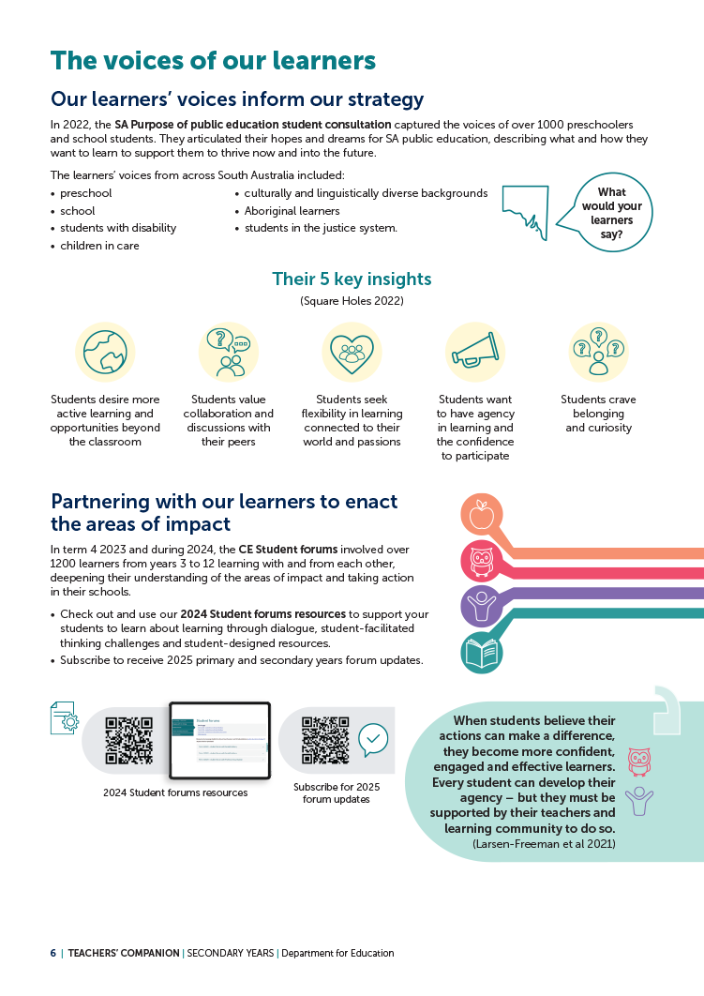

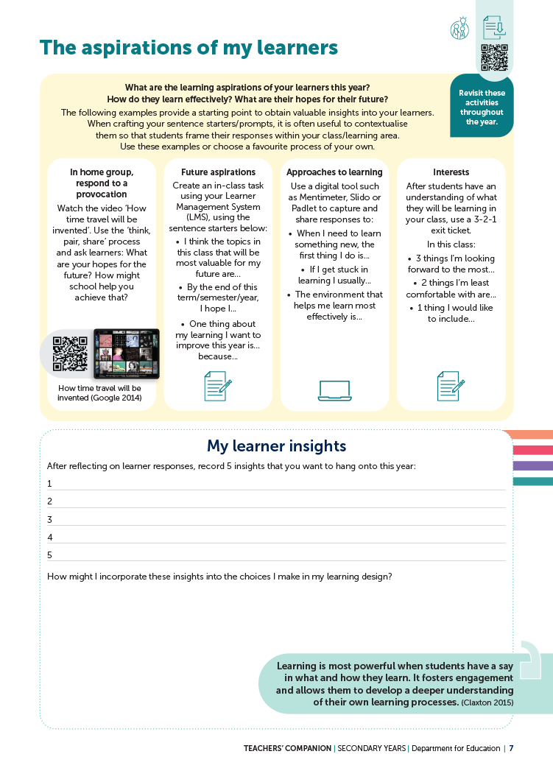
SECTION 2 | Our learners
REFER TO COMPANION PAGES 6, 7 and 8

Slide 6






2.1 | The voices of our SA learners
PAGE
6
Students desire more active learning and opportunities beyond the classroom.
Students value collaboration and discussions with their peers.
Students seek flexibility in learning connected to their world and passions.
1
Discussed is the somewhat perceived outdated education delivery and assessment methods.
2
But often feel they don’t get
the opportunity to work through problems and tasks in this manner.
3
As suggestions to increase student engagement and motivation to learn.
Students all want to have agency in learning and the confidence to participate.
Students crave the belonging and curiosity present in earlier years.
4
Safety to take risks, to voice their thinking and opportunities to develop and demonstrate agency.
A strong undertone in student feedback includes added pressures, changes in ‘delivery’ and support mechanisms. This is particularly prevalent in relation to transition to high school.
5
Source: Square Holes (2022)

Slide 7

2.1 | The voices of our learners
What might our learners say about how they want to experience learning for it to be most effective for them?
How do we know that?
REFER TO PAGE 6

Slide 8
2.2 | The aspirations of my learners
PAGE
7
How might we gain insight into the aspirations of our learners this year?
How might we capture their perceptions of themselves as learners?
How might we incorporate these insights into the choices we make in our learning design?

Slide 9

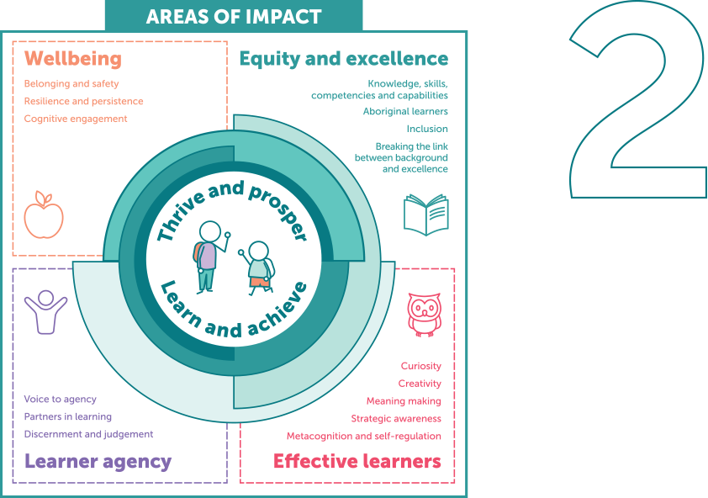
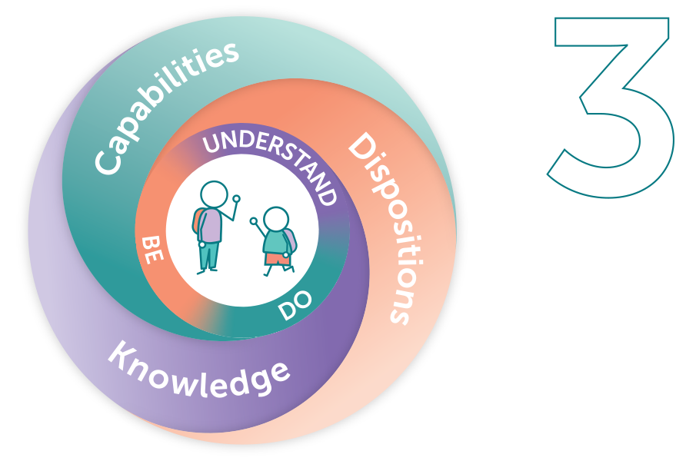
2.3 | The choices we have made as a system
PAGE
8
Purpose-driven, data-informed
The first big choice is to be a purpose-driven, data-informed education system. Being purpose-driven,
we keep children and young people at the centre when we make decisions and deeply consider what improvement looks like as we work towards our purpose. Data informs us, learner outcomes define us.
………………………………………………………………………………………………………………………………………………………………………………………………………………………………........................................
Areas of impact
The second big choice is to define our areas of impact. We can do anything, but we can’t do everything, so we have made choices as a system based on evidence about what makes the biggest difference to students’ learning and lives. Because context matters, schools will identify their focus within these choices. As schools work on their focus area of impact/domain(s) they will open up opportunities to intentionally pursue other areas over time.
………………………………………………………………………………………………………………………………………………………………………………………………………………………………........................................
The SA Curriculum for public education
The third big choice is to ensure the curriculum aligns with our purpose and areas of impact. The SA Curriculum* will help guide teachers on what to focus on and emphasise as they intentionally design learning that develops dispositions, capabilities and knowledge to support our children and young people to learn and thrive.
* The SA Curriculum is an adaptation of the Australian Curriculum version 9.0.

Slide 10

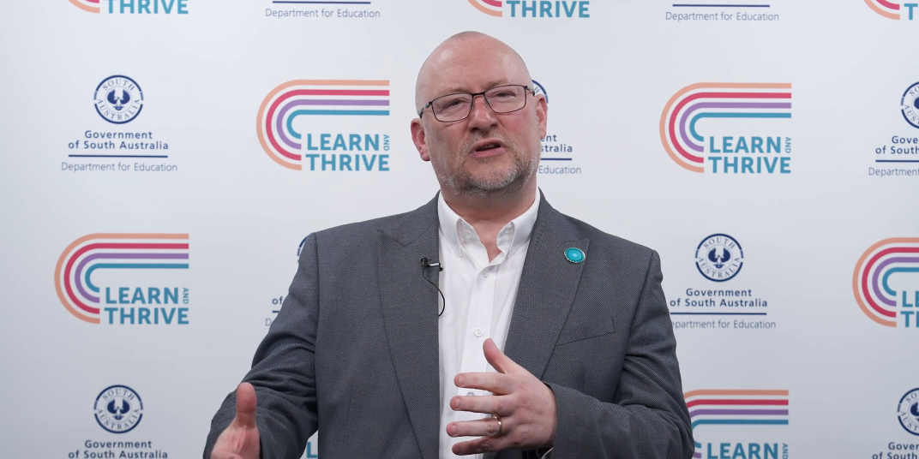
2.3 | Choice 1: Purpose-driven, data-informed
REFER TO PAGE 8 | Source: Department for Education 2024

Slide 11
2.3 | Choice 2: Areas of impact
REFER TO PAGE 8 | Source: Department for Education 2024a

Slide 12
2.3 | Choice 3: SA Curriculum for public education
REFER TO PAGE 8 | Source: Department for Education 2024b

Slide 13
2.3 | The choices we have made as a system
Why is it important to be purpose-driven and data-informed?
What do we see as the difference between being ‘purpose-driven and
data-informed’ rather than ‘data-driven’?
Being purpose-driven and data-informed guides us to think beyond standardised measures. Why does this matter for us and our learners?
REFER TO PAGE 8

Slide 14
2.3 | The choices we have made as a system
We can choose our focus area of impact/domain(s). Our focus will guide
and inform our work in curriculum and in the broader aspects of students’ experiences of school. How might this benefit us and our learners?
Our purpose statement says that ‘...we are relentless in our ambition for all children and young people to enter the world beyond the classroom ready to learn and to create opportunities to live a satisfying and fulfilling life of their choosing.’ How do we see the presence of dispositions and capabilities in the curriculum supporting this ambition?
REFER TO PAGE 8

Slide 15
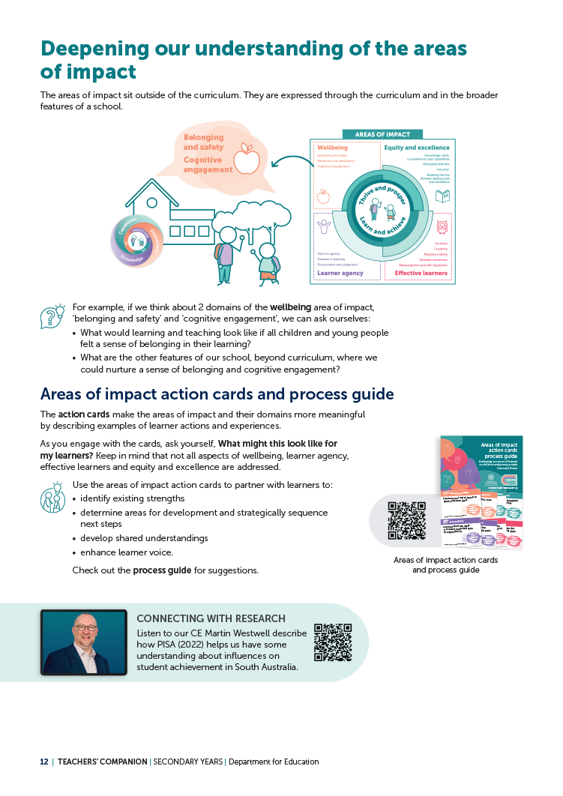
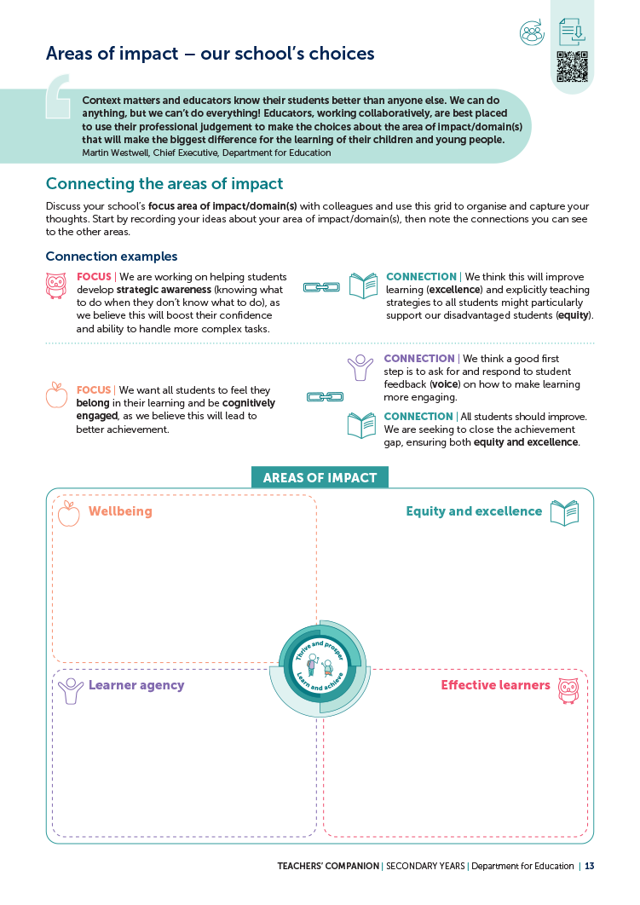
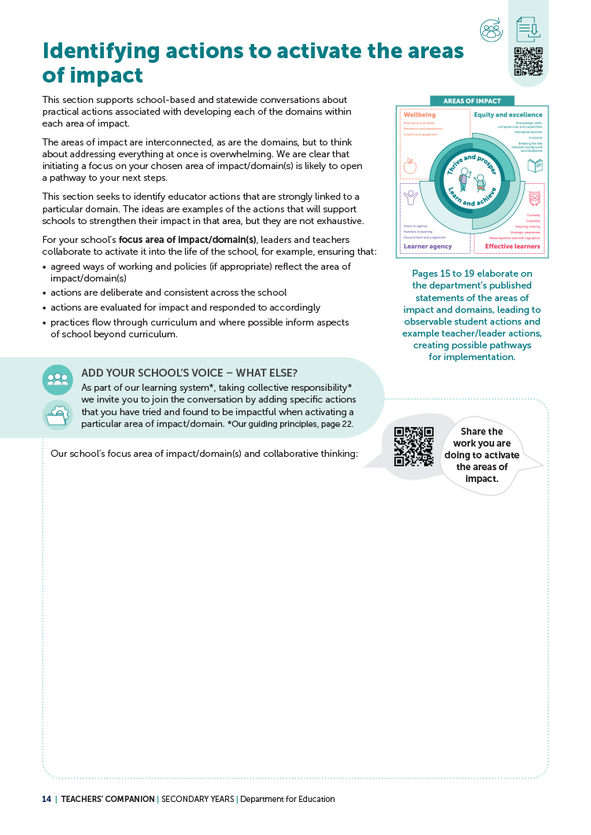
SECTION 3 | Unpacking our strategy for public education
REFER TO COMPANION PAGES 12 to 19, 22, 27 to 29, 39 to 43, 79 to 83 and 51 to 55

Slide 16

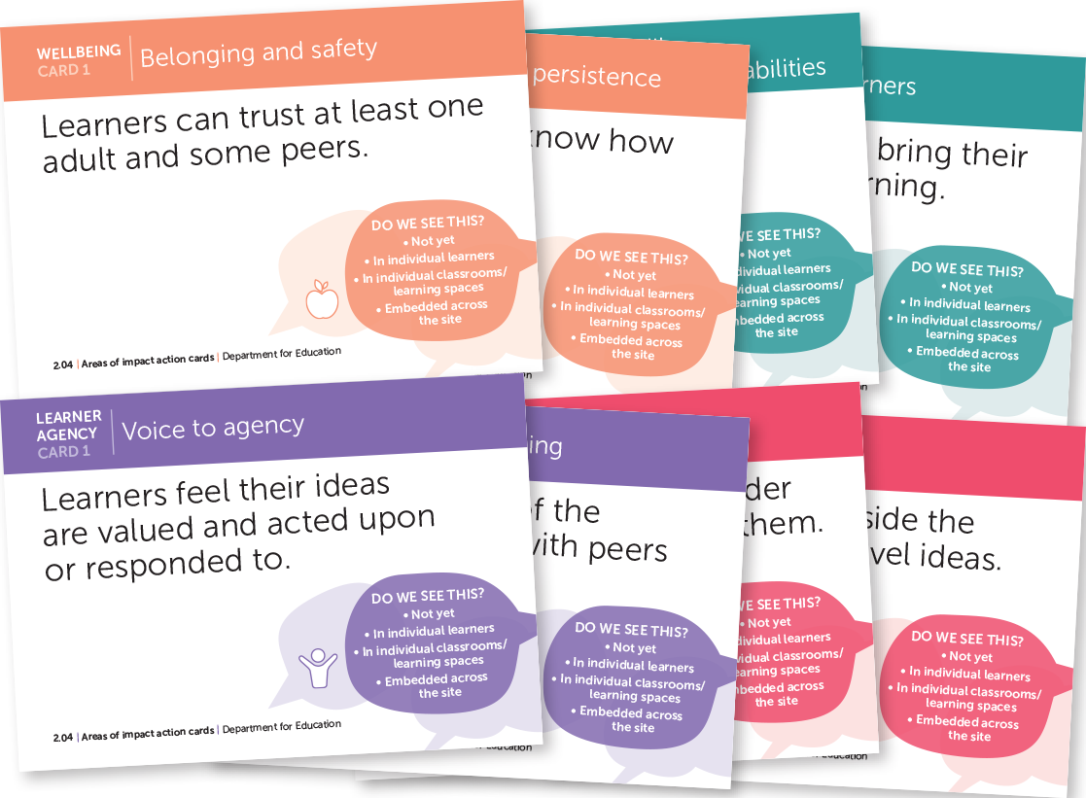

3.1 | Deepening our understanding of the areas of impact
PAGE
12
Reflecting on practice
Using the areas of impact action cards:
What are our existing strengths?
What could benefit from further development?
What could be our ‘step in’ to this space?
PARTNERS IN LEARNING
How could we use these cards
to partner with learners?

Slide 17
3.2 | Areas of impact – our school’s choices
PAGE
13
Getting familiar with our focus area of impact/domain(s)
Photo challenge
Take out your phone and open the photos app.
Randomly select a month and year.
Select a photo that connects to one or more area of impact/domain.
Explain the connection to a colleague, describing:
  the specific area of impact/domain(s) your photo relates to and
  if it relates to more than one – describe the connection(s)
  how your learners demonstrate this in your classroom.
REFER TO PAGE 13

Slide 18



3.2 | Photo challenge example
Jade selected a photo of her dog, Max, digging under the neighbour’s fence. She explains how Max, fuelled by curiosity, endured with his digging for days, changing strategies on several occasions until he
was able to squeeze his head through the hole, laying eyes on the neighbour’s yard.
Max showed curiosity because he wanted to know what was on the other side of the fence.
Max showed resilience and persistence because he kept going for days
on end until he achieved his goal.
REFER TO PAGE 13

Slide 19
3.2| Connections to other areas of impact
What connections do you see between our school’s chosen area of impact/
domain(s) and others?
See examples on page 13 of the companion.
REFER TO PAGE 13

Slide 20
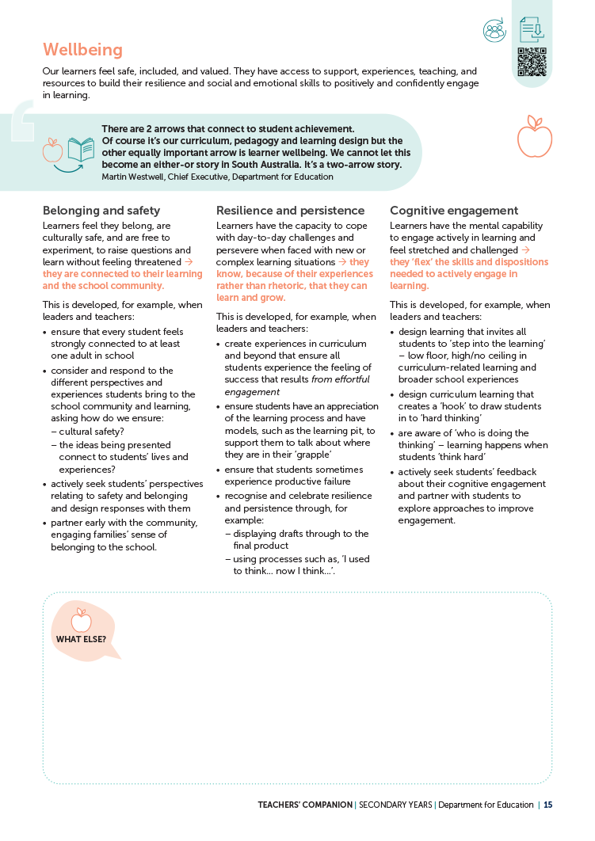

3.3| Identifying actions to activate the areas of impact
PAGE
15
Wellbeing
Imagine an observer spent a day in your learning environment. Highlight each action according to
the following criteria.
Green – This would be hard to miss in my learning environment.
Yellow – This might be observed on occasion.
Pink – This is not likely to be seen.

Slide 21
3.3| Identifying actions to activate the areas of impact
Individually, consider:
Which 1, 2 or 3 actions do you believe will have the greatest impact on your learners? Why?
What other actions (not listed on the page) might
be impactful for your learners? Why?
Share your perspective with the wider group,
then discuss and record:
the consistencies that are evident within the
group’s discussion
how this might inform the next steps for your team.
REFER TO PAGE 15

Slide 22
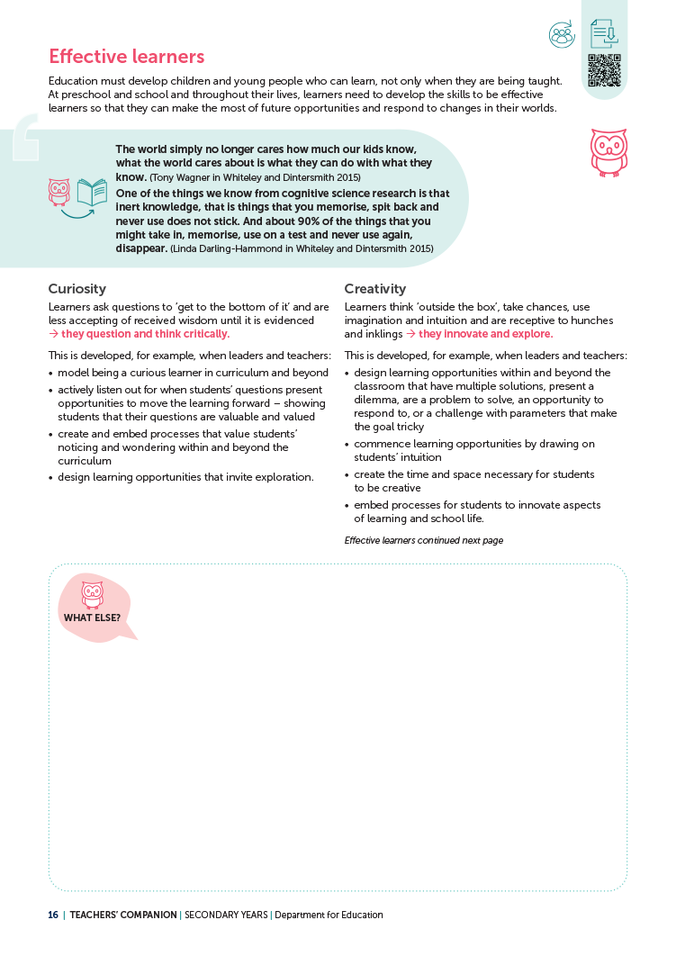
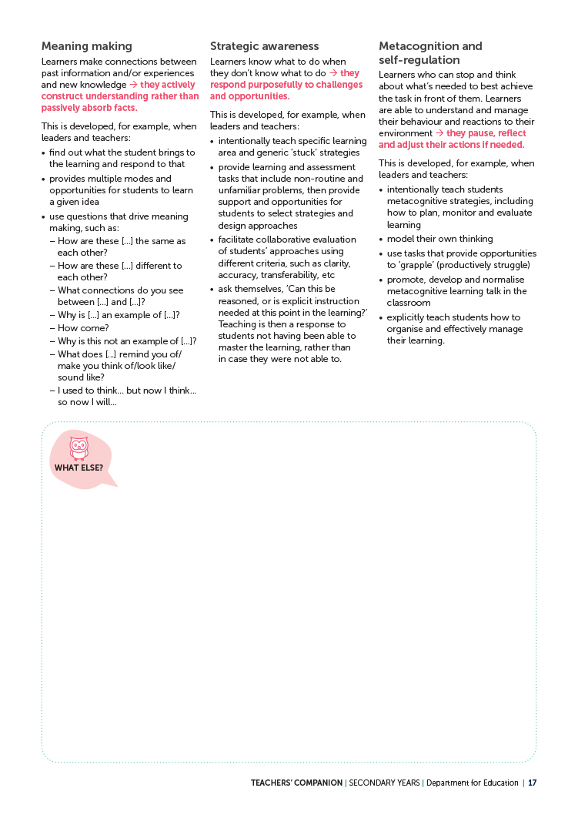
3.3| Identifying actions to activate the areas of impact
PAGES
16–17
Effective learners
Imagine an observer spent a day in your learning environment. Highlight each action according to
the following criteria.
Green – This would be hard to miss in my learning environment.
Yellow – This might be observed on occasion.
Pink – This is not likely to be seen.

Slide 23
3.3| Identifying actions to activate the areas of impact
Individually, consider:
Which 1, 2 or 3 actions do you believe will have the greatest impact on your learners? Why?
What other actions (not listed on the page) might
be impactful for your learners? Why?
Share your perspective with the wider group,
then discuss and record:
the consistencies that are evident within the
group’s discussion
how this might inform the next steps for your team.
REFER TO PAGES 16 and 17

Slide 24
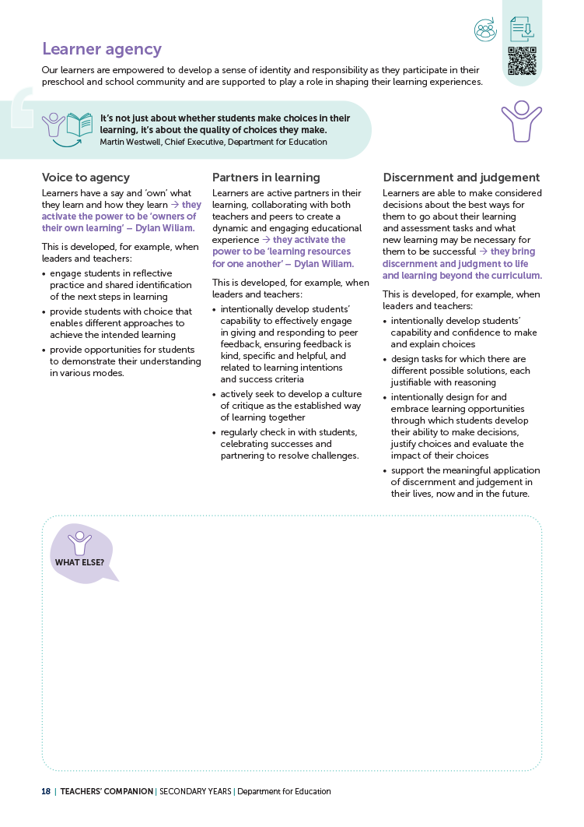
3.3| Identifying actions to activate the areas of impact
PAGE
18
Learner agency
Imagine an observer spent a day in your learning environment. Highlight each action according to
the following criteria.
Green – This would be hard to miss in my learning environment.
Yellow – This might be observed on occasion.
Pink – This is not likely to be seen.

Slide 25
3.3| Identifying actions to activate the areas of impact
Individually, consider:
Which 1, 2 or 3 actions do you believe will have the greatest impact on your learners? Why?
What other actions (not listed on the page) might
be impactful for your learners? Why?
Share your perspective with the wider group,
then discuss and record:
the consistencies that are evident within the
group’s discussion
how this might inform the next steps for your team.
REFER TO PAGE 18

Slide 26
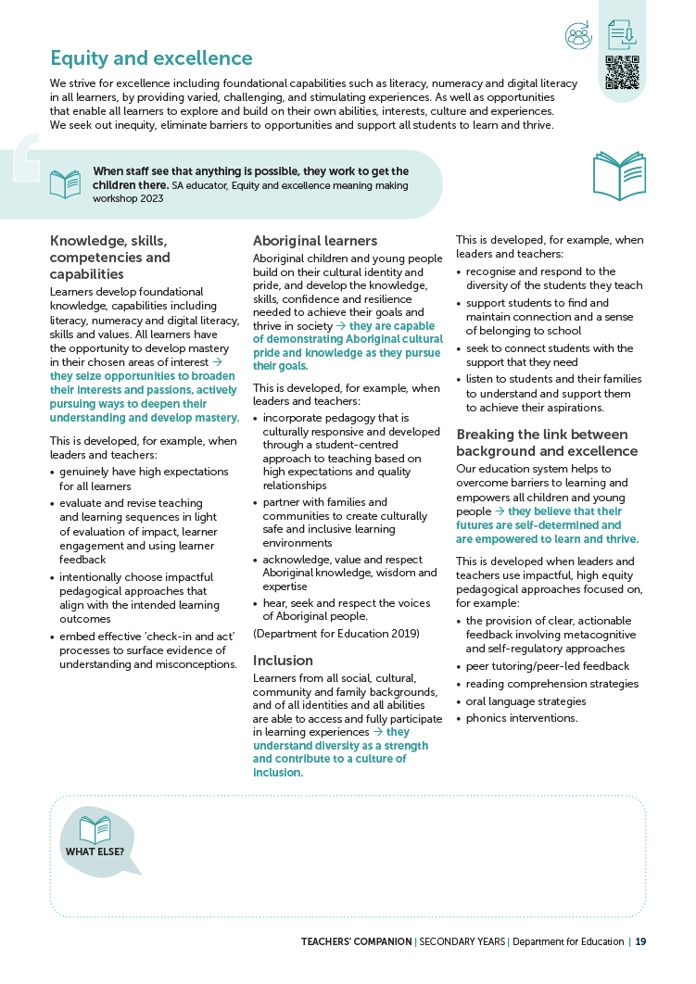
3.3| Identifying actions to activate the areas of impact
PAGE
19
Equity and excellence
Imagine an observer spent a day in your learning environment. Highlight each action according to
the following criteria.
Green – This would be hard to miss in my learning environment.
Yellow – This might be observed on occasion.
Pink – This is not likely to be seen.

Slide 27
3.3| Identifying actions to activate the areas of impact
Individually, consider:
Which 1, 2 or 3 actions do you believe will have the greatest impact on your learners? Why?
What other actions (not listed on the page) might
be impactful for your learners? Why?
Share your perspective with the wider group,
then discuss and record:
the consistencies that are evident within the
group’s discussion
how this might inform the next steps for your team.
REFER TO PAGE 19

Slide 28
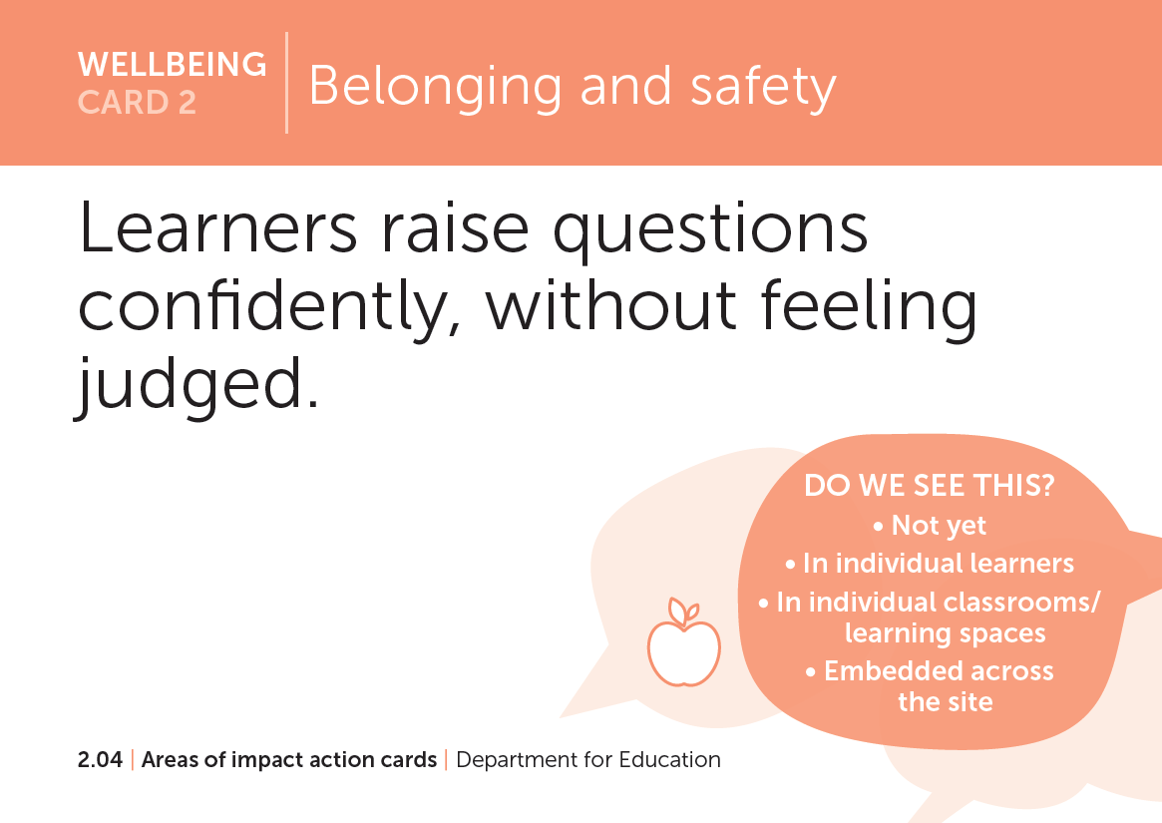
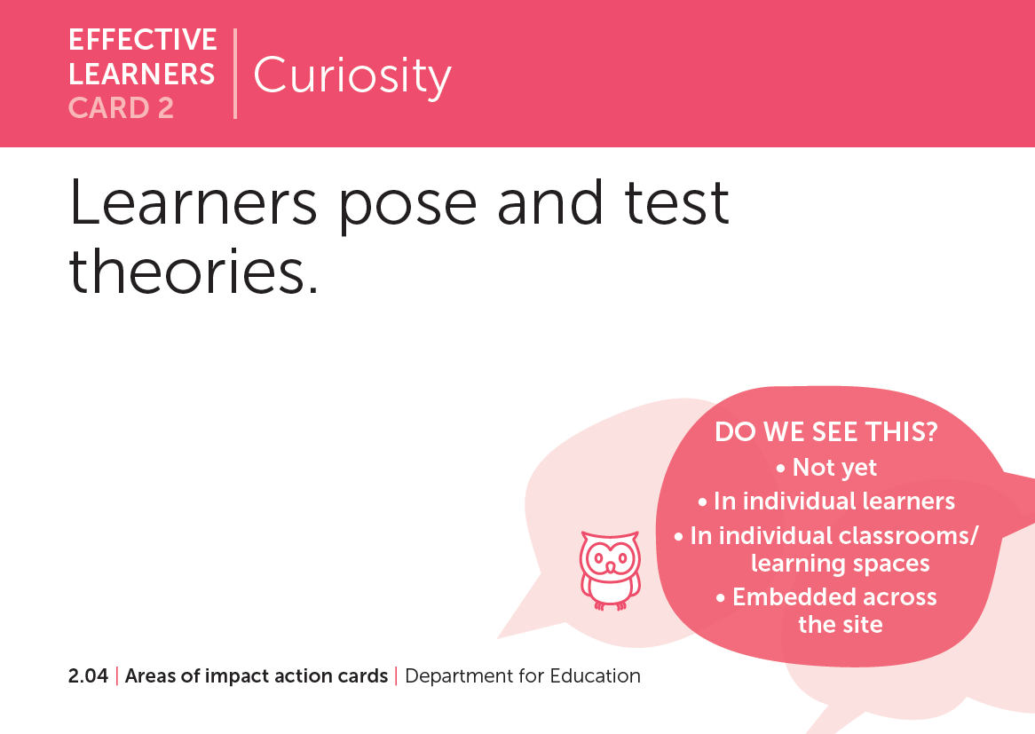
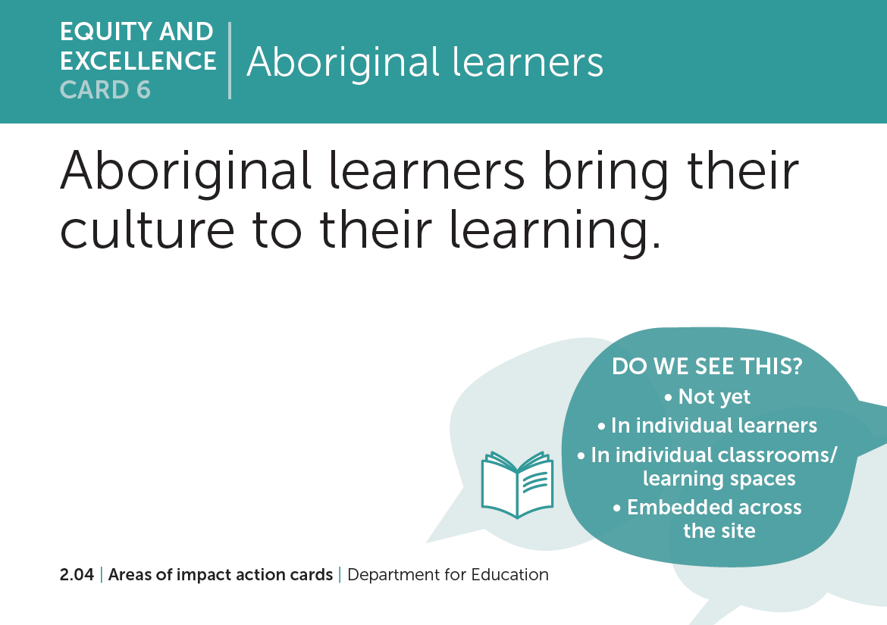
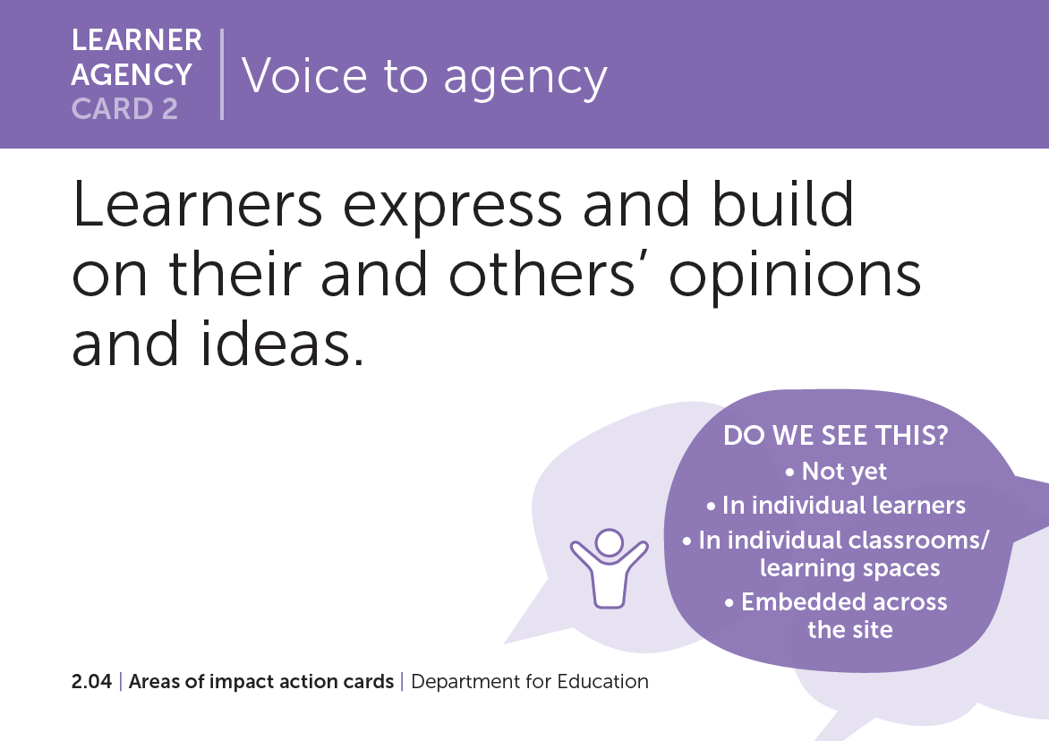
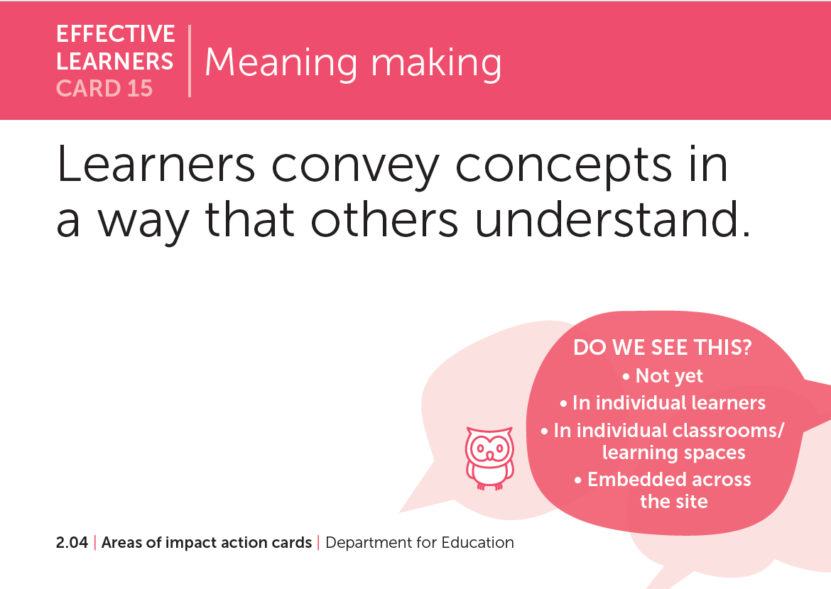
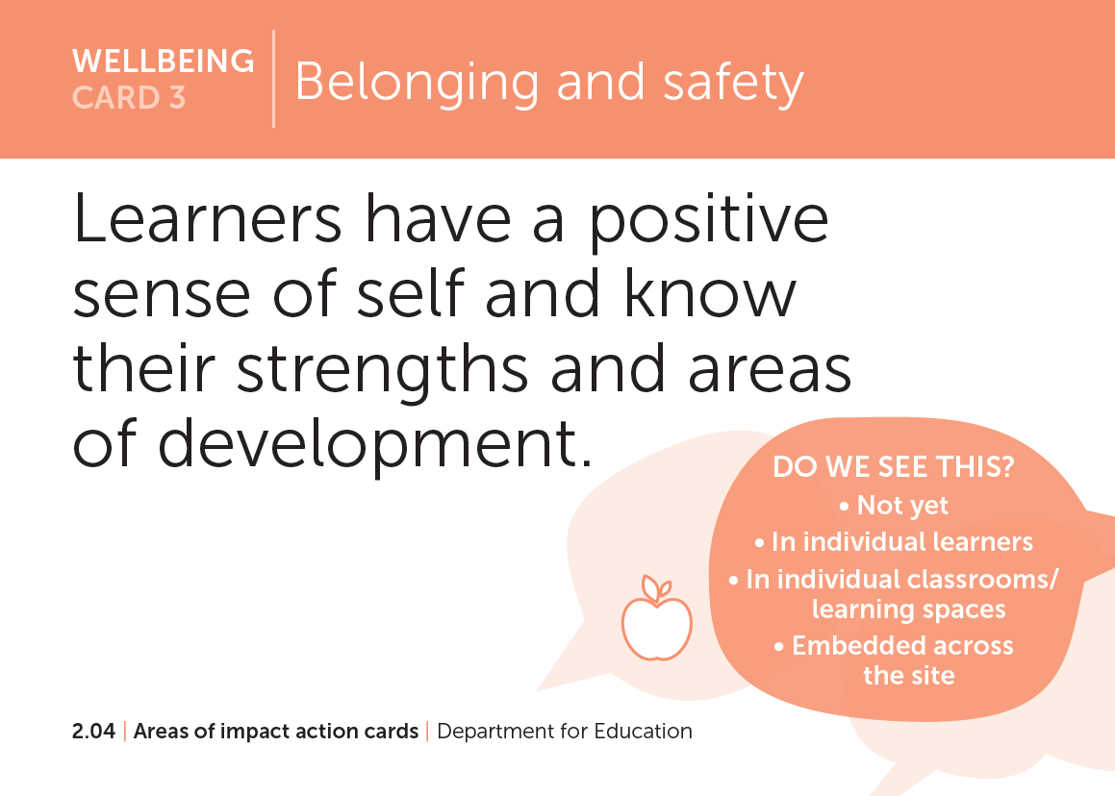
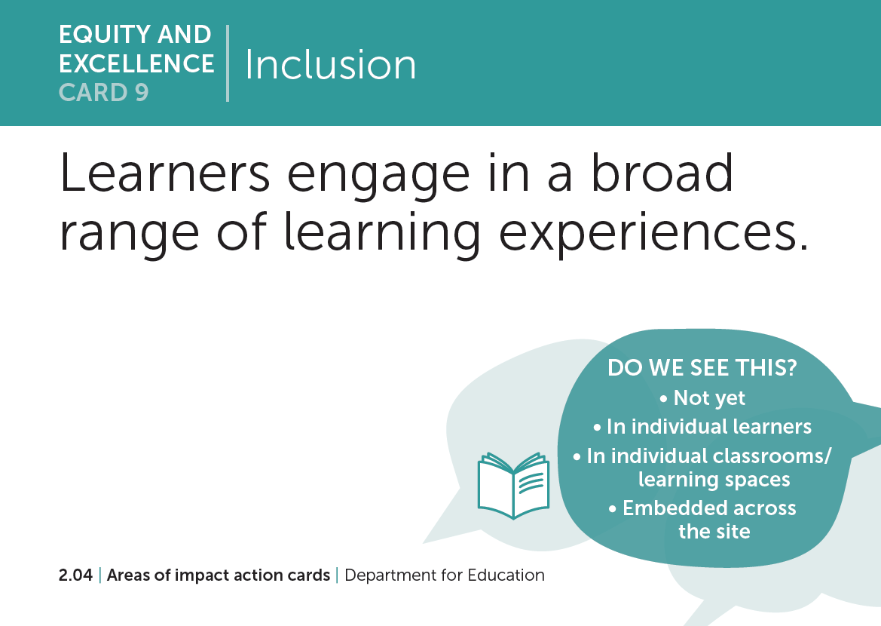

3.3| Identifying actions to activate the areas of impact
What student actions (cards) might manifest from the listed teacher actions in the companion?
REFER TO PAGES 15 to 19

Slide 29
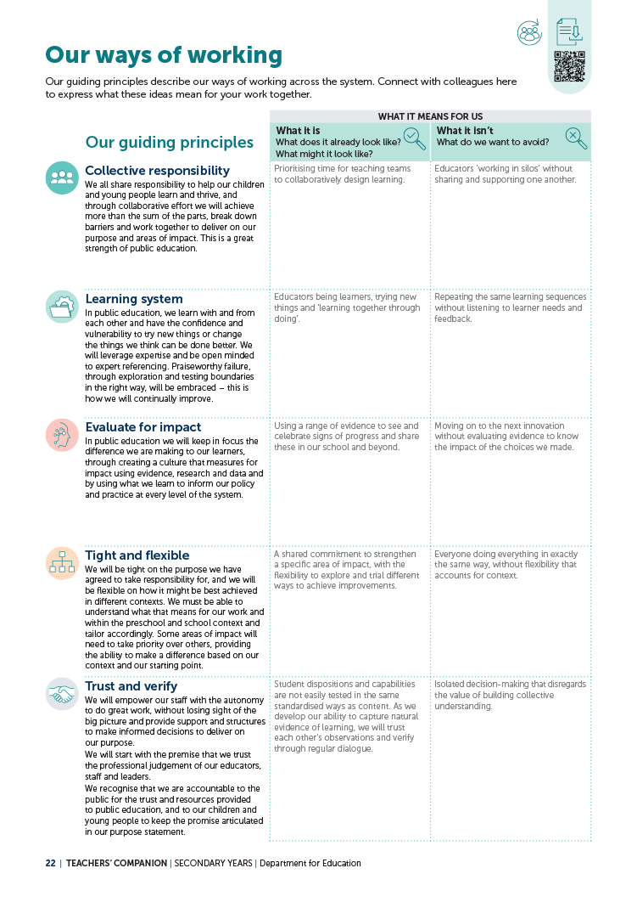
3.4| Our ways of working
PAGE
19
Our guiding principles
What does collaboration look like for us now?
How do our current ways of working and being align with
or differ from the guiding principles?
What challenges might exist to implementing these principles and how might we address them?
What behaviours and practices would demonstrate each principle?
How will we know if we’re successfully embedding these principles?
In small groups, reflect on our day-to-day work and record an example of what each principle is and isn’t on page 22 of the companion.

Slide 30
3.5| Building coherence for our learners
PAGES
27–29
Initial brainstorm
In relation to the 4 areas of impact and the presence of dispositions and capabilities in the SA Curriculum prototype, what connections do you anticipate (or know) exist between these features of our strategy and the:
Early Years Learning Framework (EYLF 2.0)?
innovation occurring in the SACE?

Slide 31
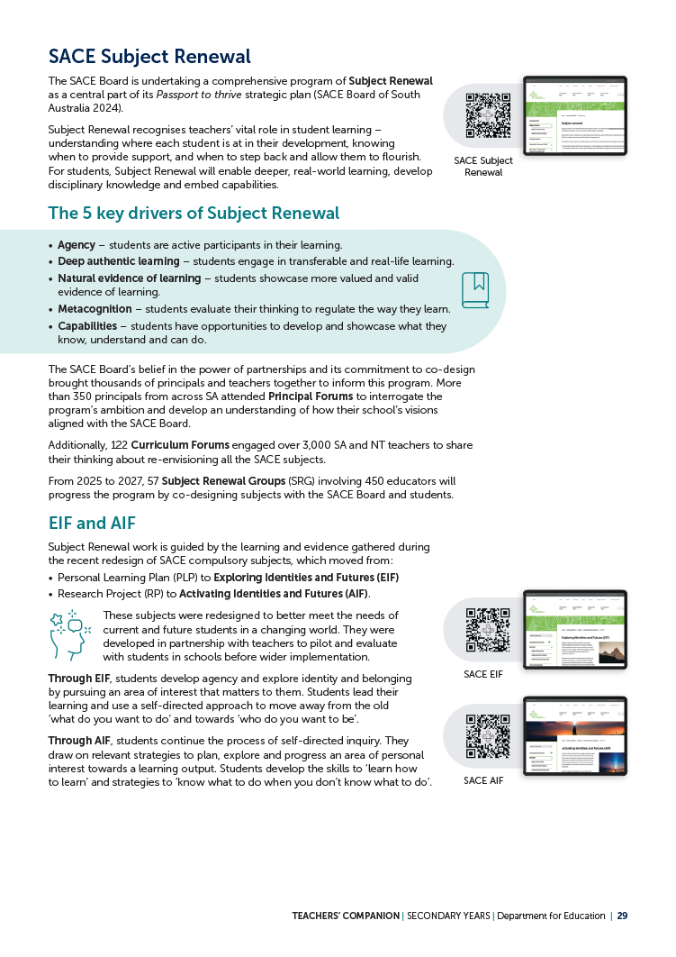
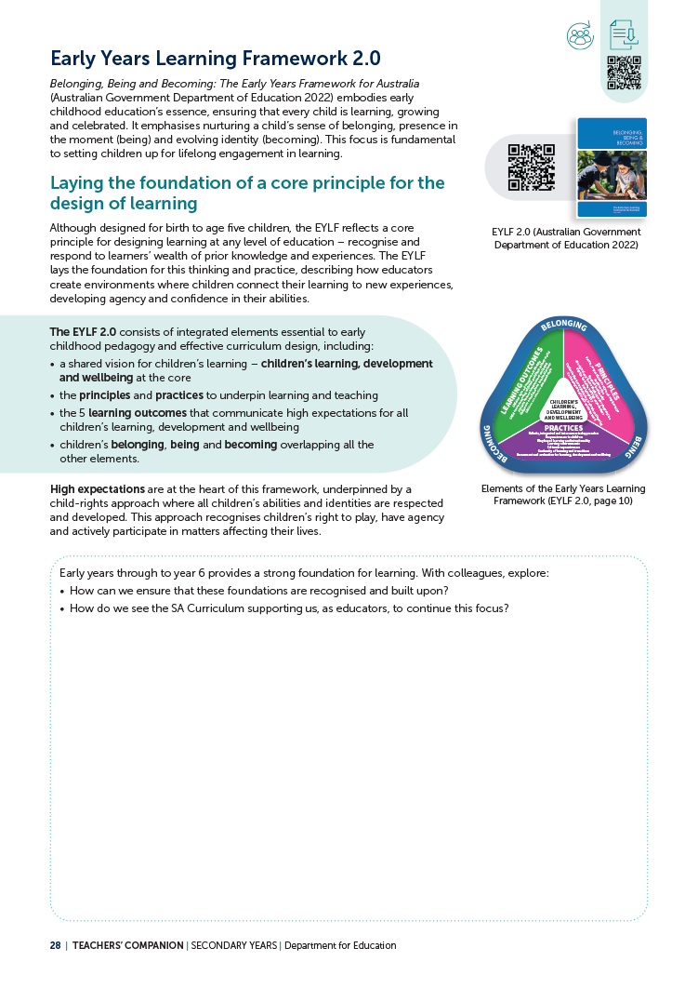
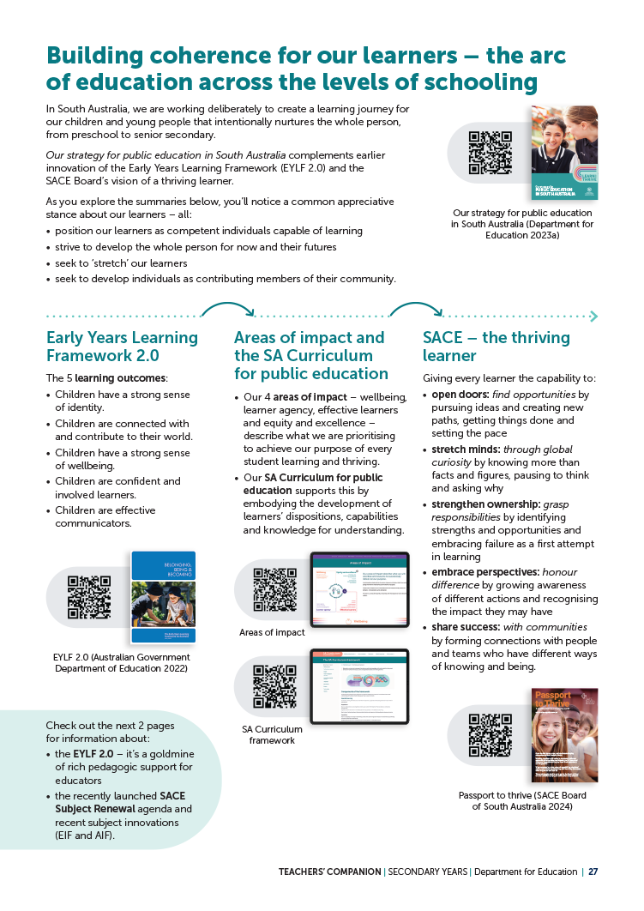
3.5| Building coherence for our learners
Read pages 27 to 29 of the companion
Individual reading time (10 minutes).
Use the relevant area of impact action cards
to narrow your focus as you read.
You may find it useful to extend your reading later using the QR links provided on the companion pages.
REFER TO PAGES 27 to 29

Slide 32
3.5| Building coherence for our learners
After reading
Individually, generate a list of important connections between our focus area of impact/domains(s), the EYLF 2.0 and the SACE.
(2 to 3 minutes)
REFER TO PAGES 27 to 29

Slide 33
3.5| Building coherence for our learners
Add one routine
Form small groups (4 to 5 people).
  Pass your paper to the person on your right.
  Take 1 to 2 minutes to read the paper in front you, then add one new connection to the list (the addition could be an elaboration, a new point, or a relationship between multiple ideas).
  Rotate papers until you have received yours back and read your group members’ contributions.
REFER TO PAGES 27 to 29
Adapted from Project Zero’s +1 Routine (President and Fellows of Harvard College and Project Zero 2019)

Slide 34
3.5| Building coherence for our learners
Add one routine
After completing a rotation of add one, remain in small groups to identify and share 1 to 2 connections that you would like to follow-up to enrich your understanding of the focus area of impact/domain(s) further.
Share your thinking with the wider group.
REFER TO PAGES 27 to 29
Adapted from Project Zero’s +1 Routine (President and Fellows of Harvard College and Project Zero 2019)

Slide 35
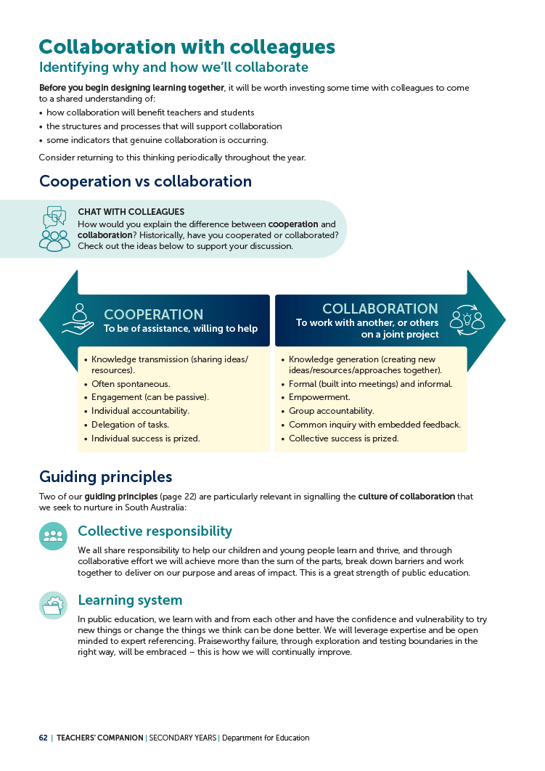
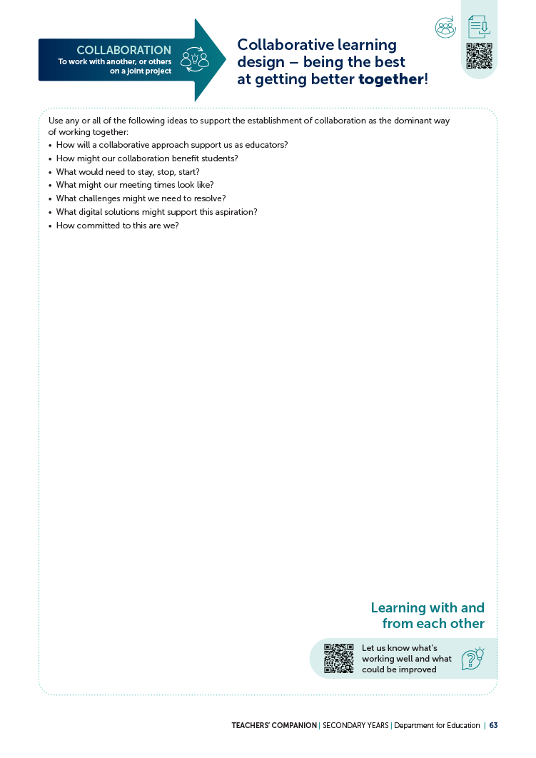
SECTION 4 | Culture of collaboration
REFER TO COMPANION PAGES 62 to 63

Slide 36
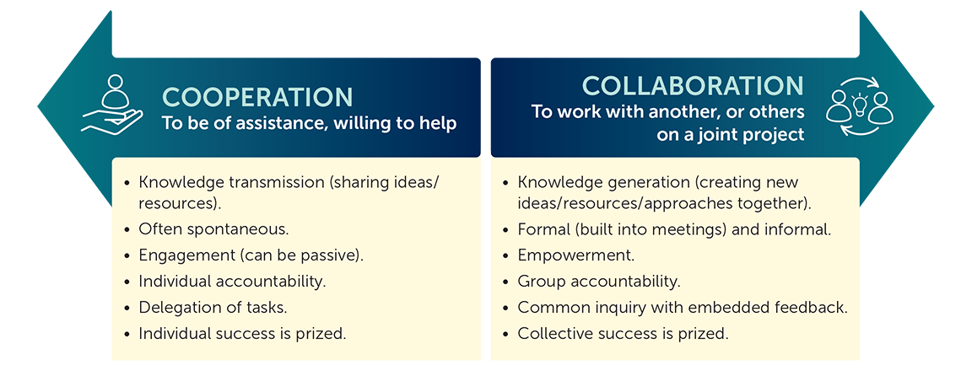
4.1| Collaboration with colleagues
PAGES
62 to 63
Historically, have we worked in a way that is more ‘cooperative’
or ‘collaborative?

Slide 37
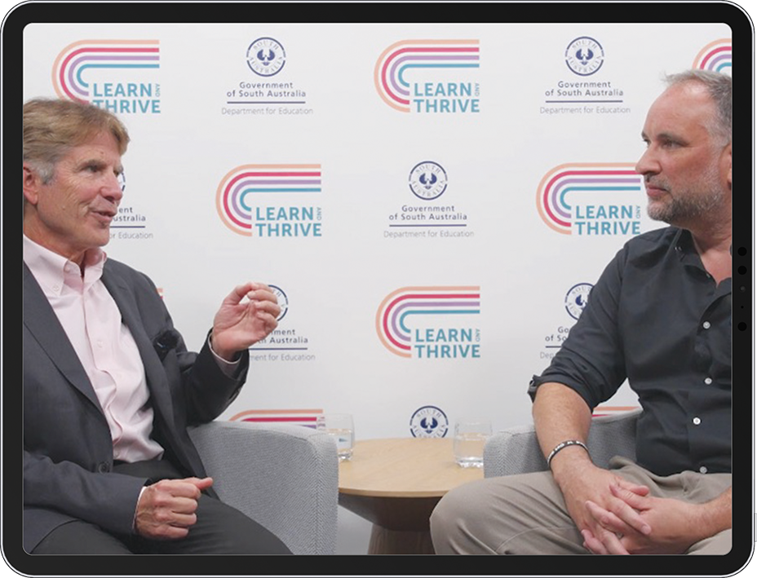
4.1| Collaboration with colleagues
Educators as collaborators
Source: Department for Education 2024d

Slide 38
4.1 | Collaboration with colleagues
Why and how we’ll collaborate
What might collaboration look like for us this year?
Use the questions on page 63 to guide your discussion and record your
individual takeaways.
REFER TO PAGES 62 to 63

Slide 39
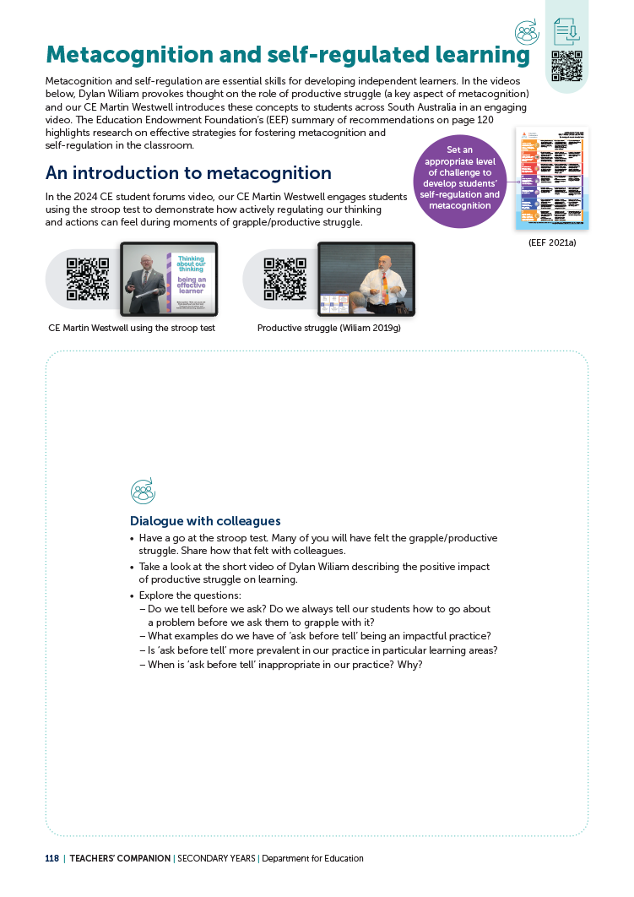
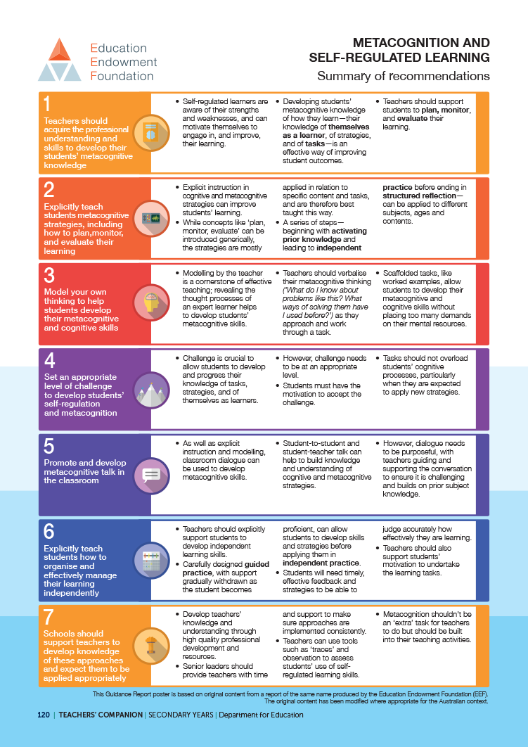
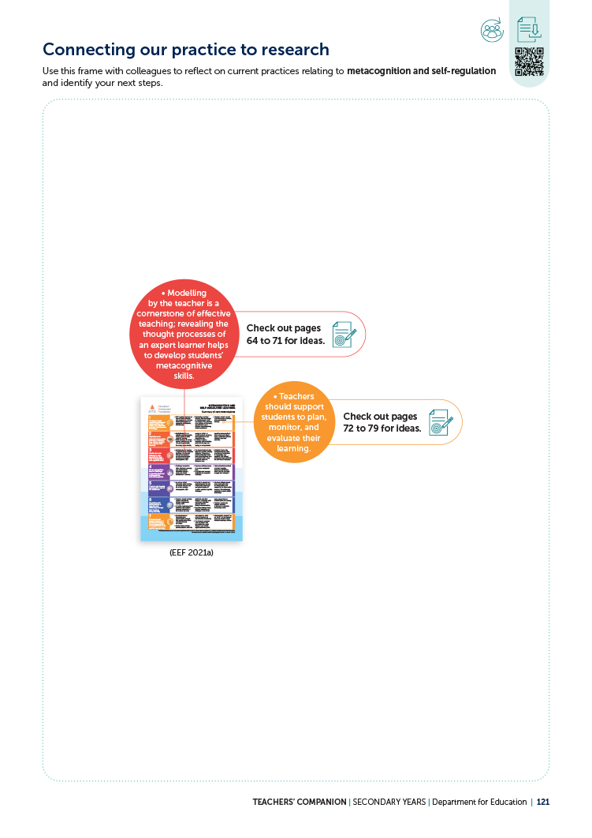
SECTION 5 | Metacognition and self-regulated learning
REFER TO COMPANION PAGES 118, 120 to 121 and 64 to 66

Slide 40
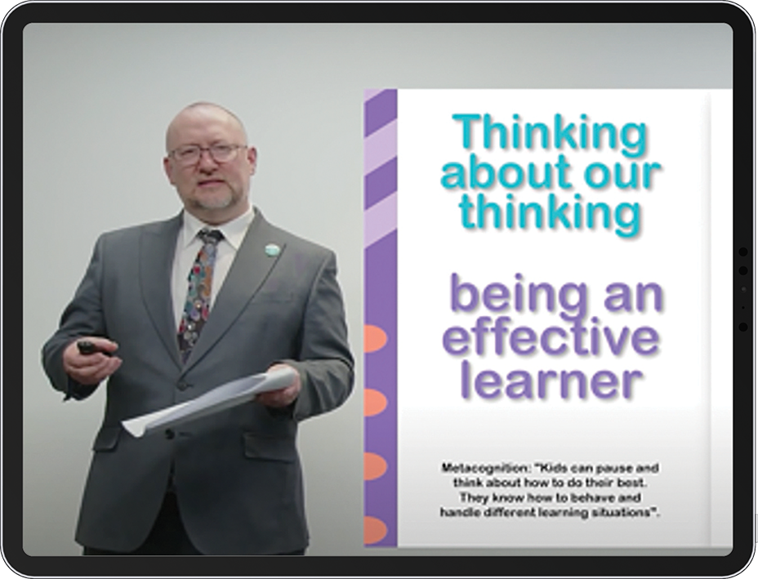
5.1| Productive struggle
PAGE
118
Introduction to metacognition and self-regulation
Have a go at the Stroop test as we watch!
After watching the video, discuss...
How did it feel?
Source: Department for Education 2024g

Slide 41
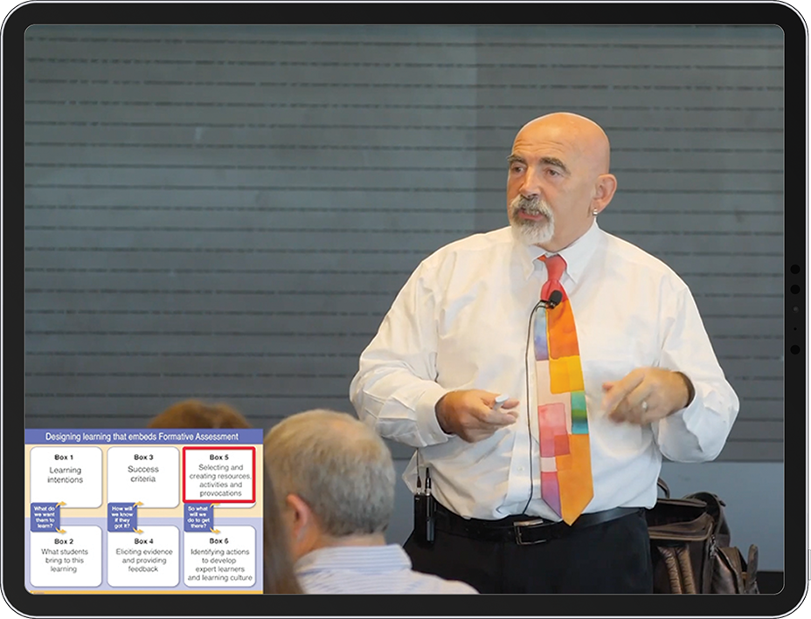
5.1| Productive struggle
REFER TO PAGE 118 | Source: Wiliam 2019c

Slide 42
5.1| Productive struggle
How do we currently design for productive struggle?
Use the questions on page 118 of your companion to guide your discussion.
REFER TO PAGE 118

Slide 43
5.1| Productive struggle
With your colleagues, consider the following:
How might we design for productive struggle in our upcoming learning?
How might we ensure that every learner can experience this?
How might we partner with learners to design learning at an appropriate level of challenge?
REFER TO PAGE 118

Slide 44
5.2| EEF Metacognition and self-regulated learning
PAGES
120 to 121
How are we going?
For each recommended action on the EEF poster, identify our current practice as:
embedded
progressing
emerging
not yet introduced.
Source: EEF 2021

Slide 45
5.2| EEF Metacognition and self-regulated learning
What are your team’s agreed next steps?
Record your agreed next steps on page 121 of your companion.
REFER TO PAGES 120 to 121

Slide 46

5.3| Creating think alouds
PAGES
64 to 66
Source: Smekens Education Solutions Inc 2019

Slide 47
5.3| Creating think alouds
Your experience of think alouds
When have you learned from another person modelling their thinking out loud? Consider all settings, not just formal learning!
REFER TO PAGES 64 to 66

Slide 48
5.3| Creating think alouds
Share your experience of think alouds
With a partner, discuss:
How did being exposed to another person’s thinking support your learning in your chosen example?
REFER TO PAGES 64 to 66

Slide 49
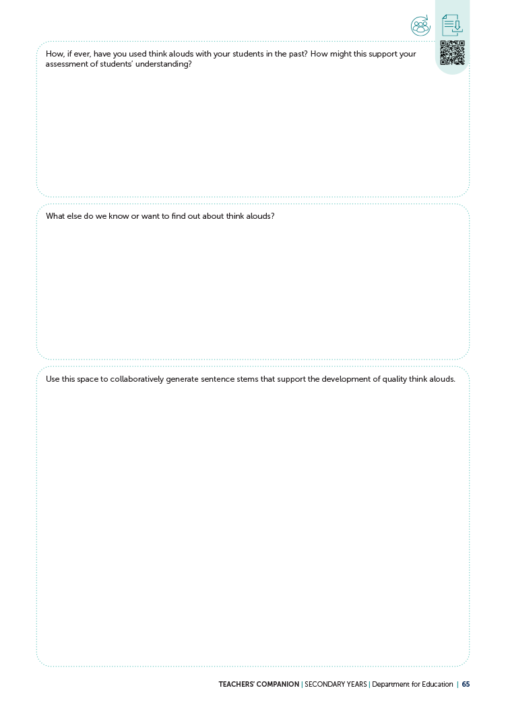
5.3| Creating think alouds
Current practice with think alouds
With a partner, discuss and respond to the questions on page 65 of the companion.
REFER TO PAGES 64 to 66

Slide 50
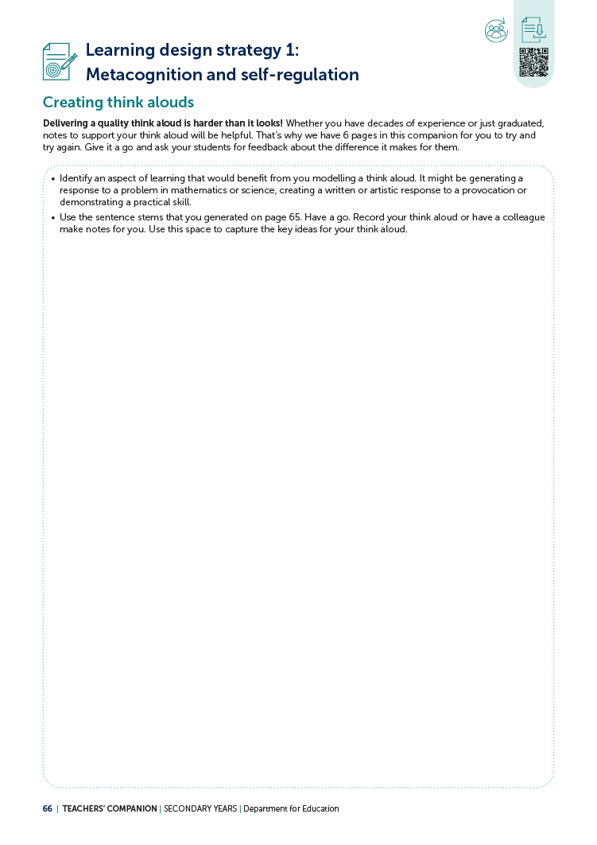
5.3| Creating think alouds
Planning for think alouds
What will be your ‘step in’ or ‘next step’ for think alouds?
Record your thinking on page 66 of the companion.
REFER TO PAGES 64 to 66

Slide 51
5.4| Scaffolding for planning, monitoring and evaluating
EEF Metacognition and self-regulated learning
Take some time to read the recommendations from the Education Endowment Foundation’s research.
PAGES
72–74
+ 120
Source: EEF 2021

Slide 52
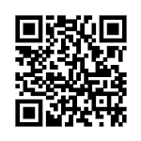
5.4| Scaffolding for planning, monitoring and evaluating
Considering a task
Explore the Dan Meyer (2012) ‘Popcorn picker’ online task page.
Which of the EEF recommendations are evident?
http://curriculumlearningsa.shor.tn/PopcornPicker
REFER TO PAGES 72 to 74 and 120 | Source: EEF 2021

Slide 53
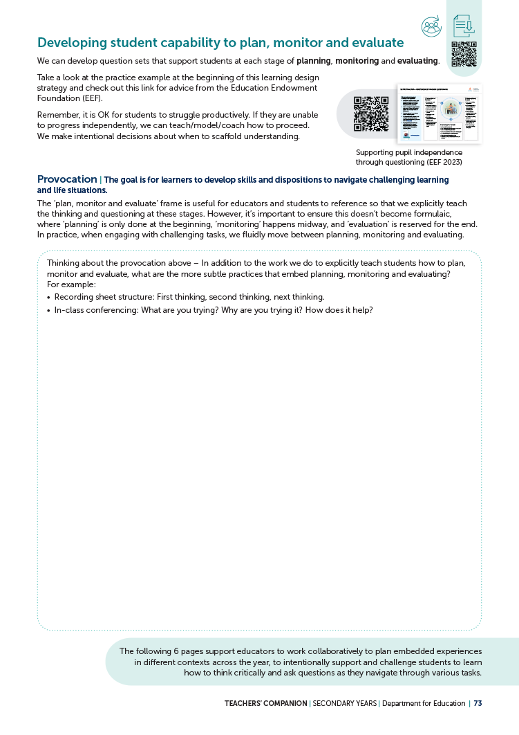
5.4| Scaffolding for planning, monitoring and evaluating
Implicit practices for planning, monitoring
and evaluating
What more subtle practices support students to embed planning, monitoring and evaluating?
Consider and respond to the questions on page 73 of the companion.
REFER TO PAGES 72 to 74 and 120

Slide 54
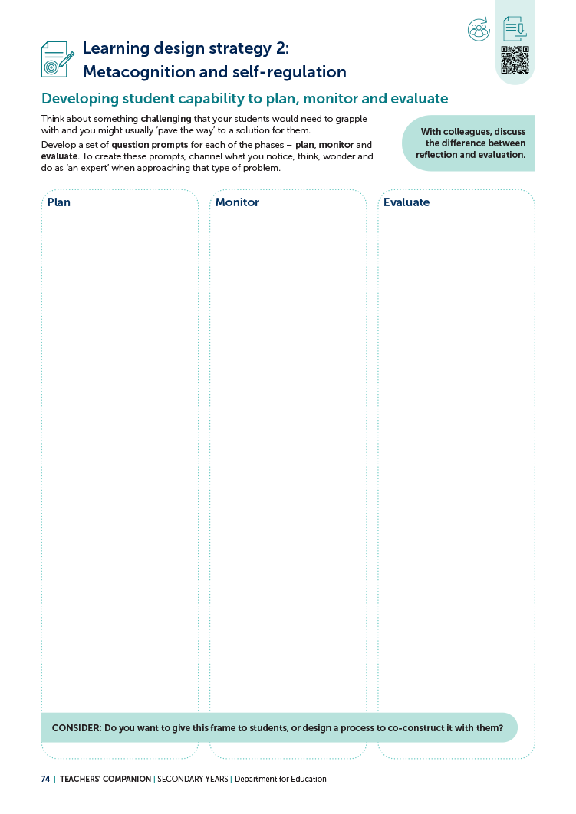
5.4| Scaffolding for planning, monitoring and evaluating
Planning to scaffold
Consider a learning experience your students will engage with soon.
How might you use questions to support your learners to plan, monitor and evaluate?
Record your thinking on page 74 of the companion.
REFER TO PAGES 72 to 74 and 120

Slide 55
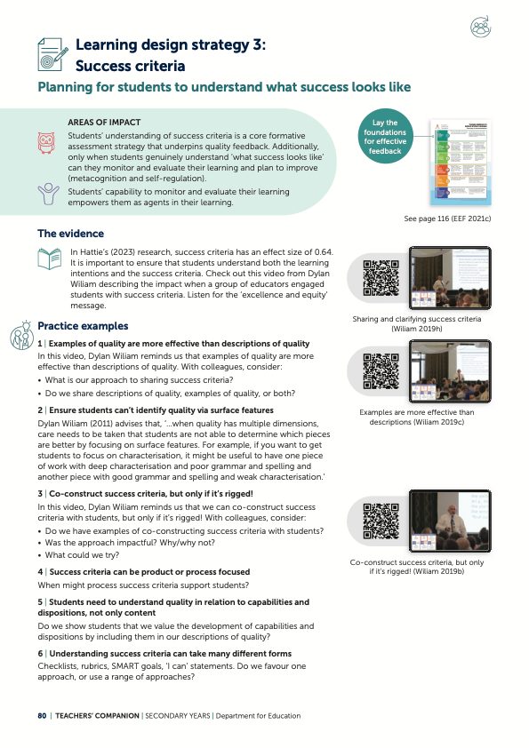
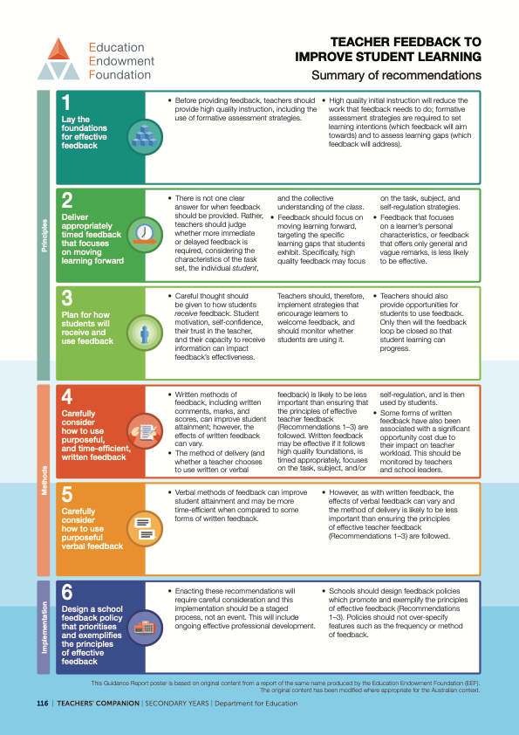
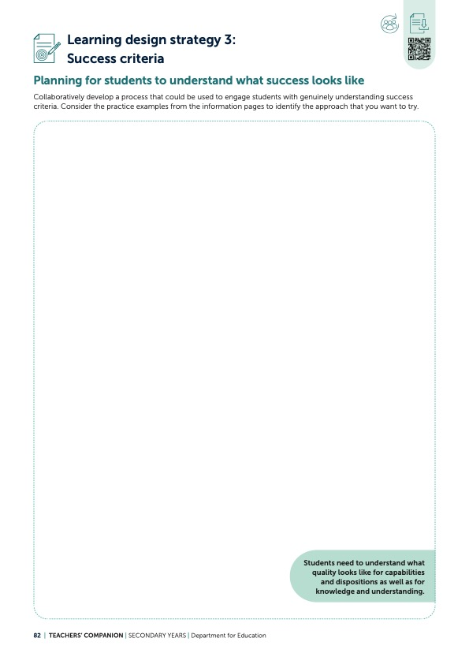
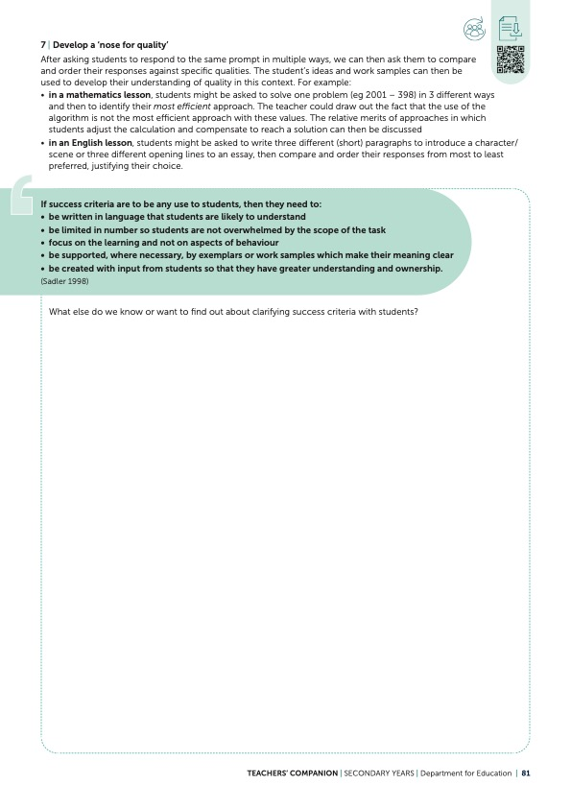
SECTION 6 | Success criteria
REFER TO COMPANION PAGES 80 to 82 and 116

Slide 56
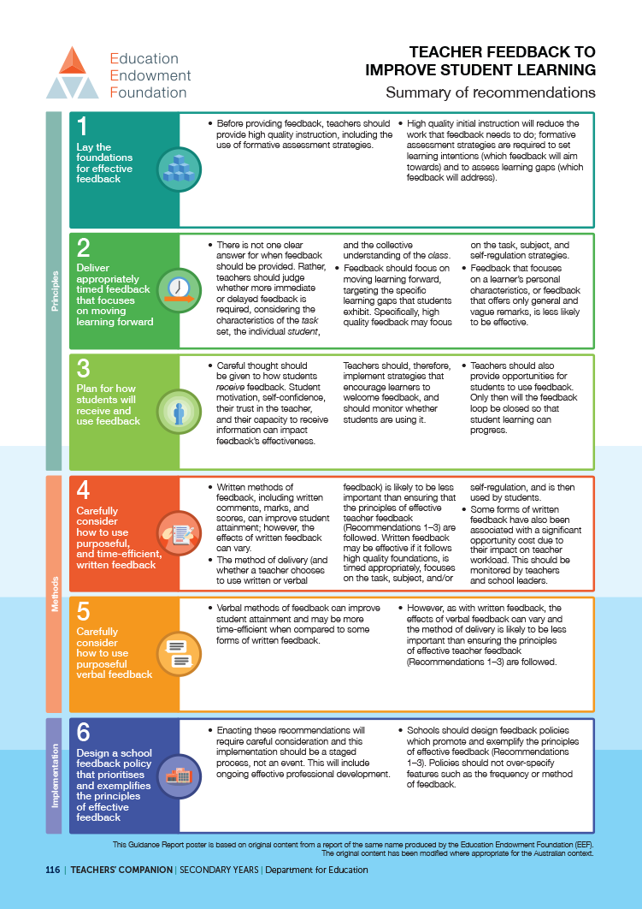
6.1| Planning for students to understand what success looks like
PAGES
80–82
+ 116
EEF Teacher feedback to improve student learning
Take some time to read the recommendations from the Education Endowment Foundation’s research.
Source: EEF 2021a

Slide 57
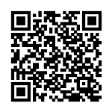
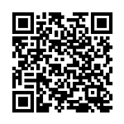
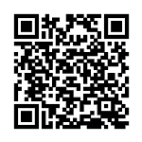
6.1| Planning for students to understand what success looks like
Jigsaw routine – video viewing
Form 3 expert groups and view one video per group, keeping the EEF research about feedback in mind.
Group 1
Group 2
Group 3
Source: Wiliam 2019
Source: Wiliam 2019a
Source: Wiliam 2019d
REFER TO PAGES PAGES 80 to 82 and 116

Slide 58
6.1| Planning for students to understand what success looks like
Jigsaw routine – video ‘expert’ groups
In your expert groups, discuss:
How did the practice in your video connect to the EEF recommendations
on feedback?
REFER TO PAGES PAGES 80 to 82 and 116

Slide 59



6.1| Planning for students to understand what success looks like
Jigsaw routine – video ‘jigsaw’ groups
Form a jigsaw group of 3, with each member having
viewed a different video.
Share the connections you noticed between your video and the EEF recommendations.
REFER TO PAGES PAGES 80 to 82 and 116

Slide 60
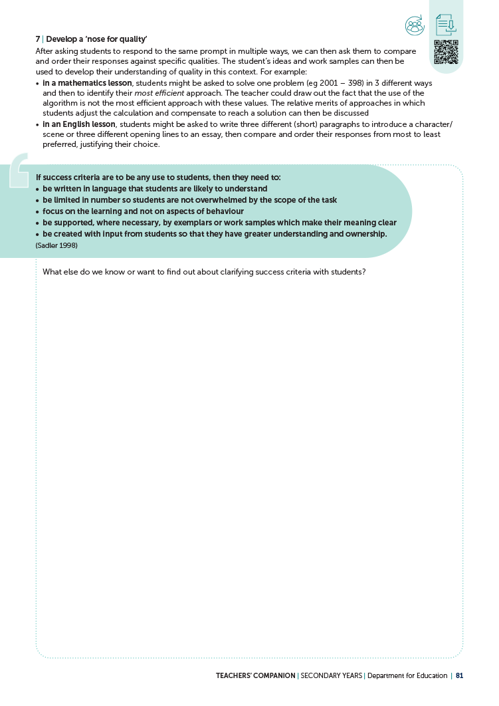
6.1| Planning for students to understand what success looks like
Planning for success criteria
Remaining in your jigsaw groups, discuss:
What else do we know or want to find out about clarifying success criteria with students?
Record your thinking on page 81 of the companion.
REFER TO PAGES PAGES 80 to 82 and 116

Slide 61
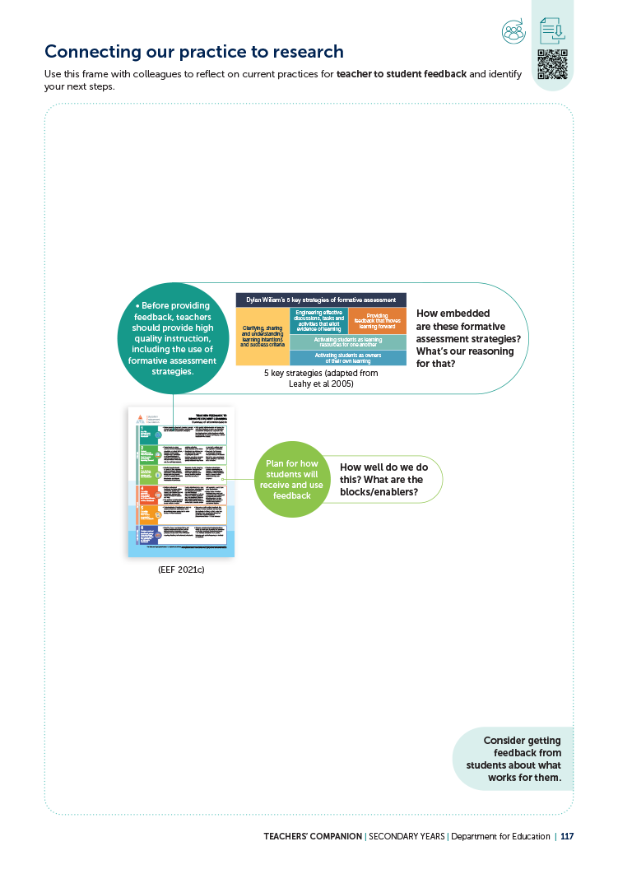
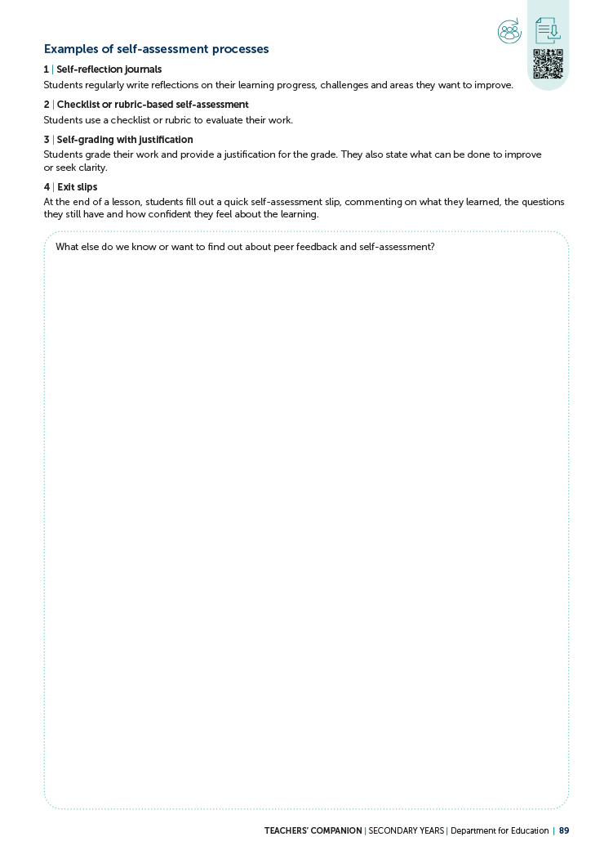

SECTION 7 | Feedback
REFER TO COMPANION PAGES 116 to 117, 89 and the guided notetaking handout

Slide 62
7.1 | The many connections to feedback
PAGE
89 + handout
Peer feedback and self-assessment –
guided notetaking
Use the guided notetaking handout as we view the following video.
Note: The handout is arranged to work from right to left, so that when you return to it,
you will notice your ‘So what?’ actions first.

Slide 63
7.1 | The many connections to feedback
Culture of critique
REFER TO PAGE 89 and guided notetaking handout | Source: Department for Education 2024c

Slide 64
7.1 | The many connections to feedback
Culture of critique
Let’s view the video again and add more to our notes.
This time as you watch, use a different lens!
For example, if you viewed the video through a classroom practice lens the first time, then view it now through the lens of how you work with colleagues.
REFER TO PAGE 89 and guided notetaking handout

Slide 65
7.1 | The many connections to feedback
Culture of critique
REFER TO PAGE 89 and guided notetaking handout | Source: Department for Education 2024c

Slide 66

7.1 | The many connections to feedback
So what?
Which of your ‘So what?’ notes might you action to take a ‘step in’ or ‘next step’ in developing a culture of critique?
REFER TO PAGE 89 and guided notetaking handout

Slide 67

7.1 | The many connections to feedback
In small groups, discuss:
How might peer feedback, self-assessment and a culture of critique help us with our chosen area of impact/domain(s)?
How does peer feedback, self-assessment and
a culture of critique connect with other areas
of impact or domains?
If we choose to be intentional with these strategies, what impact could they have for
our students?
REFER TO PAGE 89 and guided notetaking handout

Slide 68
7.1 | The many connections to feedback
Planning for your learning
Keeping in mind the connections we have made
with our focus area of impact/domain(s), discuss:
What else do we know or want to find out about peer feedback and self-assessment?
Record your thinking on page 89 of the companion.
REFER TO PAGE 89 and guided notetaking handout

Slide 69
7.2| EEF Teacher feedback to improve student learning
PAGES
116 to 117
Take some time to read the recommendations from the Education Endowment Foundation’s research.
Source: EEF 2021a

Slide 70

7.2| EEF Teacher feedback to improve student learning
How are we going?
For each recommended action on the EEF poster, identify our current practice as:
embedded
progressing
emerging
not yet introduced.
REFER TO PAGES 116 to 117

Slide 71
7.2| EEF Teacher feedback to improve student learning
What are your team’s agreed next steps?
Record your agreed next steps on page 117 of your companion.
REFER TO PAGES 116 to 117

Slide 72



SECTION 8 | Checking for understanding
REFER TO COMPANION PAGES 96 to 98

Slide 73
8.1 | Engineering effective discussions to elicit evidence of understanding
PAGES
96 to 98
Take some time to read and engage with the content (including the videos) on page 96 of the companion.

Slide 74
8.1 | Engineering effective discussions to elicit evidence of understanding
Our existing practices
Discuss:
How do we already check for understanding with our students?
Do our learning and teaching plans clearly identify key prerequisite knowledge and common misconceptions that students could bring
to their learning?
What all student response processes are used at our school?
Are these processes in frequent use at all year levels and learning areas?
What are our opportunities for improvement here? Which of these might have the most impact for our learners?
REFER TO PAGES 96 to 98

Slide 75
8.1 | Engineering effective discussions to elicit evidence of understanding
Possible ‘small step’
Discuss:
What will be our ‘small step’ in relation to improving our checking
for understanding?
How might we incorporate this into an upcoming lesson or learning experience?
What learning might we need to do before we ‘step in’?
REFER TO PAGES 96 to 98

Slide 76
8.1 | Engineering effective discussions to elicit evidence of understanding
Planning for your ‘small step’
Use page 98 of the companion to plan your ’small step’.
When you action your ‘small step’, keep in mind that
we will come back together to reflect and learn with
and from each other.
REFER TO PAGES 96 to 98

Slide 77
8.2 | What have we learned?
Educators as learners
REFER TO PAGES 96 to 98 | Source: Department for Education 2024e

Slide 78
8.2 | What have we learned?
Reflecting on our ‘small steps’
How did your ‘small step’ go?
In small groups, or as an individual, consider:
What did we learn in taking this ‘small step’ into our practice with our students? What worked and what didn’t?
What did we notice in our students?
Do we think it had an impact? How do we know?
What will we take with us into our practice and what might be our next ‘small step’?
REFER TO PAGES 96 to 98

Slide 79

SECTION 9 | Hooking students into the learning
REFER TO COMPANION PAGES 104 to 106

Slide 80

9.1 | Designing for engagement in challenging learning
PAGES 104 to 106
Innovation playlist video
Choose a video to view from the ‘Innovation playlist’.
View the video as a learner – a learner of teaching
and learning practices.
While viewing, record what you noticed about hooking students into the learning.
http://curriculumlearningsa.shor.tn/InnovPlaylistWSCB
Source: What School Could Be 2024

Slide 81

9.1 | Designing for engagement in challenging learning
Hook students into the learning
REFER TO PAGES 104 to 106 | Source: Wiliam 2019b

Slide 82
9.1 | Designing for engagement in challenging learning
Share what you noticed
In small groups, share and discuss your thinking using the questions:
What did I notice about hooking students into the learning from
the videos? Consider your selected video from the Innovation Playlist, and Dylan Wiliam.
How can this serve as inspiration for educators at our school when designing ‘learning hooks’?
REFER TO PAGES 104 to 106

Slide 83
9.1 | Designing for engagement in challenging learning
Planning to hook students into the learning
In your small groups, discuss:
What are some strategies you might try for hooking students into learning?
Record your thinking on page 106 of the companion.
REFER TO PAGES 104 to 106

Slide 84


SECTION 10 | Teachers as learners
REFER TO COMPANION PAGES 40 to 41

Slide 85
10.1 | Reflecting on our practice
PAGES
40 to 41
Before we reflect, consider these ideas from Ron Berger and Gwyn ap Harri.
Source: Department for Education 2024d

Slide 86
10.1 | Reflecting on our practice
Individual reflection
Individually, record your thinking on page 40 of your companion.
What are you feeling proud of this term:
in relation to strengthening your pedagogy?
in relation to creating a strong learning culture?
What else do you want to reflect on and work towards?
REFER TO PAGES 40 to 41

Slide 87
10.1 | Reflecting on our practice
Collaborative reflection
In small groups, record your thinking on page 41
of your companion.
Discuss your collective progress using the prompts on the page.
Before your plan your next steps, ensure you take the time to celebrate what you have achieved as
a team!
REFER TO PAGES 40 to 41

Slide 88
References
Australian Government Department of Education (AGDE) (2022) Belonging, Being and Becoming: The Early Years Learning Framework for Australia (V2.0), Australian Government Department of Education for the Ministerial Council, <http://curriculumlearningsa.shor.tn/EYLF2>
Department for Education (2023) Our strategy for public education in South Australia, Government
of South Australia, <http://curriculumlearningsa.shor.tn/StrategySAPubEdW>
Department for Education (2024) Choice 1, Government of South Australia, <https://vimeo.com/1026350025/3a1ba33479?ts=0&share=copy>
Department for Education (2024a) Choice 2, Government of South Australia, <https://vimeo.com/1026350203/9995939824?ts=0&share=copy>
Department for Education (2024b) Choice 3, Government of South Australia,
<https://vimeo.com/1026352524/657f1627f2?ts=0&share=copy>
Department for Education (2024c) Culture of critique, Government of South Australia,
<https://vimeo.com/1035846309/11925c0d69?ts=0&share=copy>
Department for Education (2024d) Educators as collaborators, Government of South Australia, <https://vimeo.com/1036583885/c2eb8917b8?share=copy>
Department for Education (2024e) Educators as learners, Government of South Australia, <https://vimeo.com/1036242177/125b7e85a1?share=copy>
Department for Education (2024f) Learning and teaching together: Empowering South Australian learners, SA Curriculum for public education, <http://curriculumlearningsa.shor.tn/SACurric>
Department for Education (2024g) Thinking about thinking with the stroop test, Government of South Australia, <https://vimeo.com/1026352505/d69c405764?ts=0&share=copy>
Education Endowment Foundation (2021) Metacognition and self-regulated learning: Summary of recommendations, <http://curriculumlearningsa.shor.tn/EEFPoster>
Education Endowment Foundation (2021a) Metacognition and self-regulated learning, Teaching and Learning Toolkit, <http://curriculumlearningsa.shor.tn/EEFToolkitMetacogSR>
Education Endowment Foundation (2021b) Teacher feedback to improve pupil learning: Summary of
recommendations, <http://curriculumlearningsa.shor.tn/EEFfeedbackposter>
Hattie J (2023) Visible learning: The sequel, Routledge, Oxon and New York
Meyer D (2012) [3ACTS] Popcorn picker, dy/dan, 4 June 2012, <http://curriculumlearningsa.shor.tn/
PopcornPicker>
President and Fellows of Harvard College and Project Zero (2019) +1 routine: A routine for the identifying important ideas worth remembering, Harvard Graduate School of Education,
<https://pz.harvard.edu/resources/1-routine>
SACE Board of South Australia (2024) Passport to thrive: A qualification for a changing world: SACE Board strategic plan 2024–2027, Government of South Australia, <http://curriculumlearningsa.
shor.tn/SACEstratplanPDF>
Smekens Education Solutions Inc (2019) Go beyond a model; reveal a think aloud, https://www.smekenseducation.com/go-beyond-a-model-reveal-a-think-aloud/
Square Holes (2022) Data analysis: Student forums on the purpose of public education in SA, Department for Education, Government of South Australia, <https://www.education.sa.gov.au/docs/ce-office/purpose/purpose-statement-data-analysis-student-forums.pdf>
What School Could Be (2024) The innovation playlist, <https://www.whatschoolcouldbe.org/innovation-playlist>
Wiliam D (2019) Co-construct success criteria, but only if it's rigged, SA Learning design, assessment
and moderation strategy, Department for Education, Government of South Australia, <http://curriculumlearningsa.shor.tn/CoConstructIfRigged>
Wiliam D (2019a) Examples are more effective than descriptions, SA Learning design, assessment
and moderation strategy, Department for Education, Government of South Australia, <http://curriculumlearningsa.shor.tn/EgMoreEffThanDesc>
Wiliam D (2019b) Hook students into the learning, SA Learning design, assessment and moderation strategy, Government of South Australia, <http://curriculumlearningsa.shor.tn/DWHookStudIntoLrng>
Wiliam D (2019c) Productive struggle, SA Learning design, assessment and moderation strategy, Department for Education, Government of South Australia, <http://curriculumlearningsa.shor.tn/
DWProdStruggle>
Wiliam D (2019d) Sharing and clarifying success criteria: One example and evidence of impact,
SA Learning design, assessment and moderation strategy, Government of South Australia, <http://curriculumlearningsa.shor.tn/DWShareClarSuccessCrit>

Slide 89
Notes:
Facilitator notes
• Comments to go here…

