Slide 1
https://www.sacurriculum.sa.edu.au/learning-design

Slide 2
Acknowledgement of Country
We acknowledge that the work undertaken to develop this guide took place on the traditional lands of South Australia’s First Peoples and we respect their spiritual relationship with their country.
In delivering public education in South Australia, we acknowledge the importance of understanding Aboriginal knowledge, languages, cultures and voices which provide critical contributions and value across our workplaces, classrooms, partnerships and communities.
Note: The Department for Education uses the term ‘Aboriginal’ to refer to people who identify as Aboriginal, Torres Strait Islander, or both Aboriginal and Torres Strait Islander. This term is preferred by Aboriginal South Australians and the department.

Slide 3

Content overview

Slide 4
Contents
SECTION 1 | Weekly pedagogic prompts
SECTION 2 | Our learners
2.1 The voices of our SA learners
2.2 The aspirations of my learners
2.3 The choices we have made as a system
SECTION 3 | Unpacking our strategy for public education
3.1 Deepening our understanding of the areas of impact
3.2 Areas of impact – our school’s choices
3.3 Identifying actions to activate the areas of impact
3.4 Our ways of working
3.5 Building coherence for our learners
SECTION 4 | Building a strong learning culture
4.1 Strong learning cultures in action
4.2 The Learning Pit
4.3 Creating safety for challenge
SECTION 5 | Metacognition and self-regulated learning
5.1 Productive struggle
5.2 EEF Metacognition and self-regulated learning
5.3 Check-in and act: Learning logs
SECTION 6 | Success criteria
6.1 Examples of quality are more effective than
descriptions of quality
6.2 Co-constructing success criteria
6.3 Developing a ‘nose for quality’
SECTION 7 | Feedback for learning
7.1 Austin’s butterfly: Peer critique
7.2 EEF Teacher feedback to improve student learning
7.3 Teacher to student feedback
7.4 Student to teacher feedback
SECTION 8 | Checking for understanding
8.1 Introducing all student response systems
8.2 Check-in and act: Mini whiteboards
8.3 Check-in and act: Question shells
8.4 Wait time
SECTION 9 | Teachers as learners
9.1 Reflecting on our practice

Slide 5
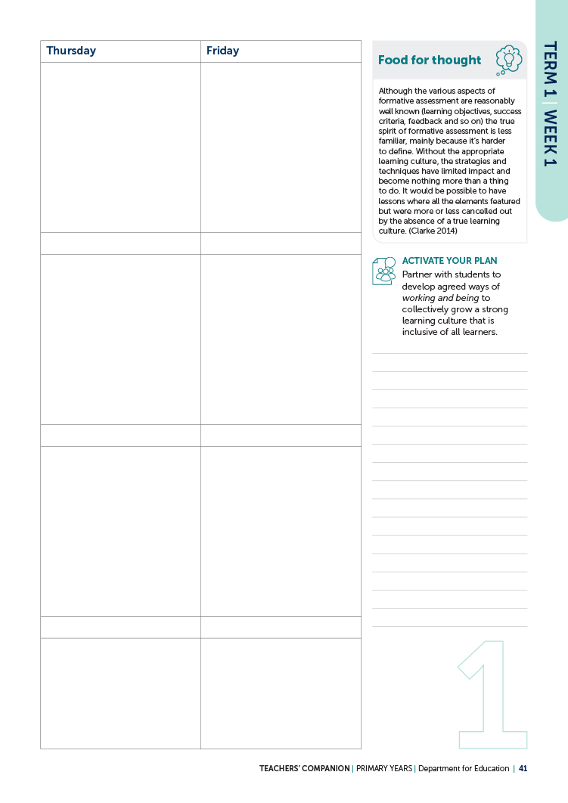

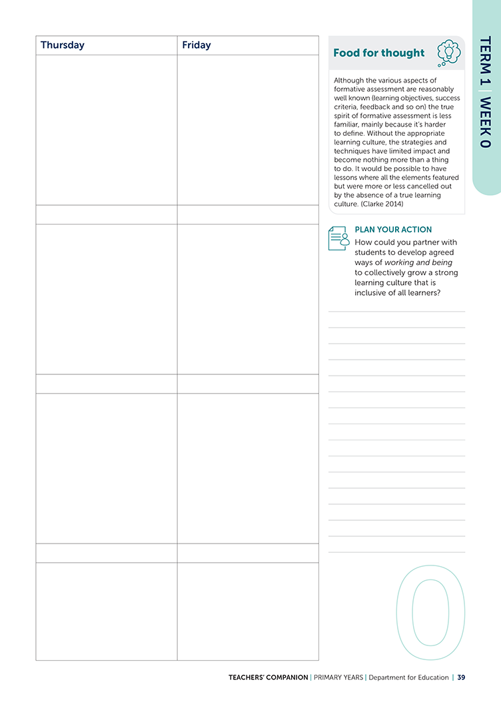
SECTION 1 | Weekly pedagogic prompts
REFER TO COMPANION PAGES 39 to 133

Slide 6

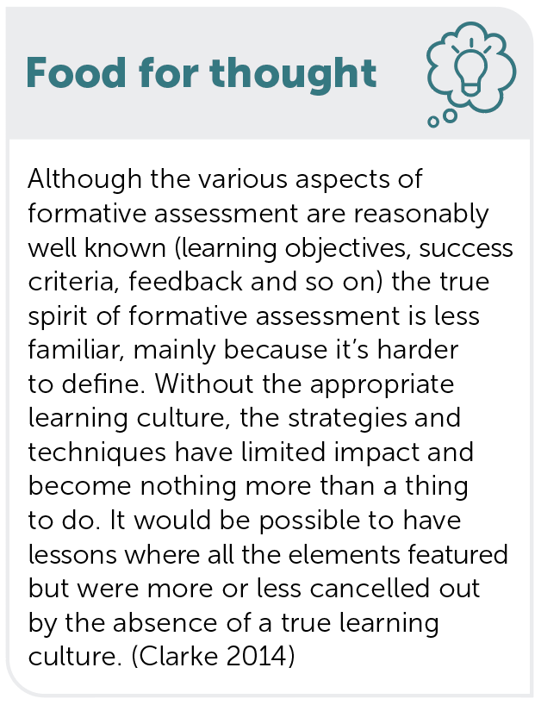
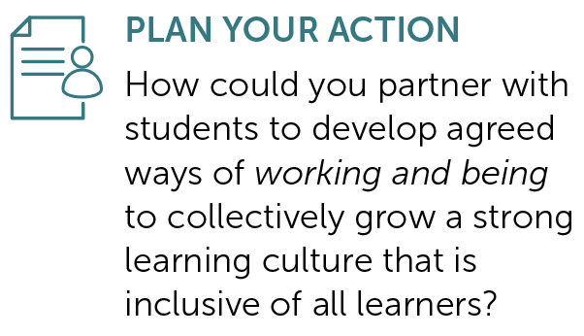
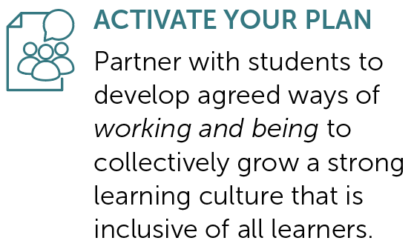
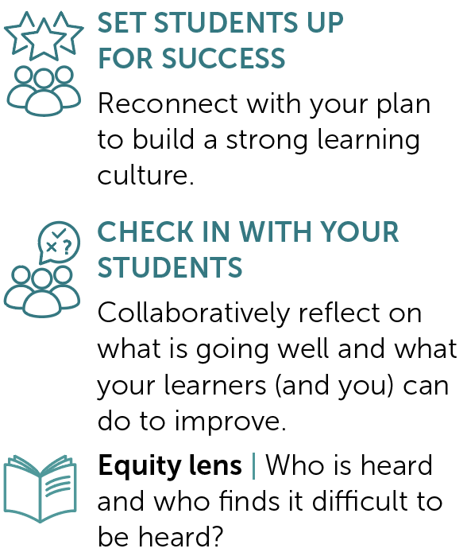
TERM 1 | Weeks 0 to 2
PAGES
39 to 43
Building a strong learning culture
Provocation Week 0 Week 1 Week 2

Slide 7
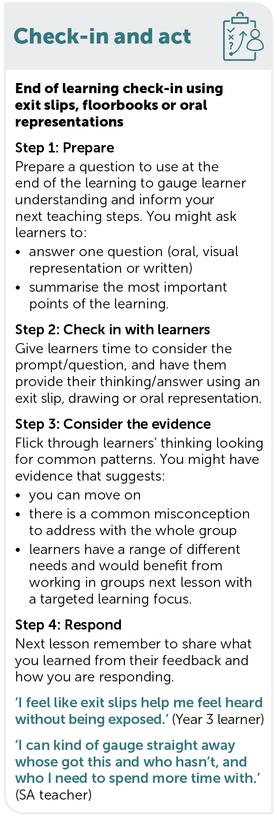
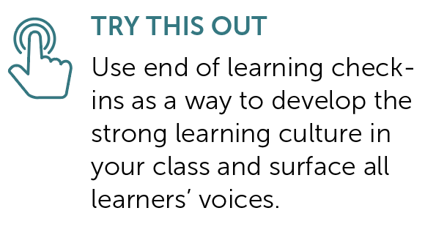
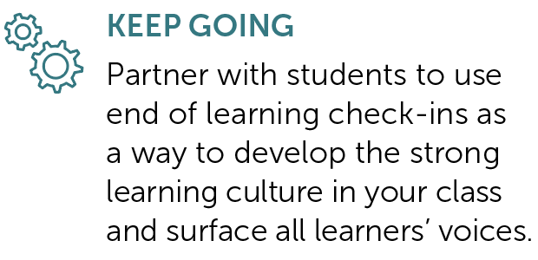
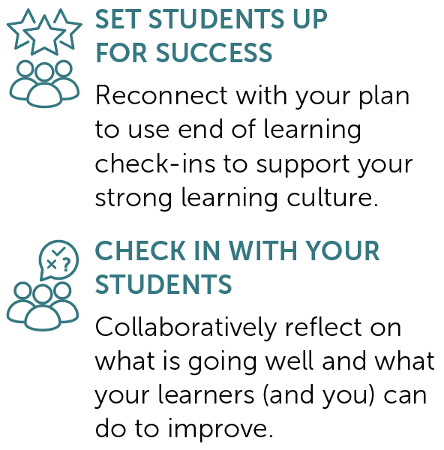
TERM 1 | Weeks 3 to 5
PAGES
45 to 49
Check-in and act: Exit slips, floorbooks or oral presentations
Provocation Week 3 Week 4 Week 5

Slide 8
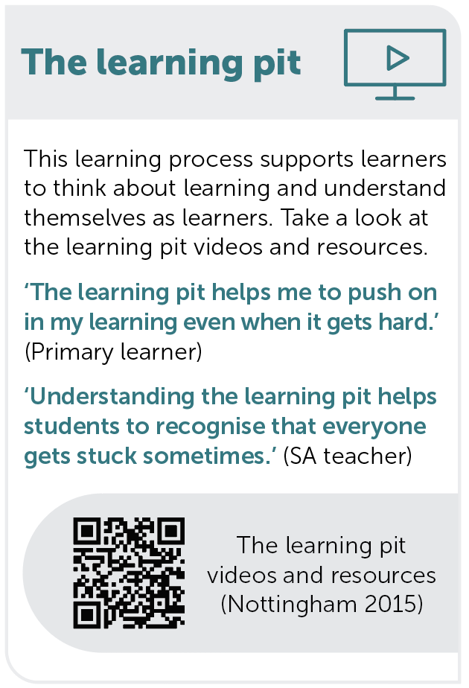
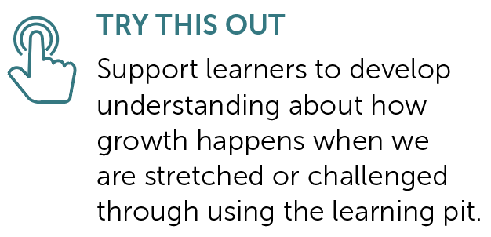
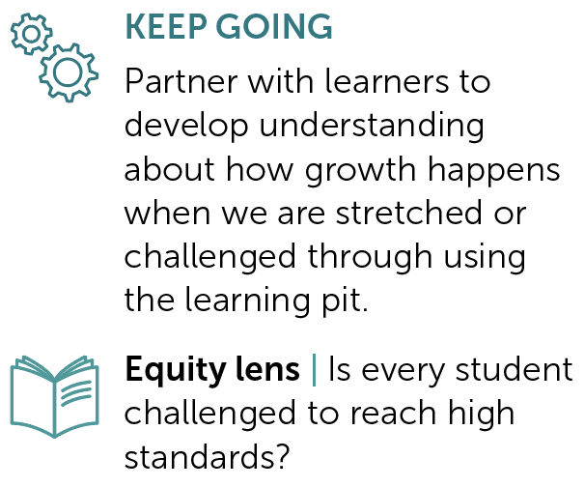
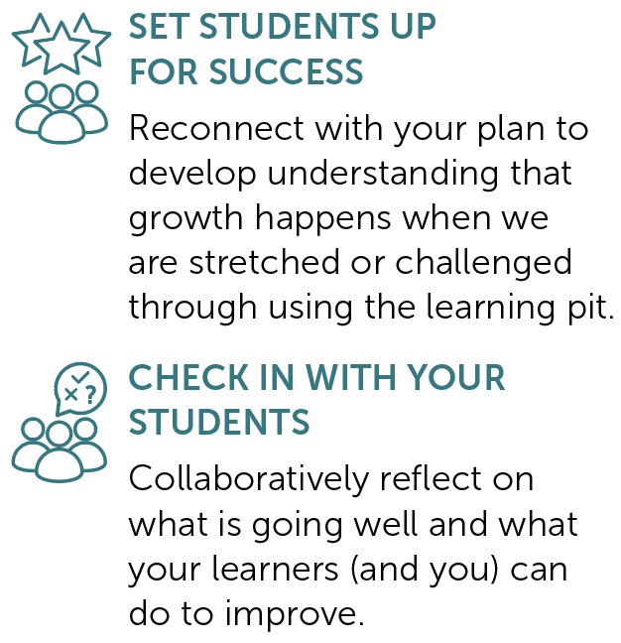
TERM 1 | Weeks 6 to 8
PAGES
51 to 55
The Learning Pit
Provocation Week 6 Week 7 Week 8

Slide 9
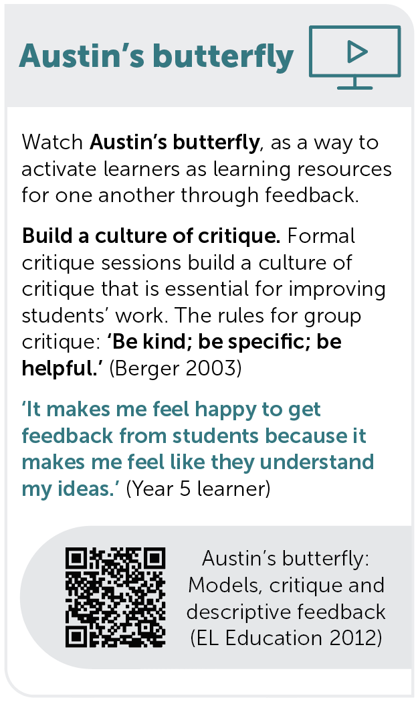
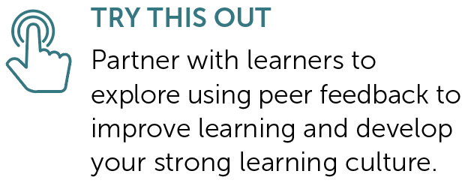
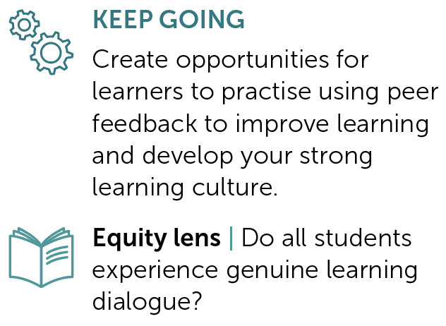
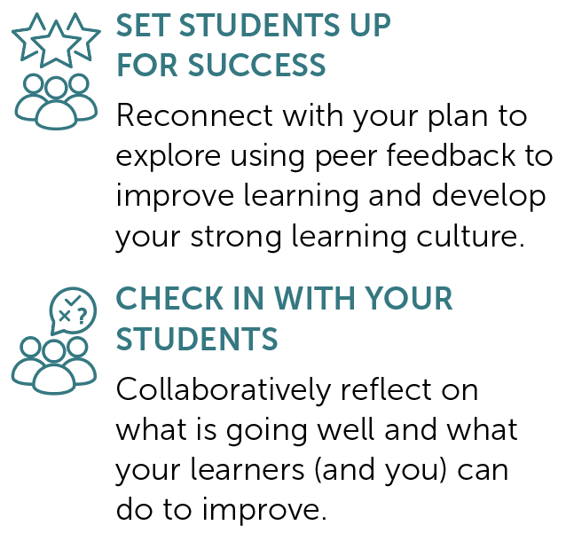
TERM 1 | Weeks 9 to 11
PAGES
57 to 61
Austin’s butterfly
Provocation Week 9 Week 10 Week 11

Slide 10
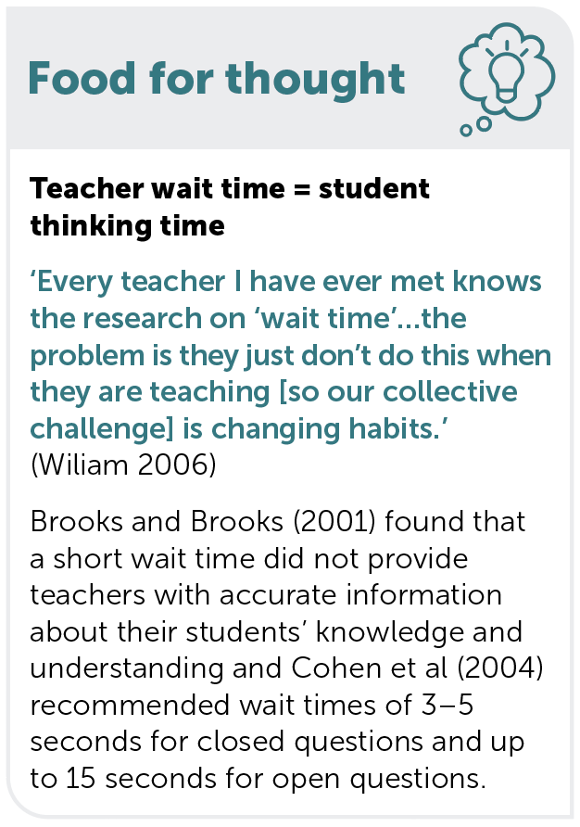
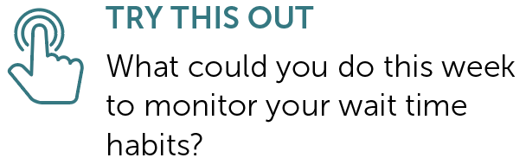
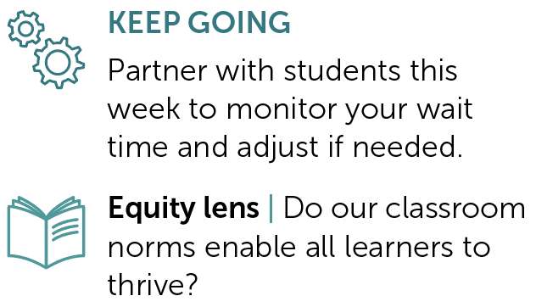
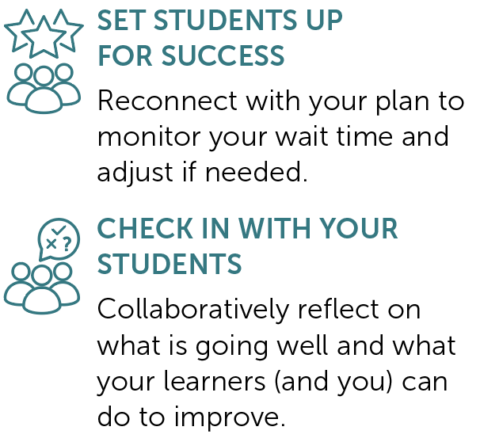
TERM 2 | Weeks 1 to 3
PAGES
67 to 71
Wait time
Provocation Week 1 Week 2 Week 3

Slide 11
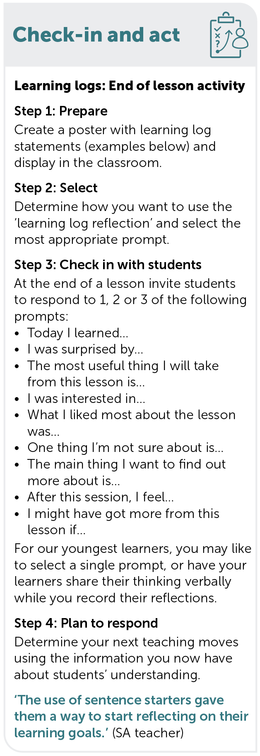
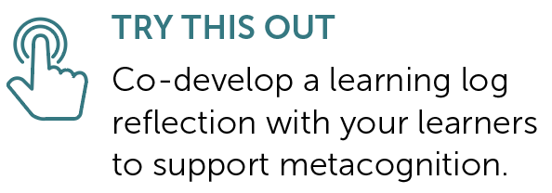
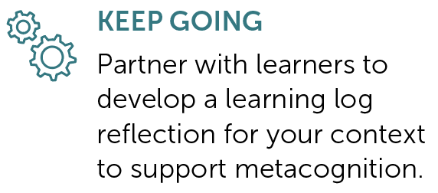
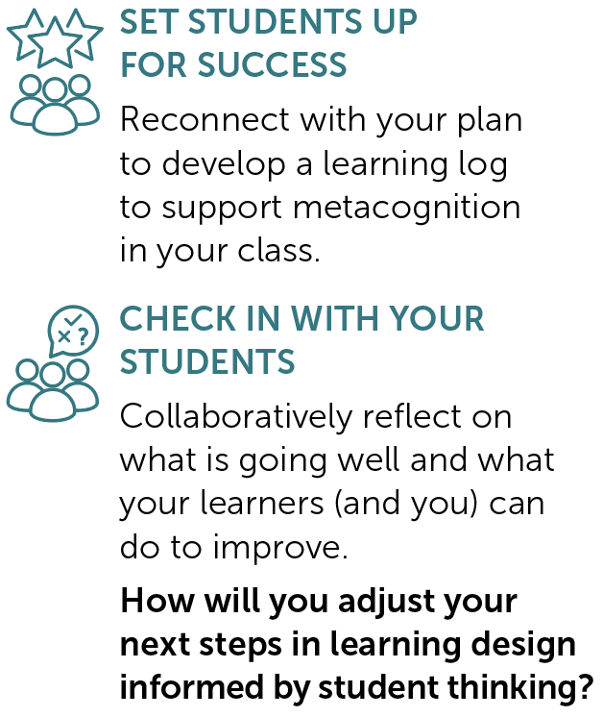
TERM 2 | Weeks 4 to 6
PAGES
73 to 77
Check-in and act: Learning logs
Provocation Week 4 Week 5 Week 6

Slide 12
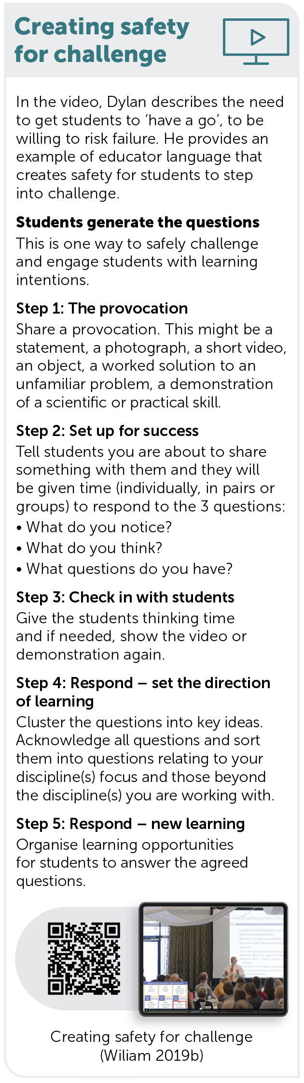
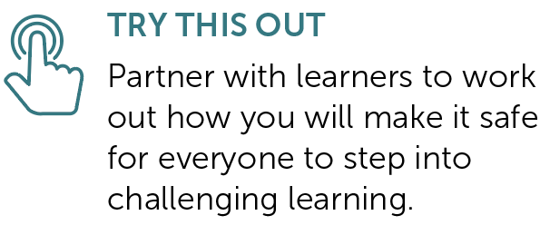
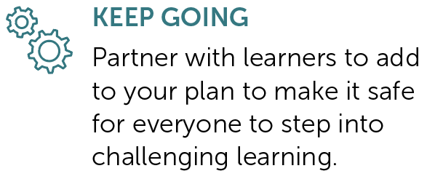
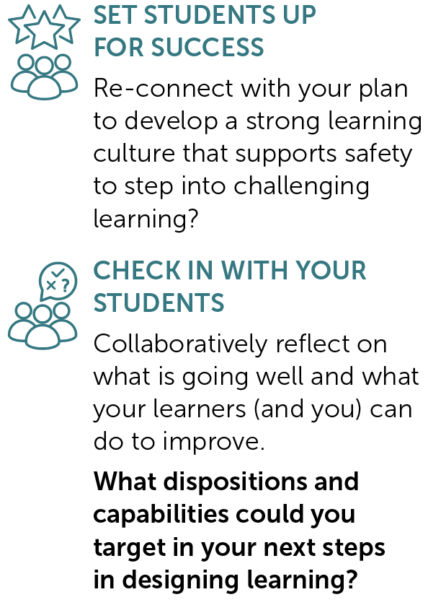
TERM 2 | Weeks 7 to 9
PAGES
79 to 83
Creating safety for challenge
Provocation Week 7 Week 8 Week 9

Slide 13

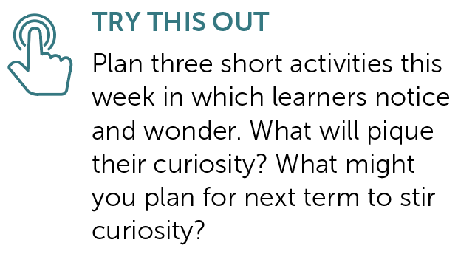
TERM 2 | Week 10
PAGE
85
Curiosity: Notice and wonder
Provocation Week 10

Slide 14

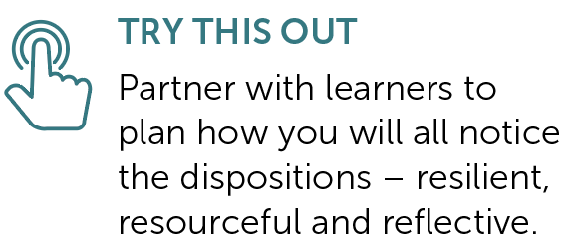
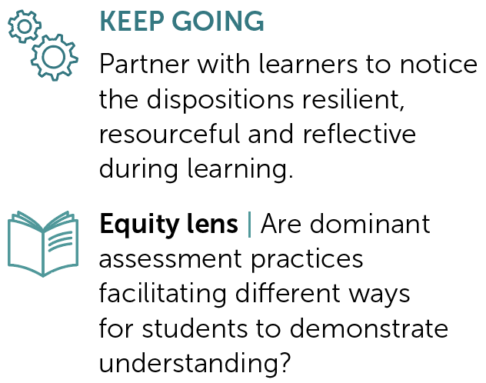
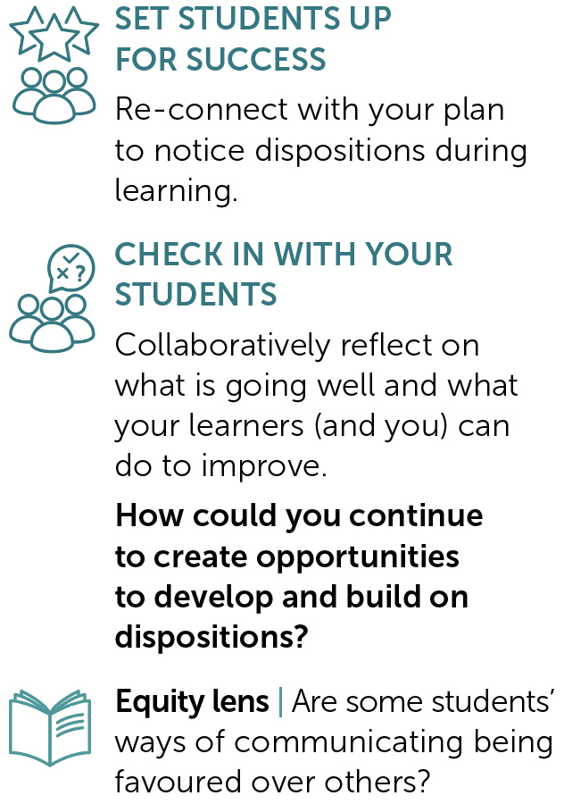
TERM 3 | Weeks 1 to 3
PAGES
93 to 97
Noticing dispositions
Provocation Week 1 Week 2 Week 3

Slide 15
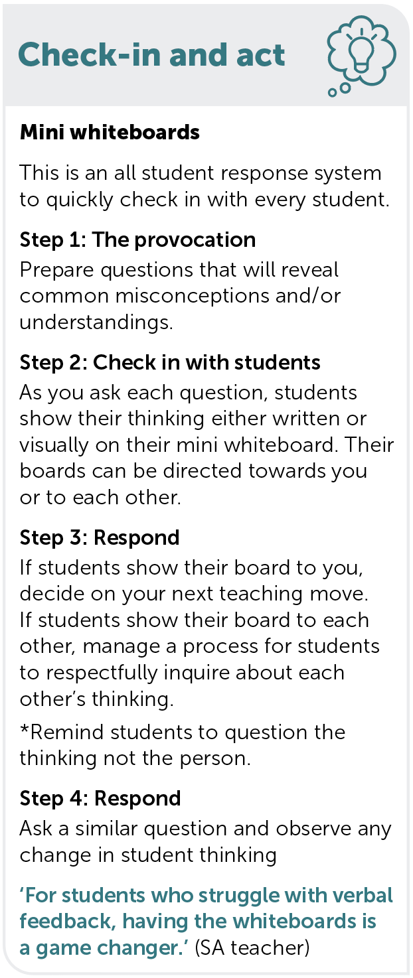
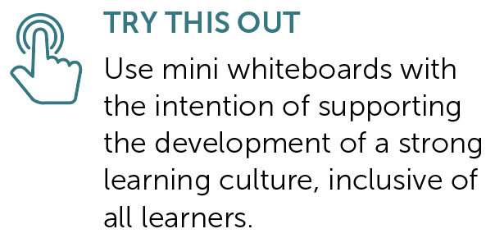
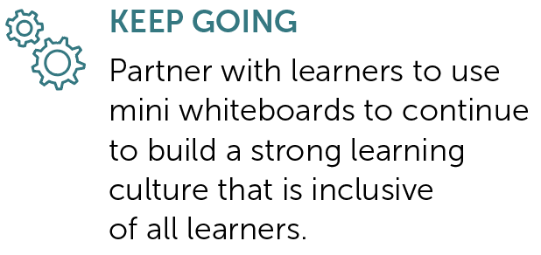
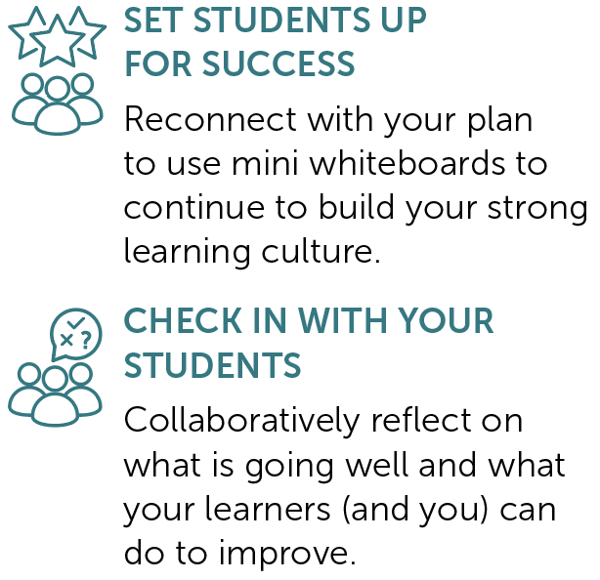
TERM 3 | Weeks 4 to 6
PAGES
99 to 103
Check-in and act: Mini whiteboards
Provocation Week 4 Week 5 Week 6

Slide 16
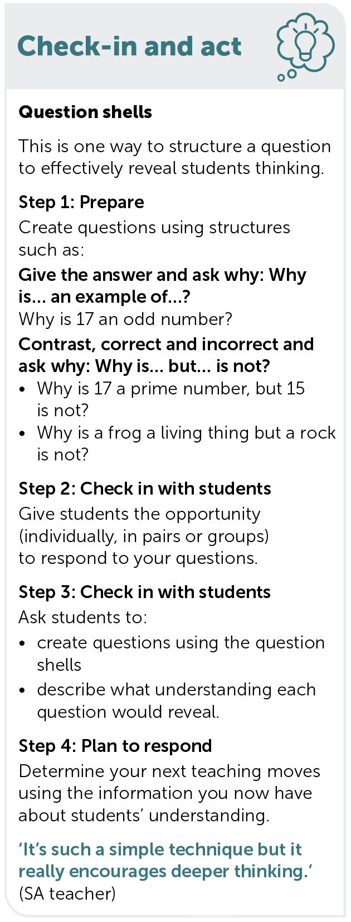
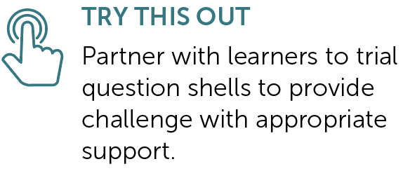
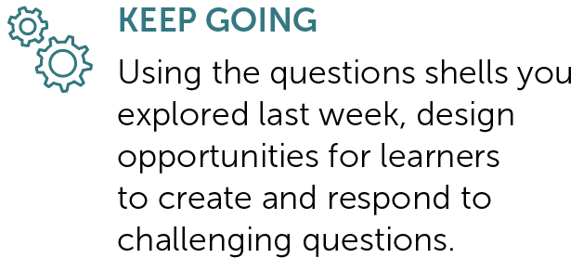
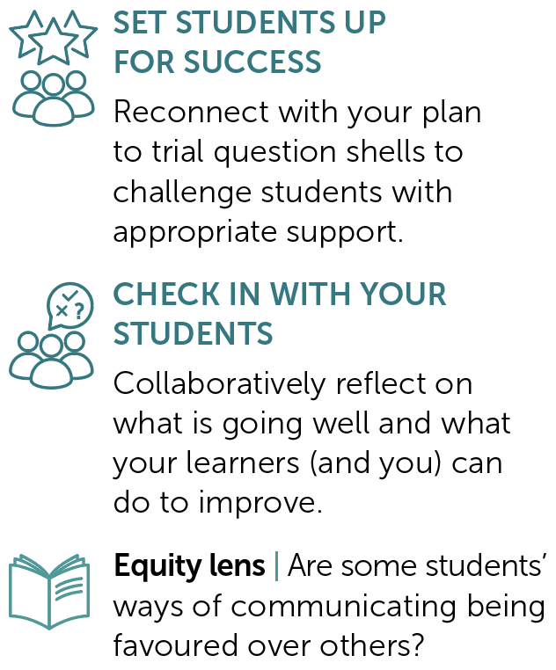
TERM 3 | Weeks 7 to 9
PAGES
105 to 109
Check-in and act: Question shells
Provocation Week 7 Week 8 Week 9

Slide 17
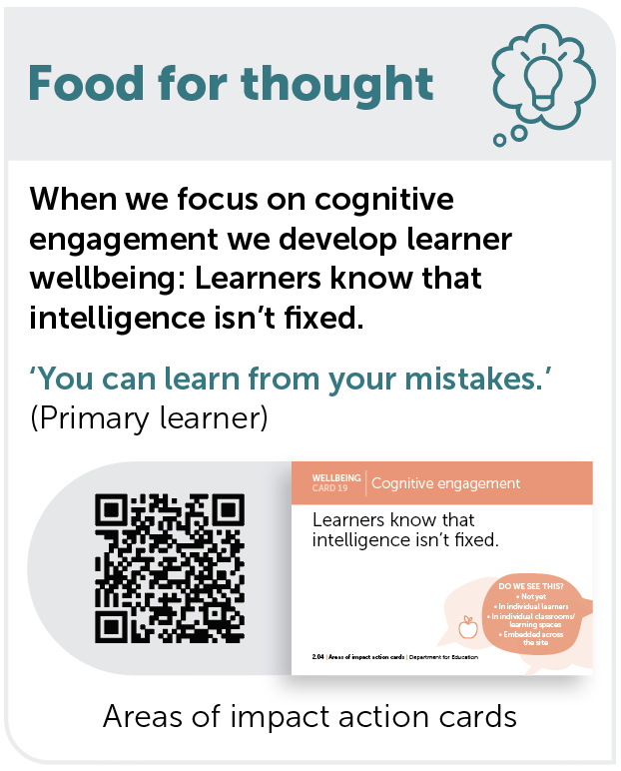
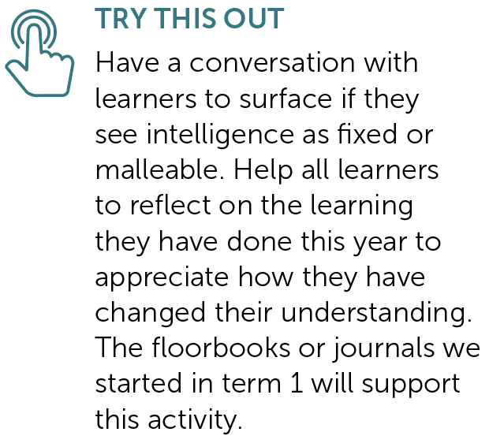
TERM 3 | Week 10
PAGE
111
Cognitive engagement: Growth mindsets
Provocation Week 10

Slide 18
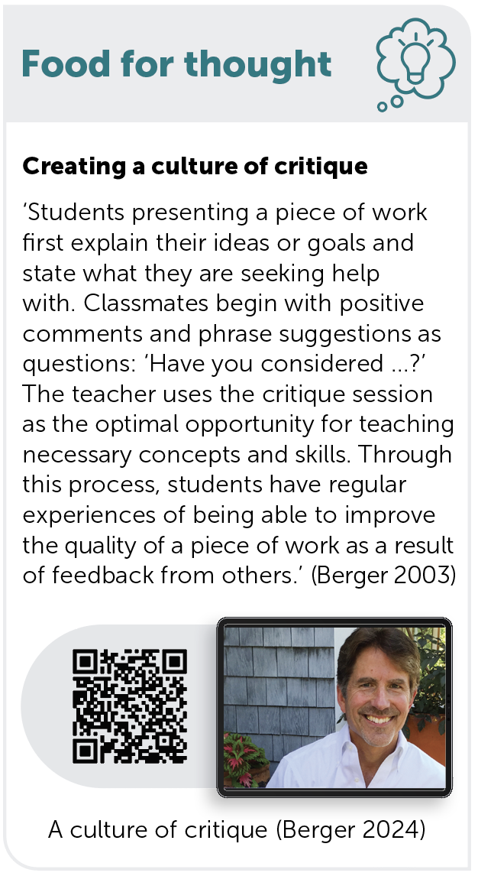
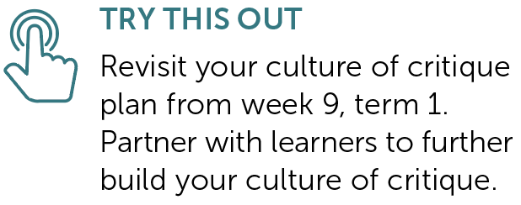
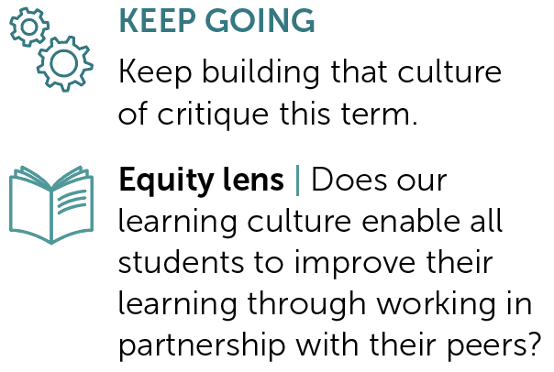
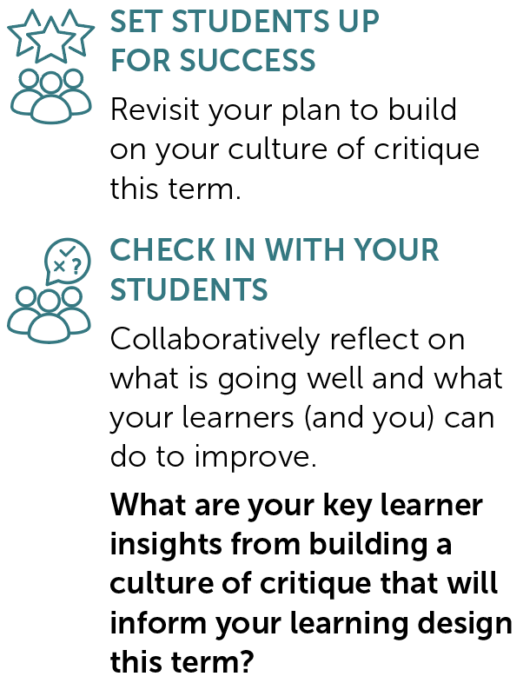
TERM 4 | Weeks 1 to 3
PAGES
117 to 121
Creating a culture of critique
Provocation Week 1 Week 2 Week 3

Slide 19
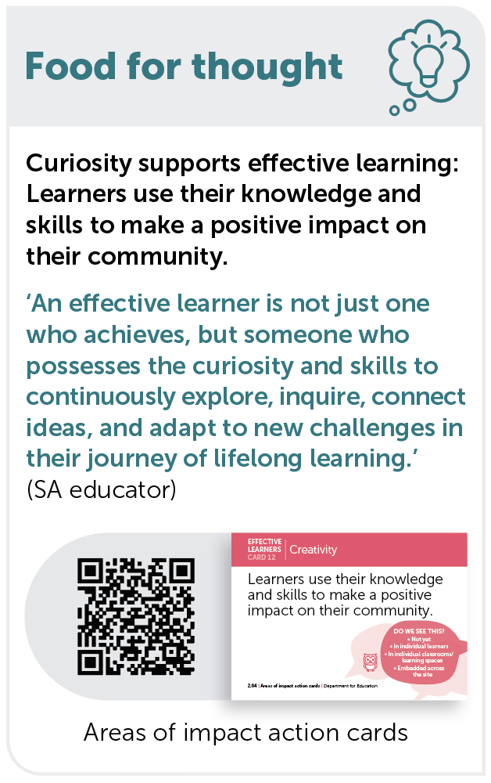
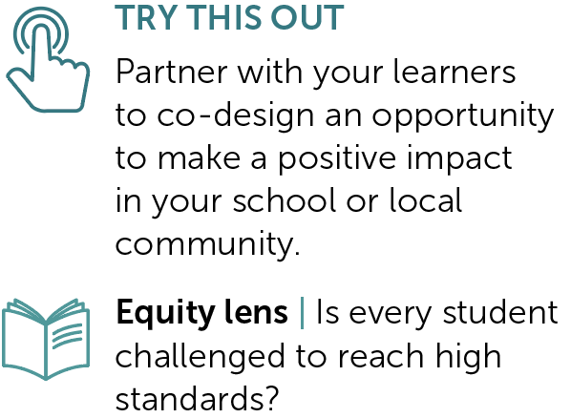


TERM 4 | Weeks 4 to 6
PAGES
123 to 127
Curiosity: Community partnerships
Provocation Week 4 Week 5 Week 6

Slide 20




TERM 4 | Weeks 7 to 9
PAGES
129 to 133
Partners in learning
Provocation Week 7 Week 8 Week 9

Slide 21



SECTION 2 | Our learners
REFER TO COMPANION PAGES 6, 7 and 8

Slide 22





2.1 | The voices of our SA learners
PAGE
6
Students desire more active learning and opportunities beyond the classroom.
Students value collaboration and discussions with their peers.
Students seek flexibility in learning connected to their world and passions.
1
Discussed is the somewhat perceived outdated education delivery and assessment methods.
2
But often feel they don’t get
the opportunity to work through problems and tasks in this manner.
3
As suggestions to increase student engagement and motivation to learn.
Students all want to have agency in learning and the confidence to participate.
Students crave the belonging and curiosity present in earlier years.
4
Safety to take risks, to voice their thinking and opportunities to develop and demonstrate agency.
A strong undertone in student feedback includes added pressures, changes in ‘delivery’ and support mechanisms. This is particularly prevalent in relation to transition to high school.
5
Source: Square Holes (2022)

Slide 23

2.1 | The voices of our learners
What might our learners say about how they want to experience learning for it to be most effective for them?
How do we know that?
REFER TO PAGE 6

Slide 24
2.2 | The aspirations of my learners
PAGE
7
How might we gain insight into the aspirations of our learners this year?
How might we capture their perceptions of themselves as learners?
How might we incorporate these insights into the choices we make in our learning design?

Slide 25



2.3 | The choices we have made as a system
PAGE
8
Purpose-driven, data-informed
The first big choice is to be a purpose-driven, data-informed education system. Being purpose-driven,
we keep children and young people at the centre when we make decisions and deeply consider what improvement looks like as we work towards our purpose. Data informs us, learner outcomes define us.
………………………………………………………………………………………………………………………………………………………………………………………………………………………………........................................
Areas of impact
The second big choice is to define our areas of impact. We can do anything, but we can’t do everything, so we have made choices as a system based on evidence about what makes the biggest difference to students’ learning and lives. Because context matters, schools will identify their focus within these choices. As schools work on their focus area of impact/domain(s) they will open up opportunities to intentionally pursue other areas over time.
………………………………………………………………………………………………………………………………………………………………………………………………………………………………........................................
The SA Curriculum for public education
The third big choice is to ensure the curriculum aligns with our purpose and areas of impact. The SA Curriculum* will help guide teachers on what to focus on and emphasise as they intentionally design learning that develops dispositions, capabilities and knowledge to support our children and young people to learn and thrive.
* The SA Curriculum is an adaptation of the Australian Curriculum version 9.0.

Slide 26


2.3 | Choice 1: Purpose-driven, data-informed
REFER TO PAGE 8 | Source: Department for Education 2024

Slide 27
2.3 | Choice 2: Areas of impact
REFER TO PAGE 8 | Source: Department for Education 2024a

Slide 28
2.3 | Choice 3: SA Curriculum for public education
REFER TO PAGE 8 | Source: Department for Education 2024b

Slide 29
2.3 | The choices we have made as a system
Why is it important to be purpose-driven and data-informed?
What do we see as the difference between being ‘purpose-driven
and data-informed’ rather than ‘data-driven’?
Being purpose-driven and data-informed guides us to think beyond standardised measures. Why does this matter for us and our learners?
REFER TO PAGE 8

Slide 30
2.3 | The choices we have made as a system
We can choose our focus area of impact/domain(s). Our focus will
guide and inform our work in curriculum and in the broader aspects
of students’ experiences of school. How might this benefit us and
our learners?
Our purpose statement says that ‘...we are relentless in our ambition for all children and young people to enter the world beyond the classroom ready to learn and to create opportunities to live a satisfying and fulfilling life of their choosing.’ How do we see the presence of dispositions and capabilities in the curriculum supporting this ambition?
REFER TO PAGE 8

Slide 31



SECTION 3 | Unpacking our strategy for public education
REFER TO COMPANION PAGES 12 to 19, 22, 27 to 29, 39 to 43, 51 to 55 and 79 to 83

Slide 32



3.1 | Deepening our understanding of the areas of impact
PAGE
12
Reflecting on practice
Using the areas of impact action cards:
What are our existing strengths?
What could benefit from further development?
What could be our ‘step in’ to this space?
PARTNERS IN LEARNING
How could we use these cards
to partner with learners?

Slide 33
3.2 | Areas of impact – our school’s choices
PAGE
13
Getting familiar with our focus area of impact/domain(s)
Photo challenge
Take out your phone and open the photos app.
Randomly select a month and year.
Select a photo that connects to one or more area of impact/domain.
Explain the connection to a colleague, describing:
  the specific area of impact/domain(s) your photo relates to and
  if it relates to more than one – describe the connection(s)
  how your learners demonstrate this in your classroom.
REFER TO PAGE 13

Slide 34



3.2 | Photo challenge example
Jade selected a photo of her dog, Max, digging under the neighbour’s fence. She explains how Max, fuelled by curiosity, endured with his digging for days, changing strategies on several occasions until he
was able to squeeze his head through the hole, laying eyes on the neighbour’s yard.
Max showed curiosity because he wanted to know what was on the other side of the fence.
Max showed resilience and persistence because he kept going for days
on end until he achieved his goal.
REFER TO PAGE 13

Slide 35
3.2| Connections to other areas of impact
What connections do you see between our school’s chosen area of impact/
domain(s) and others?
See examples on page 13 of the companion.
REFER TO PAGE 13

Slide 36


3.3| Identifying actions to activate the areas of impact
PAGE
15
Wellbeing
Imagine an observer spent a day in your learning environment. Highlight each action according to
the following criteria.
Green – This would be hard to miss in my learning environment.
Yellow – This might be observed on occasion.
Pink – This is not likely to be seen.

Slide 37
3.3| Identifying actions to activate the areas of impact
Individually, consider:
Which 1, 2 or 3 actions do you believe will have the greatest impact on your learners? Why?
What other actions (not listed on the page) might
be impactful for your learners? Why?
Share your perspective with the wider group,
then discuss and record:
the consistencies that are evident within the
group’s discussion
how this might inform the next steps for your team.
REFER TO PAGE 15

Slide 38


3.3| Identifying actions to activate the areas of impact
PAGES
16–17
Effective learners
Imagine an observer spent a day in your learning environment. Highlight each action according to
the following criteria.
Green – This would be hard to miss in my learning environment.
Yellow – This might be observed on occasion.
Pink – This is not likely to be seen.

Slide 39
3.3| Identifying actions to activate the areas of impact
Individually, consider:
Which 1, 2 or 3 actions do you believe will have the greatest impact on your learners? Why?
What other actions (not listed on the page) might
be impactful for your learners? Why?
Share your perspective with the wider group,
then discuss and record:
the consistencies that are evident within the
group’s discussion
how this might inform the next steps for your team.
REFER TO PAGES 16 and 17

Slide 40

3.3| Identifying actions to activate the areas of impact
PAGE
18
Learner agency
Imagine an observer spent a day in your learning environment. Highlight each action according to
the following criteria.
Green – This would be hard to miss in my learning environment.
Yellow – This might be observed on occasion.
Pink – This is not likely to be seen.

Slide 41
3.3| Identifying actions to activate the areas of impact
Individually, consider:
Which 1, 2 or 3 actions do you believe will have the greatest impact on your learners? Why?
What other actions (not listed on the page) might
be impactful for your learners? Why?
Share your perspective with the wider group,
then discuss and record:
the consistencies that are evident within the
group’s discussion
how this might inform the next steps for your team.
REFER TO PAGE 18

Slide 42

3.3| Identifying actions to activate the areas of impact
PAGE
19
Equity and excellence
Imagine an observer spent a day in your learning environment. Highlight each action according to
the following criteria.
Green – This would be hard to miss in my learning environment.
Yellow – This might be observed on occasion.
Pink – This is not likely to be seen.

Slide 43
3.3| Identifying actions to activate the areas of impact
Individually, consider:
Which 1, 2 or 3 actions do you believe will have the greatest impact on your learners? Why?
What other actions (not listed on the page) might
be impactful for your learners? Why?
Share your perspective with the wider group,
then discuss and record:
the consistencies that are evident within the
group’s discussion
how this might inform the next steps for your team.
REFER TO PAGE 19

Slide 44








3.3| Identifying actions to activate the areas of impact
What student actions (cards) might manifest from the listed teacher actions in the companion?
REFER TO PAGES 15 to 19

Slide 45

3.4| Our ways of working
PAGE
22
Our guiding principles
What does collaboration look like for us now?
How do our current ways of working and being align with
or differ from the guiding principles?
What challenges might exist to implementing these principles and how might we address them?
What behaviours and practices would demonstrate each principle?
How will we know if we’re successfully embedding these principles?
In small groups, reflect on our day-to-day work and record an example of what each principle is and isn’t on page 22 of the companion.

Slide 46
3.5| Building coherence for our learners
PAGES
27–29
Initial brainstorm
In relation to the 4 areas of impact and the presence of dispositions and capabilities in the SA Curriculum prototype, what connections do you anticipate (or know) exist between these features of our strategy and the:
Early Years Learning Framework (EYLF 2.0)?
innovation occurring in the SACE?

Slide 47



3.5| Building coherence for our learners
Read pages 27 to 29 of the companion
Individual reading time (10 minutes).
Use the relevant area of impact action cards
to narrow your focus as you read.
You may find it useful to extend your reading later using the QR links provided on the companion pages.
REFER TO PAGES 27 to 29

Slide 48
3.5| Building coherence for our learners
After reading
Individually, generate a list of important connections between our focus area of impact/domains(s), the EYLF 2.0 and the SACE.
(2 to 3 minutes)
REFER TO PAGES 27 to 29

Slide 49
3.5| Building coherence for our learners
Add one routine
Form small groups (4 to 5 people).
  Pass your paper to the person on your right.
  Take 1 to 2 minutes to read the paper in front you, then add one new connection to the list (the addition could be an elaboration, a new point, or a relationship between multiple ideas).
  Rotate papers until you have received yours back and read your group members’ contributions.
REFER TO PAGES 27 to 29
Adapted from Project Zero’s +1 Routine (President and Fellows of Harvard College and Project Zero 2019)

Slide 50
3.5| Building coherence for our learners
Add one routine
After completing a rotation of add one, remain in small groups to identify and share 1 to 2 connections that you would like to follow-up to enrich your understanding of the focus area of impact/domain(s) further.
Share your thinking with the wider group.
REFER TO PAGES 27 to 29
Adapted from Project Zero’s +1 Routine (President and Fellows of Harvard College and Project Zero 2019)

Slide 51


SECTION 4 | Building a strong learning culture
REFER TO COMPANION PAGES 39 to 43, 79 to 83 and 51 to 55

Slide 52



4.1| Strong learning cultures in action
PAGES
39 to 43
Jigsaw reading routine
Jigsaw groups – Form small groups of 3 to 6. Read the
assigned section of the passage. (5 to 10 minutes)
Form ‘expert groups’ – team up with other participants
that have read the same section of the passage. Discuss
your thoughts and key ideas to develop expertise in
this area. (15 minutes)
Return to your original jigsaw group – Each ‘expert’ summarises their discussion, communicating the key ideas presented in their section of
the text. (2 to 3 minutes each)

Slide 53
4.1| Strong learning cultures in action
Reflection
What do we see as features of a strong, inclusive learning culture?
What examples do we have of strong, inclusive learning cultures being developed in our context?
What examples do we have of students being involved in monitoring
and strengthening the learning culture? How embedded is this?
  How does building a strong learning culture connect to our focus area
  of impact/domain(s)?
REFER TO PAGES 39 to 43

Slide 54

4.2 | The Learning Pit
PAGES
51 to 55
Source: James Nottingham’s The Learning Pit 2015

Slide 55
4.2 | The Learning Pit
Think | Reflect on a time you found yourself in The Learning Pit:
  How did you climb your way out?
  How did you feel:
    before you entered the pit?
    in the depths of The Learning Pit?
    after you achieved success?
Pair | Share your reflection with a partner.
Share | Two pairs join to share and discuss:
  What are the common themes emerging?
REFER TO PAGES 51 to 55
Adapted from Project Zero’s Think, pair, share (President and Fellows of Harvard College and Project Zero 2019a)

Slide 56
4.2 | The Learning Pit
Going deeper
What self-talk do you remember using before, during or after this learning experience? How did it help?
How might sharing these experiences with our students benefit them?
How does The Learning Pit connect to our focus area of impact/ domain(s)?
REFER TO PAGES 51 to 55

Slide 57
4.3 | Creating safety for challenge
PAGES
79 to 83
Individually, reflect on a time where you felt challenged in your
learning:
What were the learning conditions in this scenario?
What made you feel safe to take risks or engage in challenge?
What might have prevented you from doing this?

Slide 58
4.3 | Creating safety for challenge
As a group, discuss:
What might ‘safety for challenge’ look like in our learning environments?
What signals or behaviours indicate that students feel safe to take risks?
What educator actions and beliefs promote safety for challenge?
What learner actions and beliefs promote safety for challenge?
What role might families and caregivers play in our development of safety for challenge?
REFER TO PAGES 79 to 83

Slide 59

4.3 | Creating safety for challenge
REFER TO PAGES 79 to 83 | Source: Wiliam 2019b

Slide 60
4.3 | Creating safety for challenge
Think about an upcoming experience that will involve challenging learning for your students:
How might your students’ understandings about learning and beliefs about themselves as learners influence their tolerance for challenge
in this experience?
What teacher actions might intentionally:
  ‘lower the cost of failure’ for your learners?
  increase learners’ tolerance for challenge?
REFER TO PAGES 79 to 83

Slide 61
4.3 | Creating safety for challenge
Considering the same upcoming experience and view page 79 of the companion:
How might you use the strategy outlined on page 79
to allow all learners to step into the challenge you
have designed?
What else could you do?
REFER TO PAGES 79 to 83

Slide 62



SECTION 5 | Metacognition and self-regulated learning
REFER TO COMPANION PAGES 154, 156, 157 and 73 to 77

Slide 63

5.1| Productive struggle
PAGE
154
Introduction to metacognition and self-regulation
Have a go at the Stroop test as we watch!
After watching the video, discuss...
How did it feel?
Source: Department for Education 2024e

Slide 64

5.1| Productive struggle
REFER TO PAGE 154 | Source: Wiliam 2019d

Slide 65
5.1| Productive struggle
How do we currently design for productive struggle?
Use the questions on page 154 of your companion to guide your discussion.
REFER TO PAGE 154

Slide 66
5.1| Productive struggle
With your colleagues, consider the following:
How might we design for productive struggle in our upcoming learning?
How might we ensure that every learner can experience this?
How might we partner with learners to design learning at an appropriate level of challenge?
REFER TO PAGE 154

Slide 67
5.2| EEF Metacognition and self-regulated learning
PAGES
156 to 157
How are we going?
For each recommended action on the EEF poster, identify our current practice as:
embedded
progressing
emerging
not yet introduced.
Source: EEF 2021

Slide 68
5.2| EEF Metacognition and self-regulated learning
What are your team’s agreed next steps?
Record your agreed next steps on page 157 of your companion.
REFER TO PAGES 156 to 157

Slide 69

5.3| Check-in and act: Learning logs
PAGES
73 to 77
When used routinely, learning logs can be a simple way to normalise
and habituate metacognition.
Additionally, learning logs can be a powerful formative assessment strategy, giving teachers valuable insight into their students as learners.
See page 73 of the companion.

Slide 70
5.3| Check-in and act: Learning logs
Co-design a post-lesson learning log prompt with colleagues.
The purpose of the prompt will be to:
gain insights into the learning experience of your students
check for understanding
promote metacognition by scaffolding opportunities for students to evaluate their learning.
Some prompt examples are provided on the next slide.
REFER TO PAGES 73 to 77

Slide 71
5.3| Check-in and act: Learning logs
Post-session prompts
Today I learned…
I was surprised by…
The most useful thing I will take from this lesson is…
I was interested in…
What I liked most about the
lesson was…
One thing I’m not sure about is…
The main thing I want to find out more about is…
After this session, I feel…
I might have got more from this lesson if…
PARTNERS IN LEARNING
You might choose to display
student responses on a learning
log poster or ask students to
make individual journal entries.
REFER TO PAGES 73 to 77

Slide 72
5.3| Check-in and act: Learning logs
Partners in learning
How might we co-develop a learning log reflection with our students
to support metacognition?
What prompts and/or sentence starters might we provide our students
to promote this reflection?
How might our students’ insights support our future learning design?
REFER TO PAGES 73 to 77

Slide 73




SECTION 6 | Success criteria
REFER TO COMPANION PAGES 144 to 147

Slide 74

6.1| Examples of quality are more effective than descriptions of quality
PAGES
144 to 147
Source: Wiliam 2019c

Slide 75
6.1| Examples of quality are more effective than descriptions of quality
With colleagues, discuss:
What is our approach to sharing success criteria?
Do we share descriptions of quality, examples of quality, or both?
REFER TO PAGES 144 to 147

Slide 76
6.1| Examples of quality are more effective than descriptions of quality
Following your discussion:
What future actions might we try?
What might be the impact for our learners?
REFER TO PAGES 144 to 147

Slide 77

6.2| Co-constructing success criteria
REFER TO PAGES 144 to 147 | Source: Wiliam 2019a

Slide 78
6.2| Co-constructing success criteria
As a group, consider and discuss:
Do we have an example of co-constructing success criteria with students?
Was the approach impactful? Why/why not?
What else might we try?
REFER TO PAGES 144 to 147

Slide 79

6.3| Developing a ‘nose for quality’
During the next video, record your thinking
in response to the following:
What did you notice?
What do you think about this?
How might we adapt this idea to improve
self-assessment routines in our context?
We need students to ‘develop a nose for quality’. (Claxton 2006)
REFER TO PAGES 144 to 147

Slide 80

6.3| Developing a ‘nose for quality’
REFER TO PAGES 144 to 147 | Source: Fisher 2019

Slide 81
6.3| Developing a ‘nose for quality’
Students need to understand quality in relation to capabilities
and dispositions, not only content.
Do we show students that we value the development of capabilities
and dispositions by including them in our descriptions of quality?
How might this look in our context?
REFER TO PAGES 144 to 147

Slide 82
6.3| Developing a ‘nose for quality’
Going deeper
Success criteria can be product or process focused.
When might process success criteria support students?
REFER TO PAGES 144 to 147

Slide 83



SECTION 7 | Feedback for learning
REFER TO COMPANION PAGES 57, 59, 152, 153, 150 to 151 and 129 to 133

Slide 84
7.1 | Austin’s butterfly: Peer critique
PAGES
57 to 59
Source: EL Education 2012

Slide 85
7.1 | Austin’s butterfly: Peer critique
Goal
Practise giving and receiving peer critique using a short piece of writing, focusing on fostering a positive and growth-oriented critique culture.
REFER TO PAGES 57 to 59

Slide 86
7.1 | Austin’s butterfly: Peer critique
Step 1 – First draft
Write 2 sentences describing a place where you have felt a sense of belonging. Focus on creating a vivid image.
OR
Write to a prompt connected to our focus area of impact/domain(s).
Remember, this is a first draft and not about perfection.
REFER TO PAGES 57 to 59

Slide 87
7.1 | Austin’s butterfly: Peer critique
Step 2 – Critique groups
Work in small groups of 3 to 4. Read drafts aloud, one person at a time.
Group members provide feedback following these principles:
  Be kind – Start with what works well in the writing.
  Be specific – Point out areas that could be enhanced, eg ‘Could you add a sensory detail, like a sound or smell?’
  Be helpful – Offer actionable suggestions for improvement.
REFER TO PAGES 57 to 59

Slide 88
7.1 | Austin’s butterfly: Peer critique
Step 3 – Action response
Revise your passage based on the feedback you received. Focus on incorporating 1 or 2 key pieces of feedback.
REFER TO PAGES 57 to 59

Slide 89
7.1 | Austin’s butterfly: Peer critique
Step 4 – Reflection
As a whole group, discuss:
How did it feel to receive feedback?
How did it feel to give feedback?
What made the feedback most effective?
How might we create a similar culture of peer critique in our classrooms?
REFER TO PAGES 57 to 59

Slide 90












7.1 | Austin’s butterfly: Peer critique
How do the strategies demonstrated in the Austin’s butterfly video connect to the areas of impact/domains?
REFER TO PAGES 57 to 59 | Source: Areas of impact domain cards

Slide 91
7.2| EEF Teacher feedback to improve student learning
PAGES
152 to 153
Take some time to read the recommendations from the Education Endowment Foundation’s research.

Slide 92
7.2| EEF Teacher feedback to improve student learning
How are we going?
For each recommended action on the EEF poster, identify our current practice as:
embedded
progressing
emerging
not yet introduced.
REFER TO PAGES 152 to 153

Slide 93
7.2| EEF Teacher feedback to improve student learning
What are your team’s agreed next steps?
Record your agreed next steps on page 153 of your companion.
REFER TO PAGES 152 to 153

Slide 94
7.3| Teacher to student feedback
PAGES
150 to 151
In groups, discuss:
Do we use comment only marking (never/rarely/quite frequently/often)?
What examples do we have that:
  move the learning forward?
  are tied to the learning intentions and success criteria?
  are narrow enough to act upon without feeling overwhelmed?
Do we provide sufficient time for students to respond to feedback?
What improvements could we make to our feedback practices? How might we work with students to evaluate the impact of the changes
we make?

Slide 95
7.4| Student to teacher feedback
PAGES
129 to 133
With colleagues, discuss:
How have we collected feedback from students about their learning experiences?
Examples might include:
exit slips
digital surveys (eg Microsoft Forms, Google Forms, Pear Deck, Slido, Mentimeter)
personal conferencing.

Slide 96
7.4| Student to teacher feedback
Partners in learning
Set a short-term goal to collect insights from students about their learning experiences.
Record the questions we might ask to elicit these insights.
How could we respond to the feedback we receive from students?
REFER TO PAGES 150 to 151

Slide 97



SECTION 8 | Checking for understanding
REFER TO COMPANION PAGES 99 to 103, 105 to 109 and 67 to 71

Slide 98

8.1 | Introducing all student response systems
Source: Wiliam 2019

Slide 99
8.1 | Introducing all student response systems
How might we check for understanding, in the moment, with a whole class? Hands up questioning is not the answer.
We need to know each student’s starting point, and importantly, they
need to know their starting point too.

Slide 100
8.1 | Introducing all student response systems
In small groups, discuss and document:
What all student response processes are used at our school?
Are these processes in frequent use at all year levels and learning areas?
What processes do we want our students to be familiar with?
If we were to improve the quality or frequency of this practice, what might be the impact for our learners?

Slide 101

8.2 | Check-in and act: Mini whiteboards
PAGES
99 to 103
Which area of impact does it belong to?
The following slides display individual domains from
the 4 areas of impact.
On your whiteboard:
Write the area of impact you think it belongs to
(ie wellbeing, equity and excellence, learner agency
or effective learners). Display your whiteboard.
Observe the whiteboards around you. Does anyone
think differently to you? Explain your thinking.
Remember – there are no wrong answers. Flex your reasoning skills and explain your thinking to your partner or team.

Slide 102
8.2 | Check-in and act: Mini whiteboards
Which area of impact does it belong to?
Strategic awareness
REFER TO PAGES 99 to 103

Slide 103
8.2 | Check-in and act: Mini whiteboards
Which area of impact does it belong to?
Effective learners
Strategic awareness
REFER TO PAGES 99 to 103

Slide 104
8.2 | Check-in and act: Mini whiteboards
Which area of impact does it belong to?
Discernment and judgement
REFER TO PAGES 99 to 103

Slide 105

8.2 | Check-in and act: Mini whiteboards
Which area of impact does it belong to?
Learner agency
Discernment and judgement
REFER TO PAGES 99 to 103

Slide 106
8.2 | Check-in and act: Mini whiteboards
Which area of impact does it belong to?
<Insert domain name here>
REFER TO PAGES 99 to 103

Slide 107
8.2 | Check-in and act: Mini whiteboards
Which area of impact does it belong to?
Wellbeing
<Insert domain name here>
REFER TO PAGES 99 to 103

Slide 108
8.2 | Check-in and act: Mini whiteboards
Which area of impact does it belong to?
Learner agency
<Insert domain name here>
REFER TO PAGES 99 to 103

Slide 109
8.2 | Check-in and act: Mini whiteboards
Which area of impact does it belong to?
Effective learners
<Insert domain name here>
REFER TO PAGES 99 to 103

Slide 110

8.2 | Check-in and act: Mini whiteboards
Which area of impact does it belong to?
Equity and excellence
<Insert domain name here>
REFER TO PAGES 99 to 103

Slide 111
8.2 | Check-in and act: Mini whiteboards
Which one doesn’t belong?
The following slides display 4 actions from the areas
of impact action cards.
On your whiteboard:
Write A, B, C or D to indicate which one doesn't belong.
Display your whiteboard to the team.
Observe the whiteboards around you. Does anyone think differently to you? Explain your thinking – Why do you
think this domain doesn’t belong?
Remember – there are no wrong answers. Flex your reasoning skills and explain your thinking to your partner or team.
REFER TO PAGES 99 to 103

Slide 112
8.2 | Check-in and act: Mini whiteboards
Which one doesn’t belong?
A | Learners seek information and clarification through questioning
B | Learners raise questions confidently, without feeling judged
C | Learners question information and facts before accepting them
D | Learners pose and test theories
There could be multiple ‘answers’ – be prepared to justify your choice!
REFER TO PAGES 99 to 103

Slide 113
8.2 | Check-in and act: Mini whiteboards
Which one doesn’t belong?
A | Learners engage in lots
of purposeful learning talk with peers and adults
B | Learners have opportunities to choose what they receive feedback on and how
C | Learners know the next step towards their learning goals
D | Learners seek feedback from others to move their learning forward
There could be multiple ‘answers’ – be prepared to justify your choice!
REFER TO PAGES 99 to 103

Slide 114
8.2 | Check-in and act: Mini whiteboards
Which one doesn’t belong?
A | <Add action text here>
B | <Add action text here>
C | <Add action text here>
D | <Add action text here>
REFER TO PAGES 99 to 103

Slide 115
8.2 | Check-in and act: Mini whiteboards
Reflection
How do mini whiteboards differ from the traditional ‘hands up’ call
and response system?
What other all student response systems might we trial/improve
to check for understanding in real time?
How might we support each other to move away from the traditional ‘hands up’ call and response system?
What might be the impact for our students?
REFER TO PAGES 99 to 103

Slide 116
8.3 | Check-in and act: Question shells
PAGES
105 to 109
Question shells can be an effective way to surface student thinking.
Examples:
How is … an example of … ?
How is … connected to … ?
Why is … but … is ...?

Slide 117
8.3 | Check-in and act: Question shells
How is feedback connected to learner agency?
Why is curiosity a disposition but critical thinking is a capability?
REFER TO PAGES 105 to 109

Slide 118
8.3 | Check-in and act: Question shells
Write your own
How is … an example of … ?
How is … connected to … ?
Why is … but … is ...?
REFER TO PAGES 105 to 109

Slide 119
8.3 | Check-in and act: Question shells
Reflection
How might question shells be used to surface student thinking in your leaning environment?
How might this deepen our insights into student thinking?
How could we be responsive to these insights?
REFER TO PAGES 105 to 109

Slide 120
8.4 | Wait time
PAGES
67 to 71
Teacher wait time = student thinking time
‘Every teacher I have ever met knows the research on ‘wait time’ …
the problem is they just don’t do this when they are teaching [so our collective challenge] is changing habits.’ (Wiliam 2006)

Slide 121
8.4 | Wait time
Practicing wait time
Form groups of 3 to 4.
Assign roles: a teacher, a student, and 1 or 2 observers.
The ‘teacher’ asks an open-ended question to the ‘student’ and then waits for a response, counting silently to 3 before the ‘student’ answers. If there has been no response after 3 seconds, quickly paraphrase your question or offer another prompt.
Repeat step 3 (perhaps using a different question), this time increasing your wait time to 8 seconds (or another specified wait time).
The ‘observer(s)’ watch and take notes on both the teacher’s body language during the wait and the student’s reaction.
Examples of open-ended questions
If we collectively improved our ‘wait time’, what might be the impact for our learners?
How does teacher wait-time connect to our focus area of impact/domain(s)?
<insert your own question>
REFER TO PAGES 67 to 71

Slide 122
8.4 | Wait time
Whole group discussion: Insights and challenges
Come back together as a whole group to discuss your insights
and challenges (10 minutes).
As an ‘observer’, what did you notice?
As a ‘teacher’, how did it feel to hold the wait time?
What were some challenges?
As a ‘student’, how did it feel to have more time to respond?
How did this impact your thinking?
REFER TO PAGES 67 to 71

Slide 123
8.4 | Wait time
Reflection and next steps
With your colleagues, discuss how you might support each other
to monitor, evaluate and improve your wait time.
REFER TO PAGES 67 to 71

Slide 124


SECTION 9 | Teachers as learners
REFER TO COMPANION PAGES 62 to 63

Slide 125

9.1 | Reflecting on our practice
PAGES
62 to 63
Before we reflect, consider these ideas from Ron Berger and Gwyn ap Harri.
Source: Department for Education 2024c

Slide 126
9.1 | Reflecting on our practice
Individual reflection
Individually, record your thinking on page 62 of your companion.
What are you feeling proud of this term:
in relation to strengthening your pedagogy?
in relation to creating a strong learning culture?
What else do you want to reflect on and work towards?
REFER TO PAGES 62 to 63

Slide 127
9.1 | Reflecting on our practice
Collaborative reflection
In small groups, record your thinking on page 63
of your companion.
Discuss your collective progress using the prompts on the page.
Before you plan your next steps, ensure you take the time to celebrate what you have achieved as
a team!
REFER TO PAGES 62 to 63

Slide 128
References
Australian Government Department of Education (AGDE) (2022) Belonging, Being and Becoming: The Early Years Learning Framework for Australia (V2.0), Australian Government Department of Education for the Ministerial Council, <http://curriculumlearningsa.shor.tn/EYLF2>
Claxton G (2006) ‘What kind of learning does self-assessment drive? Developing a ‘nose’ for quality: Comments on Klenowski (1995)’, Assessment in Education: Principles, Policy & Practice, 2 (3), 339–343, <https://doi.org/10.1080/0969595950020307>
Department for Education (2023) Our strategy for public education in South Australia, Government
of South Australia, <http://curriculumlearningsa.shor.tn/StrategySAPubEdW>
Department for Education (2024) Choice 1, Government of South Australia, <https://vimeo.com/1026350025/3a1ba33479?ts=0&share=copy>
Department for Education (2024a) Choice 2, Government of South Australia, <https://vimeo.com/1026350203/9995939824?ts=0&share=copy>
Department for Education (2024b) Choice 3, Government of South Australia, <https://vimeo.com/1026352524/657f1627f2?ts=0&share=copy>
Department for Education (2024c) Educators as learners, Government of South Australia, <https://vimeo.com/1036242177/125b7e85a1?share=copy>
Department for Education (2024d) Learning and teaching together: Empowering South Australian learners, SA Curriculum for public education, <http://curriculumlearningsa.shor.tn/SACurric>
Department for Education (2024e) Thinking about thinking with the stroop test, Government of South Australia, <https://vimeo.com/1026352505/d69c405764?ts=0&share=copy>
Education Endowment Foundation (2021) Metacognition and self-regulated learning: Summary of recommendations, <http://curriculumlearningsa.shor.tn/EEFPoster>
Education Endowment Foundation (2021a) Metacognition and self-regulated learning, Teaching and Learning Toolkit, <http://curriculumlearningsa.shor.tn/EEFToolkitMetacogSR>
Education Endowment Foundation (2021b) Teacher feedback to improve pupil learning: Summary of
recommendations, <http://curriculumlearningsa.shor.tn/EEFfeedbackposter>
EL Education (2012) Austin’s butterfly, Models of excellence: The center for high quality student work,
<http://curriculumlearningsa.shor.tn/RBAustinsButterfly>
Fisher D (2019) Teacher clarity: Learning intentions and success criteria, presentation at Department for Education Literacy Summit 2019, Government of South Australia
Hattie J (2023) Visible learning: The sequel, Routledge, Oxon and New York
Nottingham J (2015) James Nottingham’s learning challenge (Learning Pit) animation, YouTube, 23 November 2015, <http://curriculumlearningsa.shor.tn/JNLPvideo>
President and Fellows of Harvard College and Project Zero (2019) +1 routine: A routine for the identifying important ideas worth remembering, Harvard Graduate School of Education,
<https://pz.harvard.edu/resources/1-routine>
President and Fellows of Harvard College and Project Zero (2019a) Think, pair, share, Harvard Graduate School of Education, <https://pz.harvard.edu/resources/think-pair-share>
SACE Board of South Australia (2024) Passport to thrive: A qualification for a changing world: SACE Board strategic plan 2024–2027, Government of South Australia, <http://curriculumlearningsa.
shor.tn/SACEstratplanPDF>
Square Holes (2022) Data analysis: Student forums on the purpose of public education in SA, Department for Education, Government of South Australia, <https://www.education.sa.gov.au/docs/ce-office/purpose/purpose-statement-data-analysis-student-forums.pdf>
Wiliam D (2019) All student response systems, SA Learning design, assessment and moderation strategy, Government of South Australia, <http://curriculumlearningsa.shor.tn/DWAllStudRespSys>
Wiliam D (2019a) Co-construct success criteria, but only if it's rigged, SA Learning design, assessment and moderation strategy, Department for Education, Government of South Australia, <http://curriculumlearningsa.shor.tn/CoConstructIfRigged>
Wiliam D (2019b) Creating safety for challenge, SA Learning design, assessment and moderation strategy, Department for Education, Government of South Australia, <http://curriculumlearningsa.
shor.tn/DWSafety4Challenge>
Wiliam D (2019c) Examples are more effective than descriptions, SA Learning design, assessment and moderation strategy, Department for Education, Government of South Australia, <http://curriculumlearningsa.shor.tn/EgMoreEffThanDesc>
Wiliam D (2019d) Productive struggle, SA Learning design, assessment and moderation strategy, Department for Education, Government of South Australia, <http://curriculumlearningsa.shor.tn/
DWProdStruggle>

